Slide 1
Achonwa-Njemanze Joshua Petroleum engineering 19/eng07/001
Chm 102 assignment

Slide 2
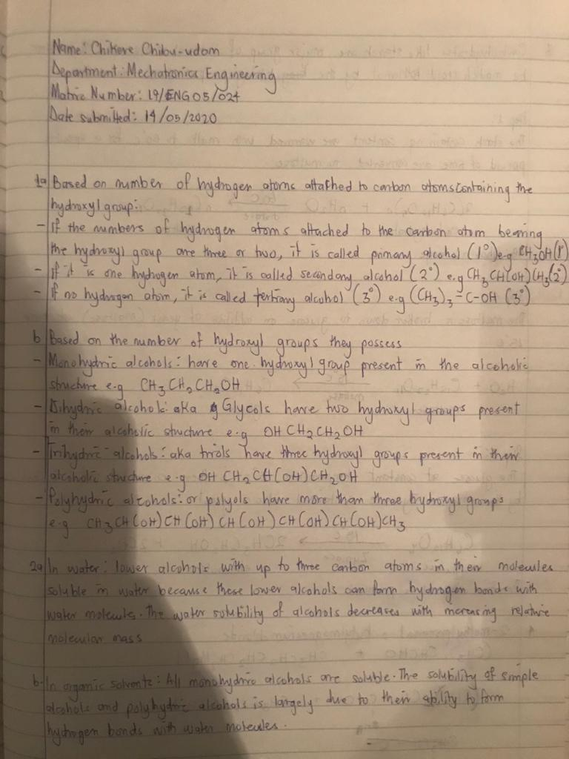

Slide 3
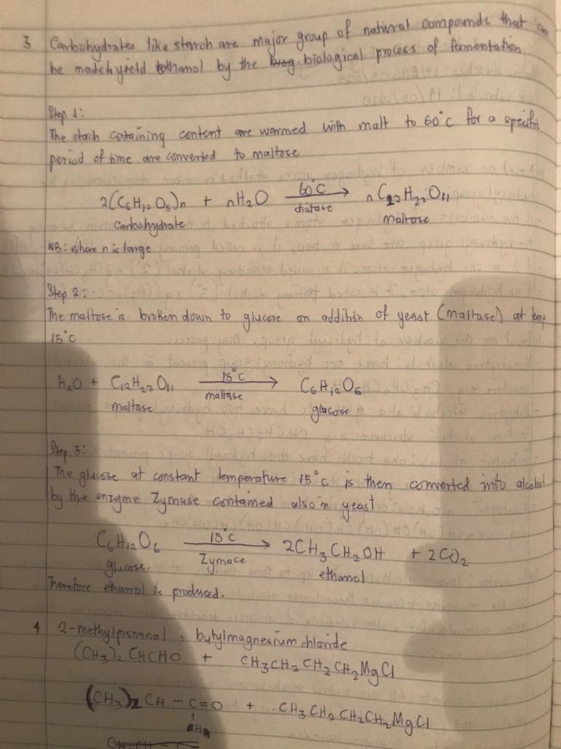

Slide 4
