Slide 1
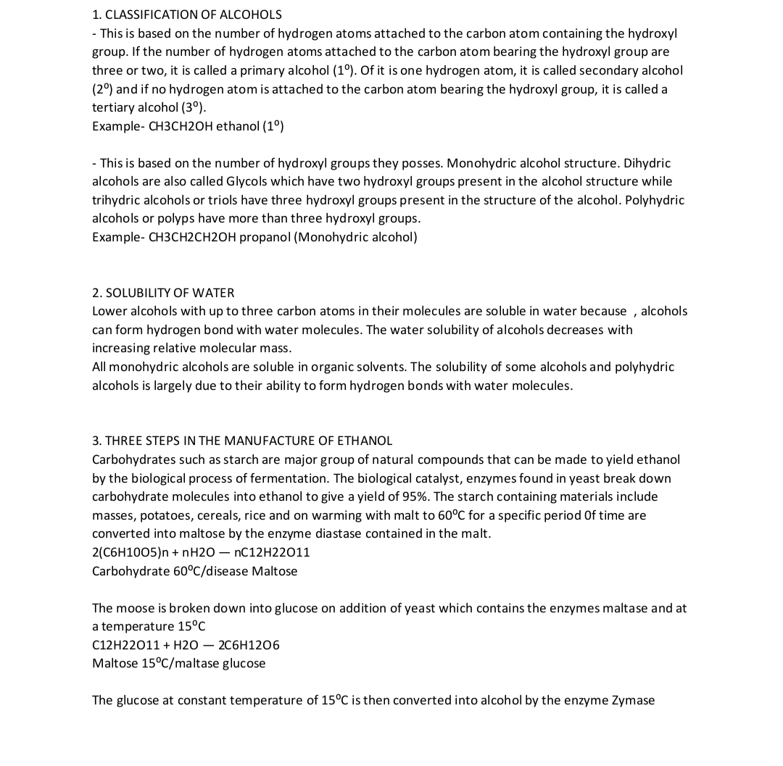

Slide 2
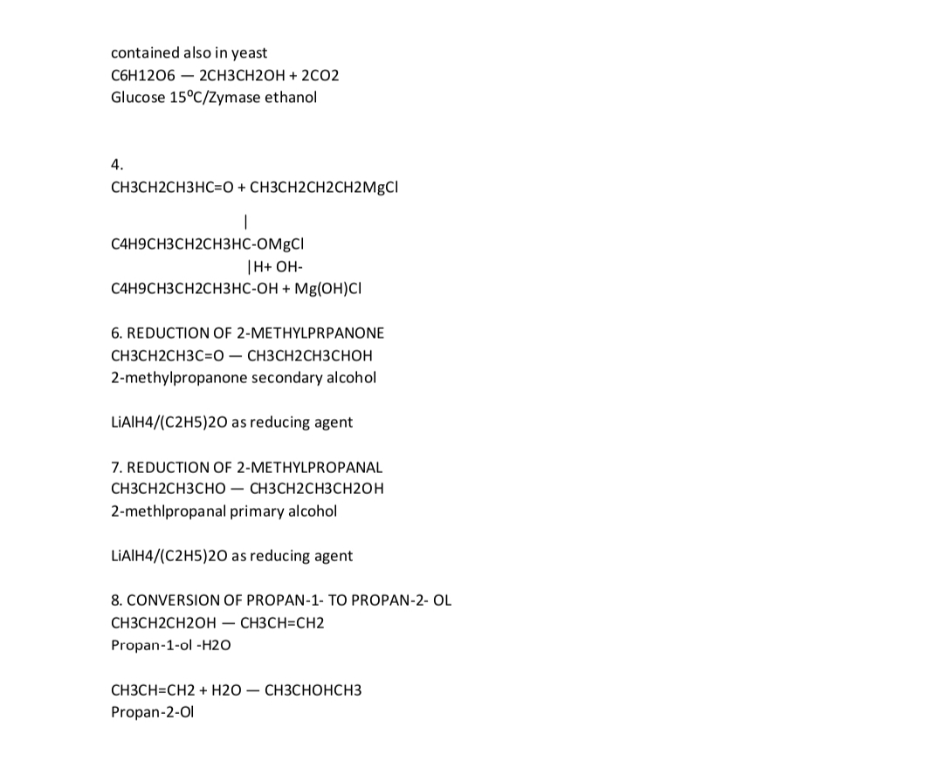

Slide 3
Name: Folarin faith tunmise Department: medicine Matric no: 19/MHS01/174

