Slide 1
CHEMISTRY ASSIGNMENT: NEW ASSIGNMENT
Name: ANUGWU FRANKLIN CHIEMELIE
REG NUMBER: 19/MHS01/097
COURSE: CHEM 102

Slide 2
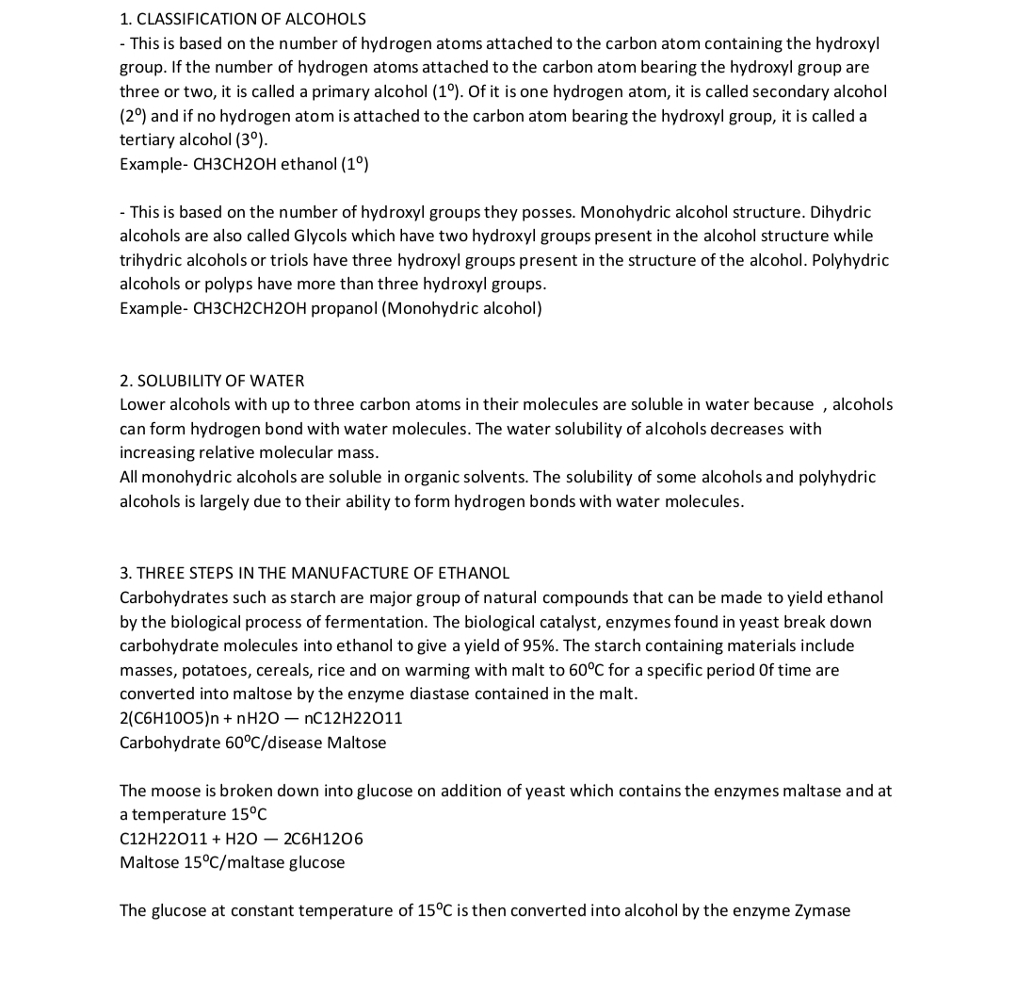

Slide 3
