Slide 1
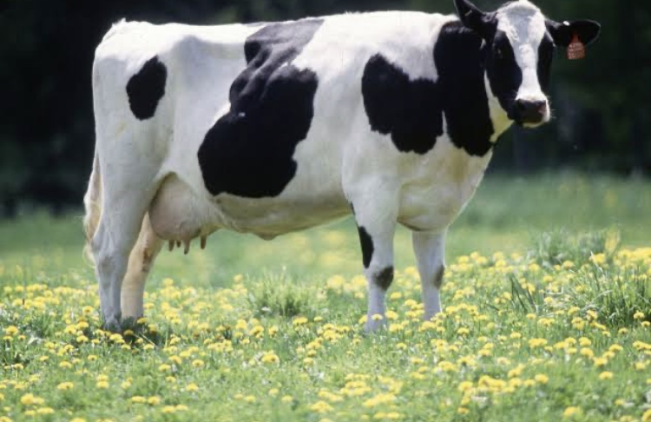
Diary Farm Business plan

Slide 2
Table Of Content.
Why start a diary farming business?
Industry Overview.
Executive Summary.
Our Products Offerings.
Our Target Market.
Sales and Marketing Strategy .
Publicity and Advertising Strategy.
Financial projection and costing.

Slide 3
Why start a Diary Farming business?
We all take in dairy food on a regular basics; in fact there isn’t any home that doesn’t consume dairy foods. The reasons is why those who have built a business around the dairy industry are making a great deal of income on a daily basics. One of the businesses that revolved around the dairy trade is starting a dairy farm.
It pays that one does all that needs to be done in order to start with the right footing. As such one, one can undertake a thorough and exhaustive research. Thereafter think towards getting a firsthand of the industry by sitting under the tutelage of someone who has a firsthand experience and dealing with the trade.
You will also be required to write a business plan. One of the good things about business plans is that they serve as a great guide and blueprint to fly with. There are plenty business plan experts out there; to save you the troubles and fees that you will have to pay. A simple diary farms business plan has been put together for your use.

Slide 4
Industry overview.
There are several business opportunities available in the agricultural industry and diary farming is one of them. One good thing about the agriculture industry is that there is market for all the produce from the industry. A diary farm is of course a thriving and profitable business because of usefulness of beef and milk. People eat beef, drink their milk, cheese can be made , along with other dairy products.
Companies in the diary farms industry primarily raise cattle for milk. Although this industry basically engage in the scale of raw milk and excludes the production of drinkable fluid milk and processed diary product like butter, cheese and powdered milk, some diary farms can till go ahead to accommodate other related business within the industry as long as they have the capacity to do so.
The diary farm industry is indeed a large industry and pretty much active in countries such as united states of America, Israel, argentine, Holland, Egypt, china, Germany, turkey, and Nigeria etc. There is no single diary farm company that has dominate market share in the industry hence smaller diary farms business can successfully make profits.
Lastly, there are few barriers to entry into the diary farms industry. Usually, all inputs are readily available. In the nearest future, players in this industry may face the highest costs associated with accessing technology, especially in relation to genetic modification engineering in livestock breeding.

Slide 5
Executive summary.
Our diary farms business is going to be a standard one hence will be involved in commercial breeding of cows, oxen, bulls, bullocks and calf E.T.C for the main aim of producing raw milk in commercial quantities. We will also be involved in boarding services, breeding services, diary support services, breeding services, diary support services, livestock health services, farrier services, and shearing services E.T.C
Mayowa’s Diary farms is a registered and world class diary farms company that will be based in the outskirt of Lagos state, Nigeria. We have done our detailed market research and feasibility studies and we were able to secure some acres of land to build our diary farming business.
Lastly, we will cultivate a working environment that provides a human, sustainable approach to earning a living , and living in our world, for our partners, employees and for our clients.

Slide 6
Our products offering.
These are areas we will concentrate on in our diary farms business. If need arises we will definitely add more related animal breeding services to our list.
Diary support services.
Milking support services.
Diary cattle farming.
Farrier services.
Shearing services.
Scale of cattle and milk.
Scale of processed meat (beef)/ can-beef (processed Diary foods, and beef E.T.C).
Scale and export of cotton wool and other diary products.
Diary farming related consultancy and advisory services.

Slide 7
Our target market.
As expected the target market of those who are the end consumer of diary farms produce and also those who benefits from the business from the business value chain of the agriculture industry is all encompassing; it is far-reaching. Every household consumes produce from livestock farms be it meat, milk, and the skin(leather) used for bags, belts and shoes production E.T.C
we will ensure that we position our business to attract consumers of raw milk and other dairy products not just in the united states of America alone but also other parts of the world which is why we will be exporting some of our dairy farm produce either in raw form or processed form to other countries of the world.

Slide 8
Sales and marketing strategy.
Introduce our business by sending introductory letters alongside our brochure to stake holders in the agriculture industry, companies that rely on the diary farms industry for their raw materials, hotels and restaurants and agriculture produce merchant E.T.C.
Advertise our business in agro-allied and food related magazines and websites.
List our diary farm on yellow pages ads (local directories).
Attend related agriculture and food expos, seminars, and business fairs E.T.C.
Leverage on the internet to promote our business.
Engage in direct marketing .
Encourage the use of word of mouth marketing (referrals).

Slide 9
Publicity and advertisement strategy.
Place adverts on both print and electronic media platforms.
Sponsor relevant community programs.
Engage in road shows from time to time in targeted neighborhoods.
Distribute our filers in target areas.
List our diary farm on yellow pages.
Advertise our diary farms in our official website and employ strategies that will help us pull traffic to the site.
Ensure that all our staff members wear our brand shirts with our company logo E.T.C.

Slide 10
Financial projections and costing.
When it comes to calculating the cost of starting a diary farming, there are some key factors that should serve as a guide. The capacity of the raw milk to be produced per time and other related diary products will determines the last cost of setting up the business.
The capital is going to consist of:
The amount needed to acquire a farm land.
The amount required for preparing the farm land and getting the necessary things for the farm.
Legal expenses for obtaining licenses and permits.
Insurances policy.
The cost for lunching and official website.
The cost to employ workers.
Additional expenditure such as business cards, signage, adverts, logo, companies t-shirts E.T.C.
Name: ogundipe oluwamayowa omotayo
Mat no: 19/ENG04/063 (D.E)
Department: Elect/Elect ENG
GST 212 Introduction to Entrepreneurship

