Slide 1
Spectrophotometer and Colorimeter
Group 1 Members
Presenter: Alabadan, Adenike Oyebola – 15/MHS06/012
Amadi, Vera Homa - 15/MHS06/012
Chinkere, Favour Chiamaka – 15/MHS06/020
Fakete, Taiwo – 13/MHS06/

Slide 2
OUTLINE
Introduction
Mode of Operation/ Working principle
Functions
Types
Parts
Management
Brands and Prices
References

Slide 3
Spectrophotometer
A Spectrophotometer is an instrument containing a monochromator, a device which produces a light beam containing wavelengths in a narrow band around a selected wavelength, and a means of measuring the ratio of that beam's intensity as it enters and leaves a cuvette99. This describes a single-beam photometer.
Buie, 2011

Slide 4
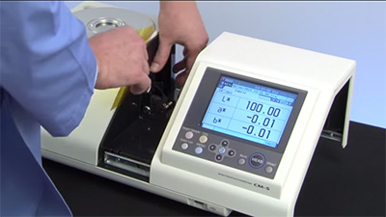
Image

Slide 5
Spectrophotometry in chemistry, is the quantitative measurement of the reflection or transmission properties of a material as a function of wavelength and a spectrometer is used for this measurement.
It works based on two principles:
Lambert’s Law
Beer’s Law
Alber et al., 2012

Slide 6
Principle
Lambert’s Law : The proportion of light absorbed by a medium is independent of the intensity of incident light. A sample which absorbs 75% (25% transmittance) of the light will always absorb 75% of the light, no matter the strength of the light source. Lambert’s law is expressed as I/Io=T Where I = Intensity of transmitted light Io = Intensity of the incident light T = Transmittance This allows different spectrophotometers with different light sources to produce comparable absorption readings independent of the power of the light source.
Bryan, 2010

Slide 7
Beer’s Law: The absorbance of light is directly proportional to both the concentration of the absorbing medium and the thickness of the medium. In Spectrophotometry the thickness of the medium is called the pathlength. In normal cuvette-based instruments the pathlength is 10 mm. Beer’s law allows us to measure samples of differing pathlength, and compare the results directly with each other.
Alber et al., 2012

Slide 8
Functions
A spectrophotometer is used in many areas of science including microbiology, biochemistry, forensics, physics, and medical health.
The spectrophotometer is used to measure colored compounds in the visible region of light (between 350 nm and 800 nm) thus it can be used to find more information about the substance being studied.
Spectrophotometer can be used for a number of techniques such as determining optimal wavelength absorbance of samples, determining optimal pH for absorbance of samples, determining concentrations of unknown samples, and determining the pKa of various samples
(Ninfa et al., 2010).

Slide 9
Functions
Spectrophotometer is also a helpful process for protein purification and can also be used as a method to create optical assays of a compound.
Additionally, Spectrophotometers are specialized to measure either UV or Visible light wavelength absorbance values.
Because a spectrophotometer measures the wavelength of a compound through its color, a dye binding substance can be added so that it can undergo a color change and be measured.
(Garrett and Grisham, 2013).

Slide 10
Types
Single beam spectrophotometer: This uses a reference standard to standardize or blank the instrument before taking measurements. Single beam spectrophotometers are usually more compact and have a higher dynamic range.
Double beam spectrophotometer: This splits the beam of light into two different paths, one of which passes through the sample while the other passes through a reference standard. Double beam spectrophotometers measure the ratio of light intensities and, therefore, are not as sensitive to fluctuations in the light source or detector.
Other types of spectrophotometers include atomic absorption spectrophotometers and fluorescence spectrophotometers.
Adeeyinwo et al., 2013

Slide 11
Parts
There are five parts in a spectrophotometer:
Light Sources:There are two light sources a tungsten lamp which generates visible light and a deu­terium or hydrogen lamp which generates UV light. Deuterium lamp gives wider and more intense light in UV region than a hydrogen lamp.
Monochromators: To select the particular wavelength filter or monochromators are used to split the light from the light source.
Cuvettes: Cuvettes are optically transparent cells made of glass / silica / plastic. Test tube or Cuvettes are used to hold the color solutions.
Photocell or photomultiplier tube: is a photoelectric device which converts light energy into electrical en­ergy. when light falls on the detector system, an electric current is generated, this reflects the Galvanometer reading.
Recorder: The current from the detector is fed to the measuring device, the Galvanometer, shows the meter reading that is directly proportional to the intensity of light.
Merrifield, 2014

Slide 12
Colorimeter
A colorimeter is a device used in colorimetry that measures the absorbance of particular wavelengths of light by a specific solution. It is commonly used to determine the concentration of a known solute in a given solution.
Colorimetry is a technique "used to determine the concentration of coloured compounds in solution. A colorimeter is a device used to test the concentration of a solution by measuring its absorbance of a specific wavelength of light (not to be confused with the tristimulus colorimeter used to measure colours in general).
Timma et al., 2015

Slide 13
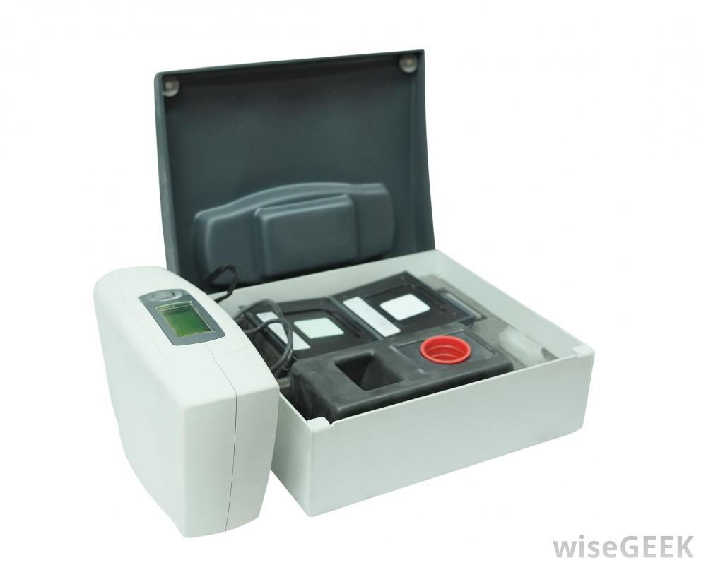
Image

Slide 14
Principle
A colorimeter is based on the photometric technique which states that when a beam of incident light of intensity I₀ passes through a solution, a part of the incident light is reflected (I_{r}), a part is absorbed (I_{a}) and rest of the light is transmitted (I_{t}) Thus, I₀ = I_{r} + I_{a} + I_{t}
Beer’s Law
This law states that the amount of light absorbed is directly proportional to the concentration of the solute in the solution.
Log₁₀ I₀/I_{t} = a_{s}c where,
a_{s} = Absorbency index
c = Concentration of Solution

Slide 15
Principle
Lambert’s Law
The Lambert’s law states that the amount of light absorbed is directly proportional to the length and thickness of the solution under analysis.
A = log₁₀ I₀/I_{t} = a_{s}b Where,
A = Absorbance of test
a_{s} = Absorbance of standard
b = length / thickness of the solution
Robert, 2008

Slide 16
Functions
Colorimeters are used for a wide range of application across the chemical and biological field including but not limited to the analysis of Blood, Determining the rates of reaction, Laboratory quality control.
The colorimeter is commonly used for the determination of the concentration of a colored compound by measuring the optical density or its absorbance.
It can also be used for the determination of the course of the reaction by measuring the rate of formation and disappearance of the light-absorbing compound in the range of the visible spectrum of light.
By colorimeter, a compound can be identified by determining the absorption spectrum in the visible region of the light spectrum.
(Blues et al., 2004)

Slide 17
Types
There are many different types of colorimeters, they include
The colour densitometer: This measures the density of primary colours.
The colour photometer: This measures the reflection and transmission of colour.
Digital, also called laboratory, and portable: Digital versions are most often used in a lab setting for sampling or in the classroom for educational purposes. Portable versions can be carried anywhere, regardless of environmental conditions, to test things like water and soil samples on site.
Shivok et al., 2014

Slide 18
Parts
There are 5 essential parts in a colorimeter:
Light Source – The most common source of light used in colorimeter is a tungsten filament.
Monochromator – To select the particular wavelength filter or monochromators are used to split the light from the light source.
Sample holder – Test tube or Cuvettes are used to hold the color solutions they are made up of Glass at the visible wavelength.
Photo Detector System – when light falls on the detector system, an electric current is generated, this reflects the Galvanometer reading.
Measuring device – The current from the detector is fed to the measuring device, the Galvanometer, shows the meter reading that is directly proportional to the intensity of light.
(Johns and Warren, 2001)

Slide 19
Maintenance
Any spill on, or around the instrument should be cleaned immediately.
At the end of the day, turn off the instrument or disconnect the power source or the battery terminals as appropriate.
Keep the cuvette chamber empty and closed when not in use.
Cover the instrument after use. Store appropriately, protected from dust.
Replace blown fuses and bulbs according to the manufacturer’s instructions.
If the equipment is faulty, consult a qualified biomedical engineer.
Verify that the instrument is away from equipment generating vibrations and direct solar radiation.
Check that there is no excessive humidity, dust or high temperature.
Ensure that there is no source of smoke, gas or corrosive emissions nearby.
(Aston, 2009)

Slide 20
References
Blues, J., Bayliss, D. and Buckley, M.(2004) The calibration and use of piston pipettes, National Physical Laboratory, Teddigton, Middlesex, UK,
Johns and Warren L. (2001) Selection of basic laboratory equipment for laboratories with limited resources, World Health Organization.
Aston, R. (2009) Principles of Biomedical Instrumentation and Measurement, Merrill Publishing Company.
Ninfa AJ, Ballou DP, Benore M (2010). Fundamental Laboratory Approaches for Biochemistry and Biotechnology (2nd ed.). Hoboken: Wiley & Sons. ISBN 9780470087664. OCLC 488246403
Trumbo, Toni A.; Schultz, Emeric; Borland, Michael G.; Pugh, Michael Eugene (April 27, 2013). "Applied Spectrophotometry: Analysis of a Biochemical Mixture". Biochemistry and Molecular Biology Education. 41 (4): 242–50. doi:10.1002/bmb.20694. PMID 23625877

Slide 21
Mettler-Toledo AG, Analytical. 2016. Retrieved Dec 23, 2018.
Cortez, C.; Szepaniuk, A.; Gomes da Silva, L. (May 1, 2010). "Exploring Proteins Purification Techniques Animations as Tools for the Biochemistry Teaching". Journal of Biochemistry Education. 8 (2): 12. doi:10.16923/reb.v8i2.215.
Garrett RH, Grisham CM (2013). Biochemistry. Belmont, CA: Cengage. p. 106. ISBN 978-1133106296. OCLC 801650341.
Ensor Roslyn (May 27, 1936). "Spectrophotometry of proteins Biochemical Journal. 30 (10): 1795–1803. doi:10.1042/bj0301795. PMC 1263262. PMID 16746224.

