Slide 1
GROUP 2 MLS 516 FLAME PHOTOMETER AND ION SELECTIVE ELECTRODE

Slide 2
GROUP 2
Onokpe Frances OgheneFejiro -Presenter 15/Mhs06/051
Dandutse Tijjani Hajara 15/MHS06/023
Ogunyemi Tosin 15/MHS06/043
Eshegbe Ezekiel 14/MHS06/022

Slide 3
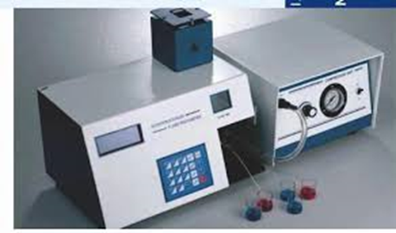
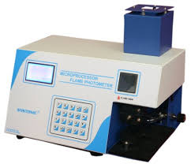

Slide 4
INTRODUCTION
A photoelectric flame photometer is a device used in inorganic chemical analysis to determine the concentration of certain metal ions, which include sodium, potassium, lithium, barium and calcium.
There is no need for light source because the flame serves both as an as an atomizer and excitation source. Flame Photometry works by measuring the intensity of light emitted (measured using a wavelength of a color) when the element is exposed to a Flame (Hamza et al., 2013).

Slide 5
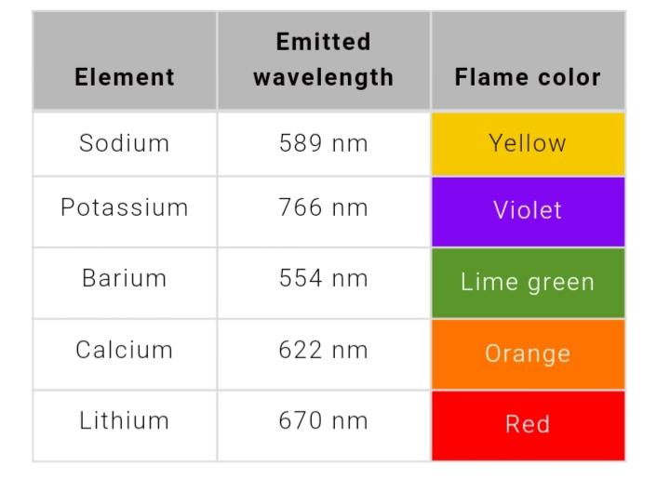

Slide 6
PRINCIPLE
It is a controlled flame test which the intensity of the flame color quantified by the photoelectric circuit. The intensity of the colour will depend on the energy that has been absorbed by the atoms that was sufficient to vaporise them. The sample is introduced into the flame, filters select the colors the photometer detects and exclude the influence of other ions (Hamza et al., 2013).

Slide 7
MODE OF ACTION
This instrument consist of four basic components: a flame or “burner,” mixing chamber, color filters, and a photo detector. In a flame photometer, the solution is aspirated through a nebulizer (or aspirator) into the flame.
After the sample matrix evaporates, the sample is atomized. Atoms then reach an excited state by absorbing heat from the flame. When these excited atoms return to their lowest-energy state, they give off colours in certain wavelengths, leading to the creation of a line spectrum.
A filter pre-selected based on the atom being analyzed is used in flame photometry. The emission line’s intensity is then practically measured and is related to the solution’s original concentration

Slide 8
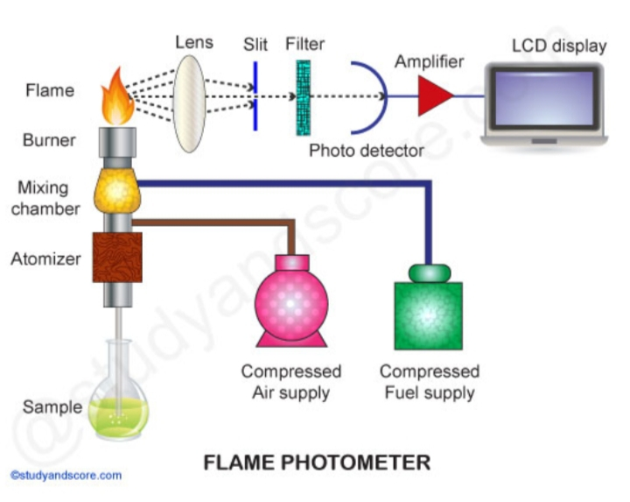

Slide 9
APPLICATIONS
Potash and fertilizer industry
Highly accurate determination of potassium and sodium concentrations
Drinking water treatment
Measurement of calcium and sodium concentrations in drinking water
Glass industry
Measurement of sodium concentrations in glass (Doku and Gadzekpo, 2009).

Slide 10
Clinical applications
Electrolyte determinations in blood and urine
Soft drinks, fruit juices and alcoholic beverages can also be analysed by using flame photometry to determine the concentrations of various metals and elements (Doku and Gadzekpo, 2009).

Slide 11
ADVANTAGES
It is a fast and sensitive analytical method.
It is very simple and economical.
It is suitable for many metallic elements (Segundo et al., 2006).
DISADVANTAGES
It is expensive.
Flame photometry cannot be used for the direct determination of every metal atom.
Frequent calibration and care should be taken because it is affected by many variables (Almieda et al., 2009).

Slide 12
PRECAUTION
Avoid handling samples with fingers. This leads to serious contamination.
All analyses involve the use of a diluent, which is almost always deionised water.
Standards and samples should not be exposed to the atmosphere for long periods (Carbonell et al., 2014).

Slide 13
ION SELECTIVE ELECTRODE

Slide 14
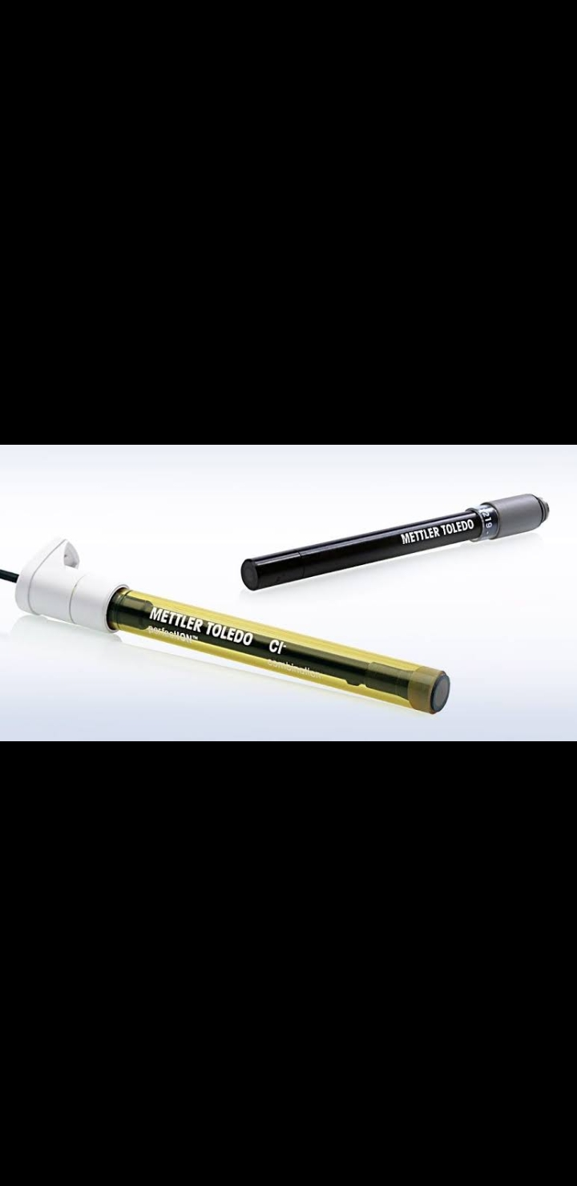

Slide 15
INTRODUCTION
An ion-selective electrode (ISE) is an electro-analytical sensor with a membrane whose potential indicates the activity of the ion to be determined in a solution .
There are commonly more than one types of ions in solution. This is done by applying a selective membrane at the ion selective electrode, which only allows the desired ion to go in and out (Wardak, 2011).

Slide 16
PRINCIPLE
The ion selective electrode consists of a thin membrane across which only the intended ion can be transported. The transport of ions from a high concentration to a low concentration through a selective binding with sites within the membrane creates a potential difference.

Slide 17
TYPES
Glass membranes: are made from an ion-exchange type of glass (silicate or chalcogenide). It has a good selectivity, but only for several single-charged cations mainly H+, Na+, and Ag+. The glass membrane has excellent chemical durability and can work in very aggressive media. An example of this type of electrode is the pH glass electrode (Bogan and Agnes, 2002).

Slide 18
Crystalline membranes are made from mono- or poly-crystallites of a single substance. They have good selectivity, because only ions which can introduce themselves into the crystal structure can interfere with the electrode response (Bogan and Agnes, 2002).
Liquid membrane electrodes: An ion-exchanger or ionophore (neutral macrocyclic ion carrier) is dissolved in a viscous organic liquid membrane. Without the exchanger or ionophore the ion of interest is unable to penetrate the membrane (Bogan and Agnes, 2002).

Slide 19
Polymer membrane electrodes: An alternative to wet liquid membrane electrodes is to use a polymeric membrane, which is composed of a polymer such as polyvinylchloride (PVC), a plasticizer, and the ion carrier or exchanger The response of these electrodes is highly selective and they have replaced many liquid membrane electrodes. Polymer electrodes have been used to determine ions such as K+, Ca2+, Cl- and NO3 (Bogan and Agnes, 2002).

Slide 20
MODE OF ACTION
Ion-selective electrodes possess a high degree of selectivity. The selectivity of the ISE is determined by the composition of the membrane. Ideally the membrane allows the uptake of only one specific ion into it. The analyte ion may be a cation or an anion. (Ceresa, 2001).

Slide 21
Within the ion selective electrode, there is an internal reference electrode, which is made of silver wire coated with solid silver chloride, embedded in concentrated potassium chloride solution (filling solution) saturated with silver chloride. This solution also contains the same ions as that to be measured.
The ion selective electrode and reference electrode are connected by a milli-voltmeter. Measurement is accomplished simply by immersing the two electrodes in the same test solution (Vigassy, 2003).

Slide 22
APPLICATIONS
Analysis of environmental samples
Groundwater monitoring
Fluoride detection around aluminum mills
Biomedical laboratories measuring the concentration of ions in bodily fluids (Lenik et al., 2002).

Slide 23
CARE AND MAINTAINANCE
Dirt and contamination on the sensor and diaphragm lead to measurement inaccuracies. They can be removed by diluted HCL, use of suitable solvents.
After cleaning, rinse off the ISEs with distilled water, do not rub dry.
Calibrate the ISE according to the operating manual of the ISE meter and the analysis specification.
Store the electrode in a dry place.

Slide 24
REFERENCES
Carbonell, V., Sanz, A., Salvador, A. and. DelaGuardia, M . (2014).“Flow injection ﬂame atomic spectrometric determination of aluminium, iron, calcium, magnesium, sodium and potassium in ceramic material by on-line dilution in a stirred chamber.” Journal of Analytical Atomic Spectrometry.6 (3) :233–238.
Almeida, M. I. G. S., Segundo, M. A., Lima, J. L. F. C., and Rangel, A. O. S. S. “(2009). Interfacing multisyringe ﬂow injection analysis to ﬂame atomic emission spectrometry: an intelligent system for automatic sample dilution and determination of potassium,” Journal of Analytical Atomic Spectrometry. 24(3):340–346.
Bakker, E., and Pretsch, E. (2005). Potentiometric sensors for trace-level analysis. Trend. Anal. Chem. 24 :199–207.
Bogan, M. J., and. Agnes ,G. R. (2002) “Poly(ethylene glycol) doubly and singly cationized by different alkali metal ions: relative cation affinities and cation-dependent resolution in a quadrupole ion trap mass spectrometer”. Journal of the American Society for Mass Spectrometry. 13(2): 177–186.

Slide 25
Ceresa, A., Sokalski, T., and Pretsch, E. (2001). “Influence of key parameters on the lower detection limit and response function of solvent polymeric membrane ion-selective electrodes,” Journal of Electroanalytical Chemistry. 501: 70–76
Doku, G. N., and Gadzekpo, V. P. Y. (2009). “Simultaneous determination of lithium, sodium and potassium in blood serum by ﬂame photometric ﬂow-injection analysis” .Talanta. 43(5): 735–739.
Hamza, A.O.M., Mohammed, R.A.A., Elkhalifa, I.O.E., and Khider, M.O. (2013). ‘Effectiveness of calibration on flame photometer performance’, Int. J. Biomedical Engineering and Technology. 12(4): 334–345.
Lenik, J., Dumkiewicz, R., Wardak, C., Marczewska, B. (2002). Naproxen ion-selective electrode and its application to pharmaceutical analysis. Acta Pol. Pharm. 59: 171–176.
Segundo, M. A., Almeida, M. I. G. S., Lima, J. L. F. C., and RangeI, A. O. S. S.( 2006). “Potentiometric multi-syringe ﬂow injection system for determination of exchangeable potassium in soils with in-line extraction.” Microchemical Journal. 83(2):75–80.
Vigassy, T., Gyurcsányi, R. E., and Pretsch, E. (2003 ).“Influence of incorporated lipophilic particles on ion fluxes through polymeric ion-selective membranes.” Electroanalysis. 15: 375–382.
Wardak, C. A. (2011). Highly selective lead-sensitive electrode with solid contact based on ionic liquid. J. Hazard. Mater.186: 1131–1135.

