Slide 1
NAME:OJUMU JOYCE MATRIC NO:17/MHS02/112

Slide 2
1)HOW ARE FUNGI IMPORTANT TO MAN KIND
1)Biological insectide :Animal pathogens, fungi help to control the population of damaging pest.
2)Farming:The mycorrhizal relationship between fungi and plant roots is essential for the productivity of farmland.Mycorrhizal fungal inoculants are available as soil additives from gardening supply stores and are promoted by supporters of organic agriculture.

Slide 3
HOW ARE FUNGI IMPORTANT TO MAN KIND
3)Food:Fungi figure prominently in the human diet. Morels, shiitake mushrooms, chanterelles, and truffles are considered delicacies. The meadow mushroom, Agaricus campestris, appears in many dishes
4)Medicine:Many secondary metabolites of fungi are of great commercial importance. Fungi naturally produce antibiotics to kill or inhibit the growth of bacteria, limiting their competition in the natural environment

Slide 4
2)ILLUSTRATE THE CELL STRUCTURE OF A UNICELLULAR FUNGUS
YEAST:The yeasts are unicellular fungi. Cells may remain attached in short chains forming a pseudomycelium, but they do not produce true mycelium. The cells are extremely variable in shape being globose, oval, elongated, or rectangular. The yeast cells are very polymorphic and are capable of assuming different forms depending upon the medium in which they grow and their age. Individually yeast cells are hyaline but in colonies they appear white, cream-coloured or slightly brownish.

Slide 5
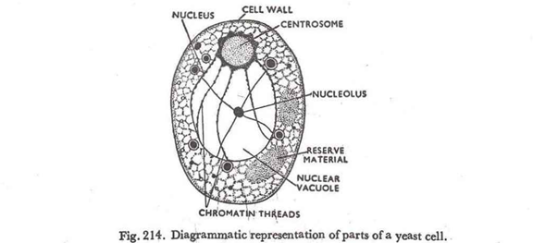

Slide 6
3)SEXUAL REPRODUCTION IN A TYPICAL FILAMENTOUS FORM OF FUNGI
1)plasmogamy and mitosis
2)karyogamy
3)Meiosis
4)Mitosis and cell division
5)Dispersal and germination
The three consecutive stages are
(i)plasmogamy
(ii)karyogamy
(iii)meiosis

Slide 7
4)HOW DO BRYOPHYTE ADAPT TO THEIR ENVIRONMENT
Bryophytes are very resilient and have a unique ability to recover from long-lasting extreme environmental conditions
Bryophytes show a high degree of phenotypic plasticity as well as a remarkable ability to photosynthesise whenever conditions are favourable. Both these traits enable them to survive in cold regions.
They are known to survive droughts, shutting down all metabolic processes, and reviving under favourable condition

Slide 8
5)DESCRIBE WITH ILLUSTRATIONS THE FOLLOWING TERMINOLOGIES
1)EUSTELES:(botany) A type of siphonostele, in which the vascular tissue in the stem forms a central ring of bundles around a pith.
2)ATACTOSTELE:(botany) A type of eustele, found in monocots, in which the vascular tissue in the stem exists as scattered bundles.
3)SIPHONOSTELE:A stele in which the vascular tissue is in the form of a cylinder surrounding the pith, as in the stems of most ferns and other seedless vascular plants.
4)DICTYOSTELE:A stele in which the vascular cylinder is broken up into a longitudinal series or network of vascular strands around a central pith (as in many ferns)

Slide 9
6)ILLUSTRATE THE LIFE CYCLE OF A PRIMITIVE VASCULAR PLANT
The life cycle of seedless vascular plants is an alternation of generations, where the diploid sporophyte alternates with the haploid gametophyte phase. The diploid sporophyte is the dominant phase of the life cycle, while the gametophyte is an inconspicuous, but still-independent, organism. Throughout plant evolution, there is a clear reversal of roles in the dominant phase of the life cycle.

Slide 10
6)ILLUSTRATE THE LIFE CYCLE OF A PRIMITIVE VASCULAR PLANT
The vascular plants, or tracheophytes, are the dominant and most conspicuous group of land plants. They contain tissue that transports water and other substances throughout the plant
Seedless vascular plants are plants that contain vascular tissue, but do not produce flowers or seeds. In seedless vascular plants, such as ferns and horsetails, the plants reproduce using haploid, unicellular spores instead of seeds. The spores are very lightweight (unlike many seeds), which allows for their easy dispersion in the wind and for the plants to spread to new habitats.

Slide 11
6)ILLUSTRATE THE LIFE CYCLE OF A PRIMITIVE VASCULAR PLANT
Although seedless vascular plants have evolved to spread to all types of habitats, they still depend on water during fertilization, as the sperm must swim on a layer of moisture to reach the egg. This step in reproduction explains why ferns and their relatives are more abundant in damp environments, including marshes and rainforests.

