Slide 2
STRATEGIES AND METHODS IN DISEASE CONTROL AND PREVENTION
OLUWADARE.T
DEPARTMENT OF COMMUNITY MEDICINE ABUAD

Slide 3
Introduction
Definition of disease control
Ongoing operations aimed at reducing:
Incidence of disease
Duration of disease
Effects of infection
Burden of disease

Slide 4
Introduction contd.
Requirement for effective disease control
Magnitude of disease
Distribution
Multifactorial causation
Sources of infection
Dynamics of transmission

Slide 5
CHAIN OF INFECTION
SOURCE/
RESERVOIR OF INFECTION
MODE OF TRANSMISSION
SUSCEPTIBLE HOST
Tetanus
Typhoid
Ebola

Slide 6
Principles/methods
1.Controlling the reservoir
Early diagnosis
Notification
Epidemiological investigation
Isolation
Treatment
Quarantine
Disinfection
Health education

Slide 7
Principles/methods contd.
Controlling the reservoir
Early diagnosis
It is needed for treatment
Epidemiological investigation
To study the distribution
To institute control measures

Slide 8
Principles/methods contd.
Controlling the reservoir
Notification
Diseases under WHO surveillance & IHR include
Paralytic polio
Malaria
Viral influenza
Relapsing fever
Cholera
SARS
Important source of epidemiological information
Early detection of disease outbreak

Slide 9
Principles/methods contd.
Controlling the reservoir
Epidemiological investigation

Slide 10
Principles/methods contd.
Controlling the reservoir
Isolation
It is separation, for the period of communicability of infected persons or animals from others in such places and under such conditions, as to prevent or limit the direct or indirect transmission of the infectious agent from those infected to those who are susceptible, or who may spread the agent to others.

Slide 11
Principles/methods contd.
Controlling the reservoir
Isolation
Purpose
Types of isolation
Strict isolation
Standard isolation
Protective isolation
High security isolation
Chemical isolation
Ring immunization

Slide 12
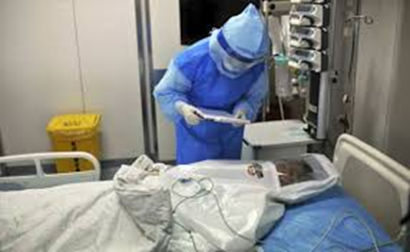
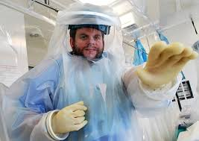
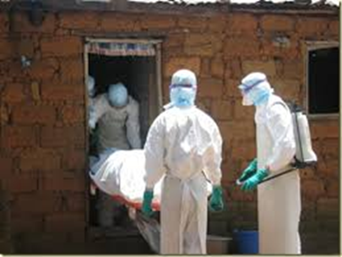
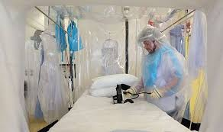
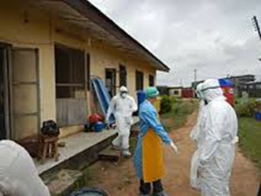

Slide 13
Principles/methods contd.
Controlling the reservoir
Quarantine
Absolute quarantine
Modified quarantine
Segregation quarantine

Slide 14
Principles/methods contd.
Controlling the reservoir
Quarantine
It is the limitation of freedom of movement of such well persons or domestic animals exposed to communicable disease for a period of time not longer than the longest usual incubation period of the disease, in such manner as to prevent effective contact with those not so exposed.

Slide 15
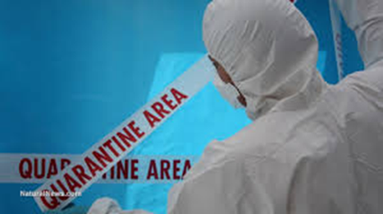
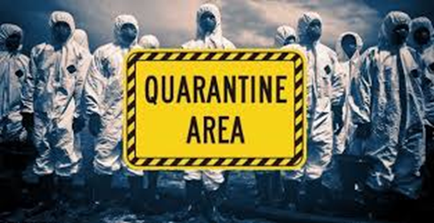

Slide 16
Principles/methods contd.
Controlling the reservoir
Treatment
Individual/mass treatment
Reduces period of communicability
Cut short the duration of illness
Prevent the development of secondary cases

Slide 17
Principles/methods contd.
Controlling the reservoir
Disinfection
It is the killing of infectious agents outside of the body by direct exposure to chemical or physical agents.

Slide 18
Principles/methods contd.
Types of disinfection
Pre-current disinfection
Concurrent disinfection
Terminal disinfection
Agents use for disinfection

Slide 19
Principles/methods contd.
2. Interrupting transmission

Slide 20
Principles/methods contd.
3. The susceptible host
Active immunization
Must be epidemiologically relevant
Immunologically effective
Operationally feasible
Socially acceptable
Health education

Slide 21
Disease prevention
Levels of disease prevention
4 Levels of disease prevention
Primordial prevention
Primary prevention
Secondary prevention
Tertiary prevention

Slide 22
Disease prevention contd.
Primordial prevention
This is prevention of the emergence or development of risk factors in countries or population or population groups in which they have not yet appeared.

Slide 23
Disease prevention contd.
Primary prevention
It is the action taken prior to the onset of disease, which removes the possibility that a disease will ever occur.

Slide 24
Disease prevention contd.
Secondary prevention
It is the action which halts the progress of a disease at its incipient stage and prevent complications.

Slide 25
Disease prevention contd.
Tertiary prevention
It can be defined as all measures available to reduce or limit impairments and disabilities, minimize suffering and to promote patient’s adjustment to irremediable conditions.

Slide 26
Strategies in disease prevention
Health promotion
Specific measures
Early diagnosis and treatment
Disability limitation
Rehabilitation

Slide 27
Strategies in disease prevention contd.
Health promotion
Health education
Environmental modification
Nutritional intervention
Lifestyle and behavioral changes

Slide 28
Strategies in disease prevention contd.
Specific measures
Immunization
Specific nutrients
Chemoprophylaxis
Protection against accident
Protection from carcinogen
Control of specific hazards in the general environment
Control of consumer product quality& safety of food, drug, cosmetics etc

Slide 29
Strategies in disease prevention contd.
Early diagnosis and treatment

Slide 30
Strategies in disease prevention contd.
Disability limitation
Impairment
Disability
Handicap

Slide 31
Strategies in disease prevention contd.
Impairment: is any loss or abnormality of psychological, physiological or anatomical structure or function

Slide 32
Strategies in disease prevention contd.
Disability: is any restriction or lack of ability to perform an activity in the manner or within the range considered normal for human being

Slide 33
Strategies in disease prevention contd.
Handicap: a disadvantage for a given individual, resulting from an impairment or a disability, that limits or prevents the fulfillment of a role that is normal for that individual

Slide 34
Strategies in disease prevention contd.
Example
Accident ------ disease or disorder
Loss of foot ------ impairment
Cannot walk -------- disability (objectified)
Unemployed --------- handicap (socialized)

Slide 35
Strategies in disease prevention contd.
Rehabilitation
Medical rehabilitation
Vocational rehabilitation
Social rehabilitation
Psychological rehabilitation
Examples

Slide 36
Test questions
There are three levels of prevention. T/F
In disease prevention the disease agent is permitted to exist at the threshold of the local community. T/F
Secondary prevention targets the pre-pathogenesis stage. T/F
Secondary prevention is cost effective. T/F

Slide 37
Test questions
Match group A with group B
GROUP A GROUP B
Primordial P. Early diagnosis& treatment
Primary P. Health promotion
Secondary P. Specific measures
Tertiary P. Rehabilitation
Disability Limitation

Slide 38
YOU’VE NEVER LIVED THIS DAY BEFORE.
AND YOU NEVER WILL AGAIN.
MAKE THE MOST OF IT
UNLOCK YOUR DREAMS
UNLOCK YOUR PASSION
UNLOCK YOUR POTENTIALS
UNLOCK YOUR MOTIVATION
UNLOCK YOUR KNOWLEDGE
UNLOCK YOUR EXPERIENCE
UNLOCK YOUR WISDOM
YOU LIVE LIFE ONLY ONCE
GOOD MORNING

Slide 39
Test questions
The weakest link in the chain of transmission of malaria is …….
An individual diagnosed of Ebola should be …….
People on board a flight with an index case of Ebola should be …….
Tetanus can best be controlled by …….
Malaria vaccines will be available for use in Gambia come year 2018. T/F
Polio has been eradicated in Nigeria. T/F

Slide 40
ANSWERS
Mode of transmission
Isolated
Quarantined
Vaccination/Immunization
F
F

