Slide 1
ENVIRONMENTAL HEALTH: DEFINITION AND COMPONENTS
OLUWADARE,T
DEPARTMENT OF COMMUNITY MEDICINE

Slide 2
‘IF YOU WANT TO LEARN ABOUT THE HEALTH OF A POPULATION, LOOK AT THE AIR THEY BREATH, THE WATER THEY DRINK, AND THE PLACES THEY LIVE. HIPPOCRATES, THE FATHER OF MEDICINE.

Slide 3
Introduction
Definition of Environment

Slide 4
Introduction
Components of the environment
Physical – water, air, soil, housing, wastes, radiation etc.
Biological – plant and animal life including bacteria, viruses, insects, rodents and animals.
Social – customs, culture, habits, income, occupation, religion etc

Slide 5
Introduction contd.
Definition of Environmental Health
Environmental health is a branch of public health which is concerned with all built environment and natural environment aspects which may affect human health.

Slide 6
Introduction contd.
Definition of Environmental Health
Environmental health refers to the theory and practice of assessing, correcting, controlling and preventing those factors in the environment that can potentially affect adversely the health of present and future generations.
WHO

Slide 7
Introduction contd.
1750-1850 this is the agricultural revolution
1850-1900, this is the industrial revolution
The third is the period between 1900 and 1945, while the
Fourth is 1945 to the present date.

Slide 8
Components of the environment
Physical – water, air, soil, housing, wastes, radiation etc.
Biological – plant and animal life including bacteria, viruses, insects, rodents and animals.
Social – customs, culture, habits, income, occupation, religion etc

Slide 9
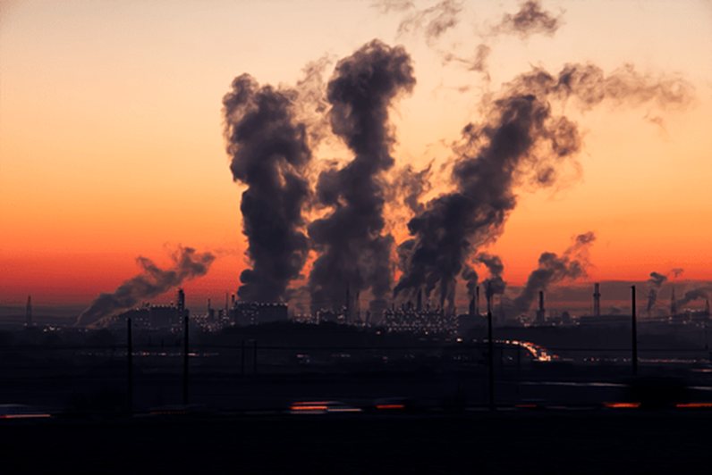
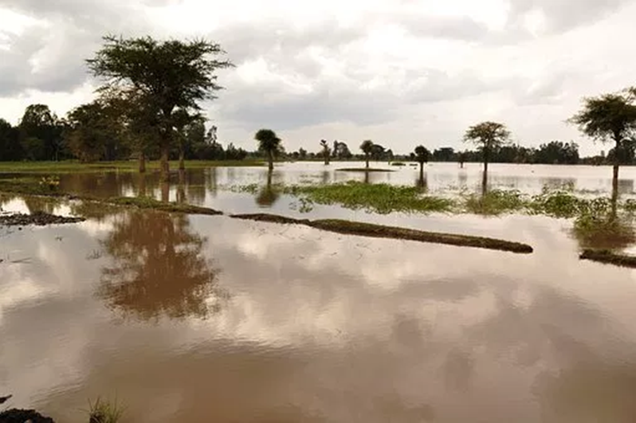
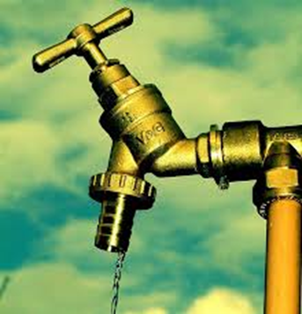
Components of Environmental Health

Slide 10
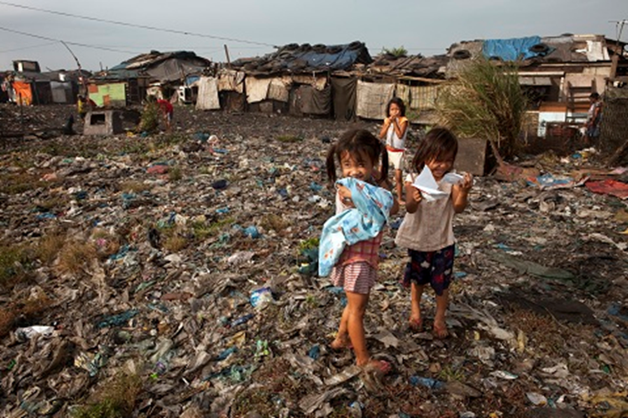
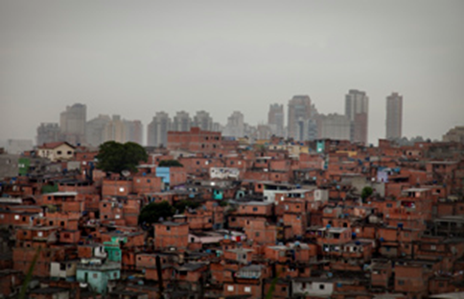
Components of Environmental Health

Slide 11
Components of EH
Water supply
Air quality
Noise pollution
Radiation
Healthful Housing
Food safety
Waste management
Vector control

Slide 12
Facets of EH
Environmental epidemiology
Associations between exposure to environmental agents and subsequent development of disease
Environmental toxicology
Causal mechanisms between exposure and subsequent development of disease
Environmental engineering
Factors that governs and reduce exposure
Environmental Law
Development of appropriate legislation to protect public health.

Slide 13
Place of EH in your community
Discussion by students
Place of Environmental Health in your community

Slide 14
WATER SUPPLY AND HEALTH
OLUWADARE,T
DEPARTMENT OF COMMUNITY MEDICINE

Slide 15
Introduction
Water supply
Adequacy/requirement and sufficiency
Quality- criteria and standard
Uses
Water distribution
Sources of water
Water pollution
Water related diseases: burden
Surveillance of drinking water quality
Role of water in achieving HFA

Slide 16
Introduction contd.
Overview of water and health
Water should be easily accessible, adequate in quantity, free from contamination, safe and readily available all year round.

Slide 17
Introduction contd.
Overview of water and health
There can be no state of positive health and well-being without safe water.
UNGA – International drinking Water Supply and Sanitation Decade(1981-1990)
34th World Health Assembly
Emphasized that safe drinking water is a basic element of Primary Health Care

Slide 18
Introduction contd.
Water should be easily accessible, adequate in quantity, free from contamination, safe and readily available all year round.

Slide 19
Water supply
Criteria and standard
Must be safe and wholesome
Free from pathogenic agents
Free from harmful chemical substances
Pleasant to taste
Usable for domestic purpose

Slide 20
Water supply contd.
Water requirement
Physiologic requirement for drinking water have been estimated at about 2litres/head/day
Consumption depends upon
Climate conditions
Standard of living
Habit of people
A supply of 150-200Ls per capital is adequate for all urban domestic purposes.

Slide 21
Water supply contd.
Water sufficiency
World wide around 1.1 billion people lack access to improved water sources
Students’ input

Slide 22
Sources of water supply
Water sources must conform to two criteria
The quantity must be sufficient to meet present and future requirement
The quality must be acceptable
Sources include
Rain
Surface water
Impounding reservoirs
Rivers and streams
Tanks, ponds and lakes
Ground water
Wells
Spring

Slide 23
Uses of water
Domestic use
Public purposes
Industrial purposes
Agricultural purposes
Power production from hydropower and steam power
Carrying away waste

Slide 24
Water pollution
Pure uncontaminated water does not occur in nature
Sources of impurities are
Natural
Man-made
Sewage
Agricultural pollutants
Industrial waste
Physical pollutants
Indicators of pollution include
Amount of total suspended solids
Biochemical Oxygen Demand (BOD) at 20 degree C
Concentration of chlorine, Nitrogen, Phosphorus and absence of dissolved oxygen

Slide 25
Water related diseases
Water related diseases are broadly classified into
Water borne diseases
Water washed diseases
Water based diseases
Water related insect-vector diseases

Slide 26
Water related diseases contd.
Water borne diseases
They are caused by ingestion of water contaminated by human or faeces or urine, which contain pathogenic microorganisms.
They can be classified into
Diarrhoeal water-borne diseases
Non-diarrhoeal water-borne diseases
Diarrhoeal water-borne diseases
Cholera
Shigellosis
Amoebiasis
campylobacteriosis

Slide 27
Water related diseases contd.
Water borne diseases
Non-diarrhoeal water borne diseases
Typhoid fever (17 million deaths each year)
Hepatitis A (1.5 million deaths each year) and E
Polio
Legionellosis
Leptospirosis

Slide 28
Water related diseases contd.
Water washed diseases
They are caused by poor personal hygiene, skin and eye contact with contaminated water.
They are also called water scarce diseases
Trachoma
Scabies
Ringworm
Louse borne epidemic typhus

Slide 29
Water related diseases contd.
Water related insect-vector diseases
They are caused by insects that breed of feed in or near water bodies.
Malaria
Onchocerciasis
Yellow fever
Dengue fever
Zika virus disease

Slide 30
THANK YOU

