Slide 1
EEE 326 - ELECTRICAL MACHINES II
SINGLE PHASE INDUCTION MODULE

Slide 2
WORKED EXAMPLE
A 23OV, 50Hz, 4 – pole , single phase induction motor has the following parameters and is running at a slip of 0.05
$R_{1}=2.51 Ω$; ${R′}_{2}=7.81 Ω$; $X_{o}=150.88 Ω$; $X_{1}=4.62 Ω$; ${X′}_{2}=7.62 Ω$; $R_{o}=30.10 Ω.$
1. Draw the EXACT EQUIVALENT CIRCUIT of the Associated Single phase Induction Motor
2. Calculate the following:
(i) $Z_{f}$ (ii) $Z_{b}$ (iii) $Z_{1}$ (iv) $Z_{eq}$ (v) $I_{1 }$, Motor circuit (vi) power factor
(vii) $E_{f}$[ forward emf], (viii) $E_{b}$[ back emf], (ix) ${I′}_{2f}$ (x) ${I′}_{2b}$
(xi) Airgap power for the forward field, $P_{gf =[ }{{I′}_{2f}]}^{2} \frac{{R′}_{2}}{2s}$ Watts

Slide 3
SOLUTION
(xii) Airgap power for the backward field, $P_{gb =[ }{{I′}_{2b}]}^{2} \frac{{R′}_{2}}{2[2−s]}$ Watts
(xiii) Mechanical power output for the forward field, $P_{mechf =\left[1−s\right]P_{gf }= [ }{{I′}_{2f}]}^{2} \frac{{R′}_{2}}{2}$. $\frac{1 −s}{s}$ Watts
(xiv) Mechanical power output for the backward field, $P_{mechb =\left[s −1\right]P_{gb }=− [ }{{I′}_{2b}]}^{2} \frac{{R′}_{2}}{2}$. $\frac{1 −s}{2 − s}$ Watts

Slide 4












REQUIRED EQUIVALENT CIRCUIT
$${I^{′}}_{2f}$$
$${{ I}^{′}}_{of}$$
$$\frac{ {R′}_{2}}{ 2s_{f}}$$
$$E_{f}$$
$$\frac{ R_{O}}{ 2}$$
$$\frac{X_{0}}{2}$$
Forward field
$$\frac{ {X′}_{2}}{ 2}$$
$$V_{1}$$
$${I^{′}}_{2b}$$
$${{ I}^{′}}_{ob}$$
$$\frac{ {R′}_{2}}{ 2s_{b}}$$
$$\frac{ R_{O}}{ 2}$$
$$\frac{X_{0}}{2}$$
$$Backward$$
$$field$$
$$E_{b}$$
$$\frac{ {X′}_{2}}{2}$$

Slide 5

DETERMINATION OF PARAMETERS OF THE EQUIVALENT CIRCUIT
$\frac{X_{o}}{2}$ = $\frac{150.88}{2}$ = 75.44 Ω
$\frac{R_{o}}{2}$ = $\frac{30.10}{2}$ = 15.05 Ω
$\frac{{R′}_{2}}{2s_{f}}$ = $\frac{7.81}{2[0.05]}$ = 78.10 Ω; where ${s=s}_{f}=0.05 ; s_{f}$+ $s_{b}$ = 2
$\frac{{X′}_{2}}{2}$ = $\frac{7.62}{2}$ = 3.81 Ω
$\frac{{R′}_{2}}{2s_{b}}$ = $\frac{{R′}_{2}}{2[2 −s]}$ = $\frac{7.81}{2[2 − 0.05]}$ = 2.003 Ω

Slide 6
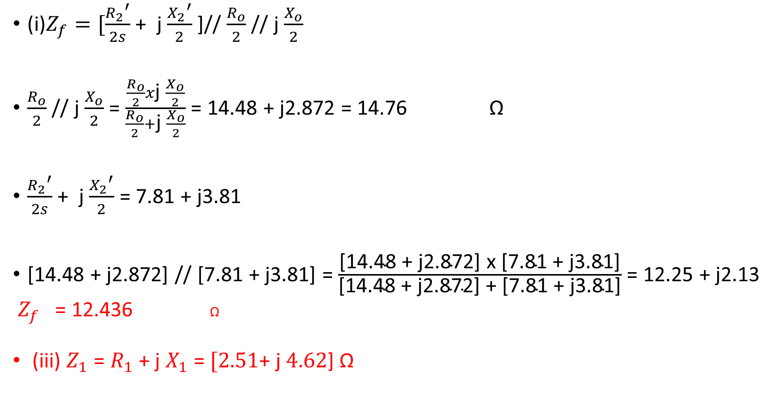
(i)$Z_{f}=[\frac{{R_{2}}^{′}}{2s}$ + j $\frac{{X_{2}}^{′}}{2}$ ]// $\frac{R_{o}}{2}$ // j $\frac{X_{o}}{2}$
$\frac{R_{o}}{2}$ // j $\frac{X_{o}}{2}$ = $\frac{\frac{R_{o}}{2}x\text{j} \frac{X_{o}}{2}}{\frac{R_{o}}{2}+\text{j} \frac{X_{o}}{2}}$ = 14.48 + j2.872 = 14.76 Ω
$\frac{{R_{2}}^{′}}{2s}$ + j $\frac{{X_{2}}^{′}}{2}$ = 7.81 + j3.81
[14.48 + j2.872] // [7.81 + j3.81] = $\frac{\text{[14.48 + }\text{j}\text{2.872] }\text{x}\text{ [7.81 + }\text{j}\text{3.81]}}{\text{[14.48 + }\text{j}\text{2.872] + [7.81 + }\text{j}\text{3.81]}}$ = 12.25 + j2.13
$Z_{f}$ = 12.436 Ω
(iii) $Z_{1}$ = $R_{1}$ + j $X_{1}$ = $[2.51$+ j $4.62$] Ω
$${11.22}^{0}$$
$${11.22}^{0}$$

Slide 7
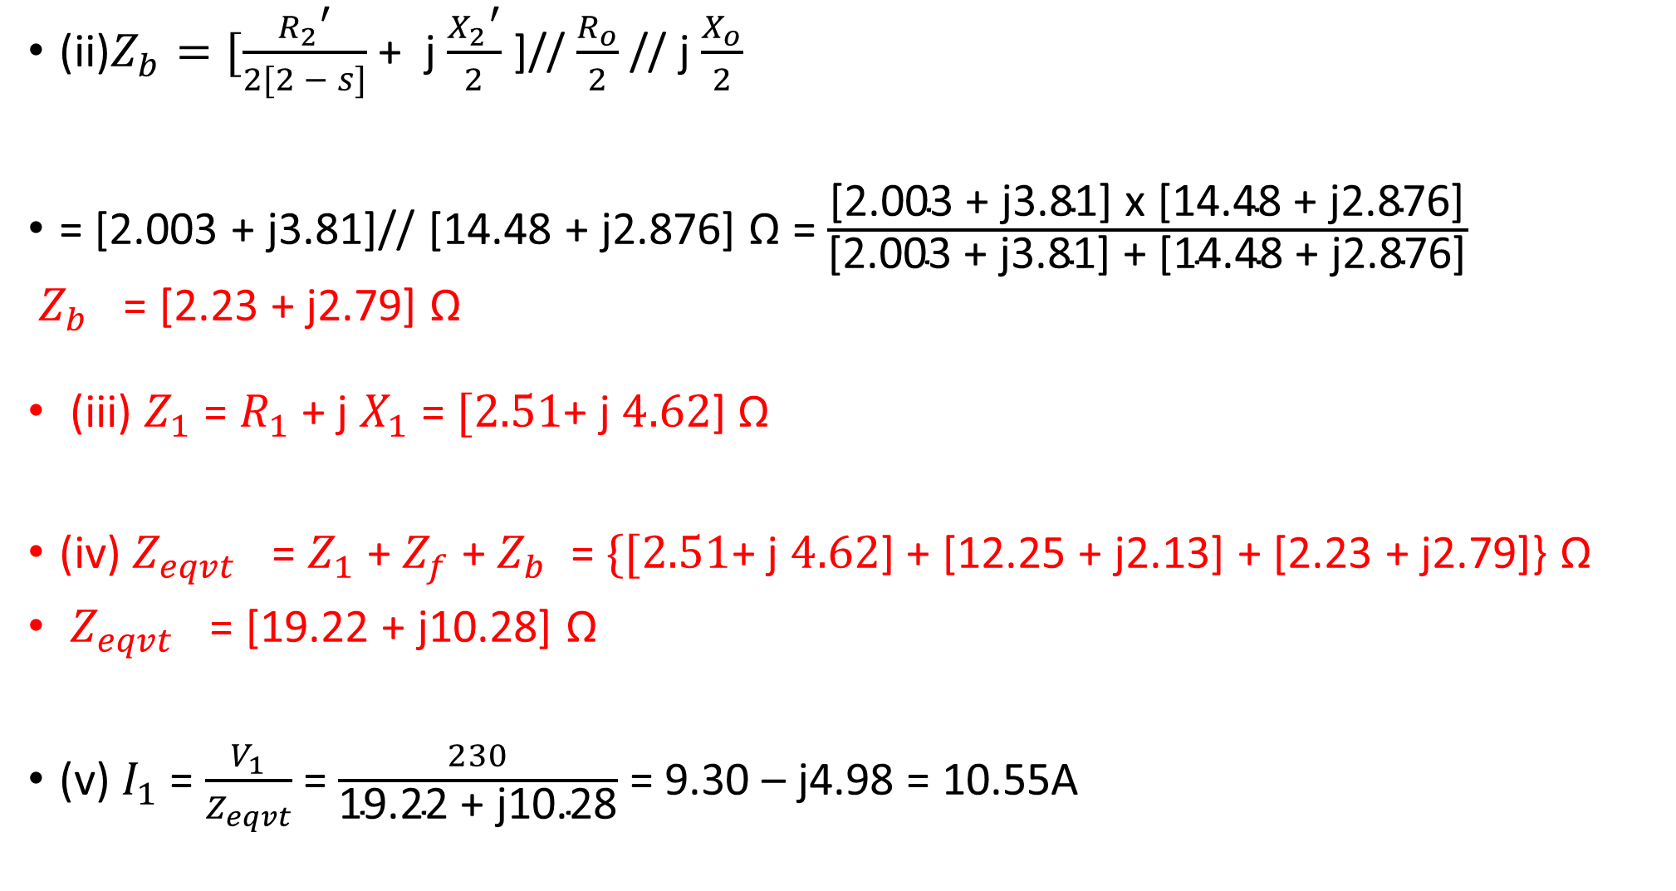
(ii)$Z_{b}=[\frac{{R_{2}}^{′}}{2[2 − s]}$ + j $\frac{{X_{2}}^{′}}{2}$ ]// $\frac{R_{o}}{2}$ // j $\frac{X_{o}}{2}$
= [2.003 + j3.81]// [14.48 + j2.876] Ω = $\frac{\text{[2.003 + }\text{j}\text{3.81] }\text{x}\text{ [14.48 + }\text{j}\text{2.876]}}{\text{[2.003 + }\text{j}\text{3.81] + [14.48 + }\text{j}\text{2.876]}}$
$Z_{b}$ = [2.23 + j2.79] Ω
(iii) $Z_{1}$ = $R_{1}$ + j $X_{1}$ = $[2.51$+ j $4.62$] Ω
(iv) $Z_{eqvt}$ = $Z_{1}$ + $Z_{f}$ + $Z_{b}$ = $\{[2.51$+ j $4.62$] + [12.25 + j2.13] + [2.23 + j2.79]} Ω
$Z_{eqvt}$ = [19.22 + j10.28] Ω
(v) $I_{1}$ = $\frac{V_{1}}{Z_{eqvt}}$ = $\frac{230}{\text{19.22 + }\text{j}\text{10.28}}$ = 9.30 – j4.98 = 10.55A
$$−28.14$$

Slide 8
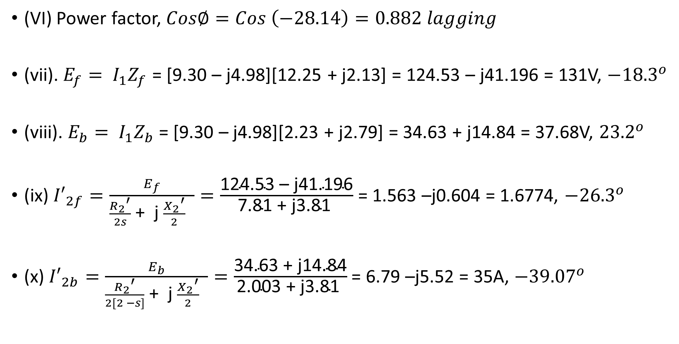
SOLUTION CONT’D
(VI) Power factor, $Cos∅=Cos \left(−28.14\right)=0.882 lagging$
(vii). $E_{f}= I_{1}Z_{f}$ = [9.30 – j4.98][12.25 + j2.13] = 124.53 – j41.196 = 131V, ${−18.3}^{o}$
(viii). $E_{b}= I_{1}Z_{b}$ = [9.30 – j4.98][2.23 + j2.79] = 34.63 + j14.84 = 37.68V, ${23.2}^{o}$
(ix) ${I′}_{2f}=\frac{E_{f}}{\frac{{R_{2}}^{′}}{2s}\text{ + }\text{j} \frac{{X_{2}}^{′}}{2} }=\frac{\text{124.53 – }\text{j}\text{41.196}}{\text{7.81 + }\text{j}\text{3.81 }}$ = 1.563 –j0.604 = 1.6774, ${−26.3}^{o}$
(x) ${I′}_{2b}=\frac{E_{b}}{\frac{{R_{2}}^{′}}{2[2 −s]}\text{ + }\text{j} \frac{{X_{2}}^{′}}{2} }=\frac{\text{34.63} \text{+ }\text{j}\text{14.84}}{\text{2.003}\text{ + }\text{j}\text{3.81 }}$ = 6.79 –j5.52 = 35A, ${−39.07}^{o}$

Slide 9
SOLUTION CONT’D
(xi) Airgap power for the forward field, $P_{gf}$ = ${[I′}_{2f}]^{2}$x [$\frac{{R_{2}}^{′}}{2s}$] = [$1.677]^{2}$x [$78.1$]
$P_{gf}$ = 219.6 Watts
(xii) Airgap power for the forward field, $P_{bf}$ = ${[I′}_{2b}]^{2}$x [$\frac{{R_{2}}^{′}}{2(2 −s)}$] = [$8.75]^{2}$x [$2.003$]
$P_{gf}$ = 153.35 Watts
(xiii) Mechanical Power Output for the forward field, $P_{mech.f}=\left[1 − s\right]P_{gf}$
$=\left[1 −0.05\right]\left[219.6\right]$
$P_{mech.f}=$ 208.62 Watts
(xiii) Mechanical Power Output for the backward field, $P_{mech.b}=\left[s−1\right]P_{bf}$
$=\left[1 −0.05\right]\left[153.35\right]$
$P_{mech.f}=$ - 145 Watts

