Slide 1
Respiratory System Pharmacology
Akinluyi E.T. (Ph.D)
Department of Pharmacology and Therapeutics,
Afe Babalola University, Ado-Ekiti
Ekiti State

Slide 2
The regulation of respiration
Two pathways are involved in the regulation of respiration
Sensory receptors and afferent pathways
Efferent pathways.
The afferent pathways
This comprises of the stretch receptors, the unmyelinated C- fibres and the irritant receptors associated with myelinated vagal fibres
Irritant receptors on myelinated fibres and/or C-fibre receptors respond to exogenous chemicals, inflammatory mediators and physical stimuli, causing bronchoconstriction, mucus secretion and coughing.

Slide 3
Efferent pathways
The efferent pathways comprises of:
Parasympathetic nerves which causes bronchoconstriction and mucus secretion through M3 receptors.
Sympathetic nerves which innervates tracheobronchial blood vessels and glands only, and the β adrenoceptors expressed on human airway smooth muscle (and mast cells, epithelium, glands and alveoli). β agonists causes relaxation of bronchial smooth muscle, inhibition of mediators release from mast cells and increase in mucus clearance.
Non-adrenergic non-cholinergic (NANC) nerves: Inhibitory NANC nerves, relaxes smooth muscle by releasing nitric oxide and vasoactive intestinal peptide. Excitatory NANC nerves cause neuroinflammation by releasing substance P and neurokinin A.

Slide 4
Cough Physiology
A Cough is a sudden and often repetitively occurring, protective reflex, which is initiated by infection, noxious fumes, dust, or other types of foreign bodies.
The reflex results in a sudden expulsion of air to clear the respiratory tract of respiratory secretions or foreign particles.
It is a physiologic mechanism or protective reflex (due to stimulation of mechano or chemoreceptors in the throat), and is one way in which the lungs and airways are protected from inhaled particles.
Coughing sometimes brings up sputum (also called phlegm), a mixture of mucus, debris, and cells expelled from the lungs. Respiratory secretions and foreign objects are naturally removed by the cough reflex.

Slide 5
The cough reflex
The cough reflex has both sensory (afferent) mainly via the vagus nerve and efferent components.
Pulmonary irritant receptors in the epithelium of the respiratory tract are sensitive to both mechanical and chemical stimuli.
Chemical or mechanical irritation of the epithelium within the bronchial mucosa causes bronchoconstriction, which in turn stimulates the stretch receptors located within the tracheobronchial tree.
The internal laryngeal nerve carries the sensory information via the vagus nerve to the cough center located in the medulla oblongata.
Stimulation of this area produces a cough to remove the foreign material from the respiratory tract before it reaches the lungs.
Mucus production in the bronchi is an airway defense mechanism, and it increases with inflammation and infection.

Slide 6
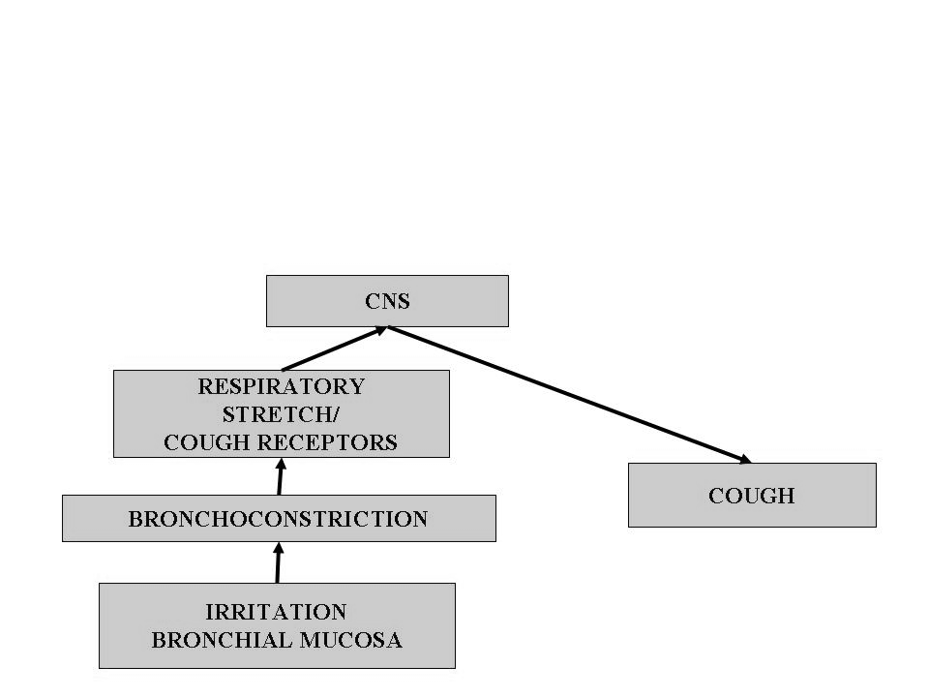
The cough reflex

Slide 7
Types of cough
Productive cough
Non productive cough
Productive cough: This type of cough is beneficial as it effectively drains the airway and expels excessive secretions and exudates. It helps remove harmful foreign substances from the airway. Its suppression is not desirable, may even be harmful.
Non productive cough: It is a dry cough. It is non- productive chronic cough and is due to smoking and local irritants.
Apart from specific remedies (antibiotics), cough may be treated as a symptom

Slide 8
Symptomatic (nonspecific) cough therapies

Slide 9
Antitussives
They are also called cough centre suppressants.
These are agents that suppress the cough reflex on the medulla oblongata to suppress cough of many respiratory conditions.
They are broadly classified into:
Central (CNS) acting:
Opioids e.g. Codeine, Hydrocordone
Non-opioids e.g. Benzonatate, Dextromethorphan
Peripherally acting: Prenoxdiazine

Slide 10
Opioids
These agents suppress the cough reflex by direct action on the cough center in the medulla.
Examples include Codeine, Hydrocordone, Ethylmorphine, Pholcodeine
Codeine is an opium alkaloid, qualitatively similar to and less potent than morphine, but is more selective for cough centre. Codeine suppresses cough for about 6 hours.
Adverse effects of codeine include: abuse liability; constipation; respiratory depression; drowsiness.

Slide 11
Non-opioids
Examples: Benzonatate, Dextromethorphan, Butamirate citrate, Noscapine, Chlophedianol
Dextromethorphan is a central NMDA (N-methyl D-aspartate) receptor antagonist. It works by inhibiting the cough center in the brain, elevating the threshold for coughing. It is a common ingredient of many antitussive combinations.
Adverse effects of dextromethorphan include dizziness, nausea, drowsiness; at high doses hallucinations and ataxia may occur.
Noscapine (Narcotine) exert its antitussive effects through the activation of sigma opioid receptors. It suppresses cough but has no narcotic, analgesic or dependence inducing properties. It is especially useful in spasmodic cough.

Slide 12
Peripherally acting antitussive
Example is Prenoxdiazine
It acts by desensitizing the pulmonary stretch receptors and reducing tussle impulses originating in the lungs.
Does not cause respiratory depression. Does not cause addiction. Its efficacy is not impressive.

Slide 13
Expectorants
They are also called mucokinetics. These are drugs that increase bronchial secretions or reduce its viscosity, facilitating its removal by coughing.
Expectorants can be:
Bronchial secretion enhancers: Drugs that are considered to increase bronchial secretion by salt action. E.g. Guaifenesin, sodium citrate, potassium citrate, potassium iodide, ammonium chloride, etc.
Mucolytics: These are agents that breakdown mucous in order to help respiratory patients in coughing up thick, tenacious secretions. E.g. Bromhexine, acetylcysteine, carbocysteine, ambroxol, etc.

Slide 14
Mucolytics
Mucolytic bromhexine is a potent mucolytic and mucokinetic, capable of inducing thin copious bronchial secretion.
It depolymerizes mucopolysaccharides directly as well as by liberating lysosomal enzymes. This breaks the network of fibers in tenacious sputum.
Side effects include rhinorrhoea and lacrimation, nausea, gastric irritation, hypersensitivity.
Ambroxol is a metabolite of bromhexine having similar mucolytic action, uses and side effect.
Acetylcysteine acts by opening the disulfide bonds in mucoproteins present in sputum, making it less viscous. It has to be administered directly into the respiratory tract.
Carbocisteine liquefies viscous sputum in the same way as acetylcysteine. It is administered orally. It may break gastric mucosal barrier, and so is contraindicated in peptic ulcer patients.
Side effects include gastric discomfort and rashes

Slide 15
Pharyngeal demulcents
Pharyngeal demulcents soothe the throat and reduce afferent impulses from the inflamed/irritated pharyngeal mucosa, thus provide symptomatic relief in dry cough arising from throat.
Examples include Lozenges, cough drops, linctuses glycerine and liquorice.

Slide 16
Bronchodilators
Bronchospasm can induce/aggravate cough, especially in individuals with bronchial hyper-reactivity.
Bronchodilators relieve cough in such individuals
They improve the effectiveness of cough in clearing secretions by increasing the surface velocity of airflow during cough
Examples include Salbutamol and Terbutaline

Slide 17
Antihistamines
This class of drugs are used to block the release or action of histamine- a chemical mediator of inflammation that increases secretions and constricts the air passageway
They directly compete with histamine for specific receptor sites.
There are two histamine receptors: histamine-1 (H1) and histamine-2 (H2)
The H2 Blockers are used to reduce gastric acid in peptic ulcer disease, while the H1 blockers are agents designed to relieve respiratory symptoms and to treat allergic conditions.
The antihistamines selectively block the effects of histamine at the H1 receptor sites in the target tissue by competing with histamine for the receptor, decreasing the cellular responses.
They are more effective in preventing the actions of histamine rather than reversing them.
They also have anticholinergic properties.

Slide 18
Histamine vs. Antihistamine Effects
Smooth Muscle (on exocrine glands)
Histamine effects:
Stimulate salivary, gastric, lacrimal, and bronchial secretions
Antihistamine effects:
Prevent salivary, gastric, lacrimal, and bronchial secretions
Immune System (Release of substances commonly associated with allergic reactions)
Histamine effects:
Mast cells release histamine and other substances, resulting in allergic reactions.
Antihistamine effect:
Binds to histamine receptors, thus preventing histamine from causing a response.

Slide 19
Anticholinergic:
Drying effect that reduces nasal, salivary, and lacrimal gland secretions (runny nose, tearing, and itching eyes)
Sedative: Some antihistamines cause drowsiness
Most common side effects of antihistamines are the anticholinergic (drying) effects. These include:
Dry mouth
Difficulty urinating
Constipation
Changes in vision
Antihistamines also cause drowsiness (Mild drowsiness to deep sleep)
Notes:
Called a wheal-and-flare reaction, it includes swelling, produced by the release of serum into the tissues (wheal), and redness of the skin, resulting from the dilation of blood vessels (flare).

Slide 20
Bronchial asthma
Asthma is characterized by hyper-responsiveness of the trachea and bronchi smooth muscles to various stimuli resulting in:
Contraction or airway smooth muscles
Increased secretion
Mucosal edema
Mucus plugging.
Of these causes of airway obstruction, contraction of smooth muscle is most easily reversed by current therapy.
Reversal of edema and cellular infiltration requires sustained treatment with anti-inflammatory agents
Symptoms of asthma include:
Dyspnea
Wheezing
Cough
Chest tightness

Slide 22
Pathogenesis of Asthma
Asthma maybe categorized into two:
▪ Allergic or atopic asthma
▪ Non-allergic or non-atopic asthma
ALLERGIC ASTHMA
There is evidence of allergen sensitization
It usually begins in childhood and is triggered by environmental allergens such as dust mites, pollens, cockroaches, molds, animal dander or foods.
Positive family history and positive skin test resulting from the offending antigen.
There is hay fever
Elevated antibodies immunoglobulin E (IgE)

Slide 23
2. Non-allergic asthma
No evidence of allergen sensitization
There is negative skin test result
No positive family history
Normal serum IgE
Occurs in middle aged subjects
Common triggers are viruses (rhinovirus, parainfluenza virus) which causes respiratory infections.
Inhaled air, pollutants such as sulfurdioxide, ozone and nitrogen dioxide may also contribute to chronic inflammation
In these patients, there is hyperirritability of the bronchial tree

Slide 24
Immediate phase of asthma attack
In allergic asthma, the immediate phase (i.e. the initial response to allergen provocation) occurs abruptly and is mainly caused by spasm of the bronchial smooth muscle.
Allergen interaction with mast cell-fixed IgE causes release of histamine, leukotriene B₄ and prostaglandin (PG) D₂.
Other mediators released include IL-4, IL-5, IL-13, macrophage inflammatory protein-1α and tumour necrosis factor (TNF)-α.
Various chemotaxins and chemokines attract leucocytes-particularly eosinophils and mononuclear cells-into the area, setting the stage for the delayed phase

Slide 25
The late phase
The late phase involves a progression of the inflammatory reaction which was initiated in the early phase.
The most important of these is the influx of Th2 lymphocytes
Synthesis and release of a variety of cytokines: interleukins 3 and 5, granulocyte-macrophage colony-stimulating factor (GM-CSF), and tissue growth factor (TGF) from T cells and mast cells.
These cytokines in turn attract and activate eosinophils and neutrophils, whose products include eosinophil cationic protein (ECP), major basic protein (MBP), proteases, and platelet-activating factor.
These mediators cause the edema, mucus hypersecretion, smooth muscle contraction, and increase in bronchial reactivity associated with the late asthmatic response.

Slide 26
BASIS FOR PHARMACOTHERAPY
1.) To reverse bronchoconstriction: Bronchodilators
▪ β-Adrenoceptor agonists
▪ Anticholinergics
▪ Xanthine derivatives
2.) To control or prevent inflammation:
▪ Corticosteroids
▪ Leukotriene antagonists
▪ Mast cell stabilizers
▪ Anti-IgE antibody

Slide 27
BRONCHODILATORS

Slide 28
β-Adrenergic receptor agonists
Activation of β2-receptors located on the bronchiolar smooth muscle stimulates adenylyl cyclase and increase in cyclic adenosine monophosphate (cAMP) to cause bronchodilation
β2-receptor agonists dilate the bronchi by a direct action on the β2-receptors of smooth muscles. They cause rapid dilation of the airways
They also inhibit the mediators of bronchoconstriction
They inhibit mediator release from mast cells and TNF-α release from monocytes. They also increase mucus clearance by an action on the cilia.
They are the first-line drugs for the acute treatment of asthma attacks, but can also be used for the chronic treatment.
They are usually given by inhalation
Prolonged use may lead to desensitization and receptor downregulation

Slide 29
Categories of β2-Adrenergic receptor agonists
Non-selective β-adrenergic agonists: Epinephrine
β2- selective adrenergic agonists
Short acting agents: Albuterol (Salbutamol), terbutaline, bambuterol.
These agents are usually used for the treatment of acute asthma attacks.
They have rapid onset of action, causes quick relief.
They are given by inhalation; the maximum effects occurs within 30 min and the duration of action is 3-5 h.
They can be combined with ipratropium bromide

Slide 30
ii) Long acting agents: Salmeterol and formoterol.
They are used for the prevention of asthma attacks and for chronic management of asthma.
They have a long duration of action (between 8-12 h), but slower onset of action. Therefore, they are not to be used for the quick relief of an acute asthma attack.
These agents are only given by inhalation
These drugs appear to interact with inhaled corticosteroids to improve asthma control. They are given regularly (2x daily) as an adjunctive therapy in patients whose asthma is inadequately controlled by corticosteroids.
They are not recommended for the sole therapy for asthma
Salmeterol has 10-12 h of bronchodilator effect. It is generally combined with a corticosteroid (fluticasone propionate)
Formoterol’s bronchodilator effect last for about 12 hours. It can be combined with the corticosteroids budesonide or beclomethasone dipropionate.

Slide 31
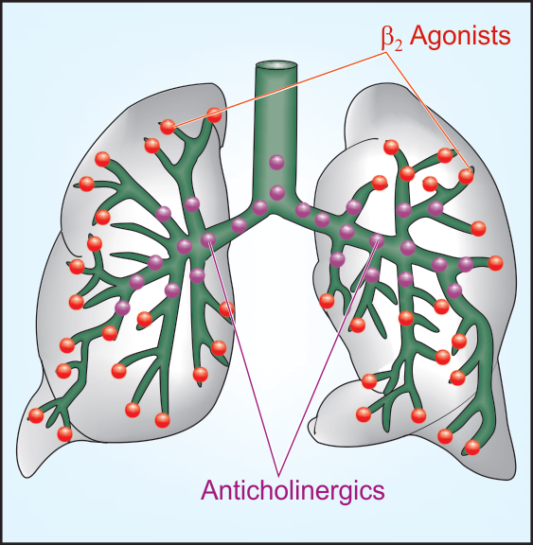
Unwanted effects of β-adrenergic agonists
In the context of asthma, the commonest adverse effect is tremor. Other unwanted effects include:
Tachycardia
Cardiac dysrhythmia.

Slide 32
Anticholinergics
Examples: Ipratropium bromide and tiotropium
They block the muscarinic type-cholinergic receptors on bronchiolar smooth muscles and mast cells, leading to bronchodilation.
Ipratropium blocks bronchoconstriction mainly in the larger airways while β2 agonists mainly relaxes bronchiolar smooth muscles, but they do not have any superiority to β2 agonists.
It can be used alone or combined with β2 agonists
Ipratropium bromide- short acting (4–6 hours)
Tiotropium bromide- long acting (24 hours).
They are the bronchodilators of choice in COPD. They are not recommended in acute asthma.

Slide 33
Methylxanthines
Examples include Theophylline, theobromine, caffeine.
They act as competitive inhibitors of phosphodiesterase enzyme (PDE; the enzyme that hydrolyses cyclic nucleotides), leading to increased intracellular cAMP and cGMP levels.
The levels of cAMP determine the degree of bronchodilation, and when the levels are increased, there is an increased relaxation of smooth muscle.
These agents have also been proposed to inhibit the action of adenosine at its receptor (A1 and A2) sites. When adenosine binds to its receptors, it provokes contraction of isolated airway smooth muscle and histamine release from airway mast cells.

Slide 34
Indications for use
used as a bronchodilator for the treatment of asthma although its not a first line drug due to its varying side effects.
used more for chronic obstructive pulmonary disorder (COPD)
Adverse reactions
Nausea and vomiting-most often seen adverse effect.
Agitation, insomnia and convulsions-CNS stimulant effect
Cardiac arrhythmia- cardiac stimulant
Gastric disorders- increase gastric acid secretion (contraindicated in peptic ulcer)
Note: theophylline has a very narrow therapeutic window, and so plasma levels are closely monitored

Slide 35
INHIBITORS OF INFLAMMATION

Slide 36
Corticosteroids
Corticosteroids suppress the mucosal inflammation (anti-inflammatory effect) and decrease the mucosal edema. They have no bronchodilator effects.
They are used for the prophylaxis of asthma attacks.
They have anti-inflammatory actions by inhibiting cytokine synthesis, reducing prostaglandins, leukotrienes, and thromboxane A2 levels. They also decrease vascular permeability
They increase the susceptibility of β-adrenergic receptors to endogenous ligands.
They also play a role in preventing the development of tolerance to β-agonist drugs
They have late onset of action (3–7 days)
There are 2 categories: inhaled and systemic corticosteroids

Slide 37
i) Inhaled corticosteroids
Examples: bedomethasone dipropionate, budesonide, fluticasone propionate
They are not used alone for acute asthma attacks but in combination with salmeterol or salbutamol.
They have high topical and low systemic activity (due to poor absorption/ or marked first pass metabolism). Thus, systemic adverse effects are rarely seen compared to parenteral and oral forms
They can be used in patients who have been started with oral steroids or who have no history at all.
Adverse effects include: dysphonia, cough, oral candidiasis, adrenal cortex suppression and atrophy (caused by long-term use of high doses), risk of osteoporosis and retardation of vertical bone growth

Slide 38
ii) Systemic steroids (oral and parenteral forms)
Examples: i.v. hydrocortisone, oral prednisolone and methylprednisolone.
Systemic steroid therapy is resorted to in asthma in the following situations:
Severe attacks that is not controlled by bronchodilators and inhaled steroids or when there are frequent recurrences of increasing severity.
Patients with status asthmaticus or acute asthma exacerbation: This is asthma attack not responding to intensive bronchodilator therapy.

Slide 39
Leukotriene antagonists
Examples include Zafirlukast and montelukast
They act as competitive antagonists of leukotriene receptors. These drugs bind to Cys-LT1 receptor; expressed in the respiratory mucosa and infiltrating inflammatory cells.
Stimulation of this receptor by leukotrienes results in bronchoconstriction
Zafirlukast and montelukast competitively inhibit the effects of leukotrienes on their receptor, thereby inhibiting bronchial smooth muscle contraction.
They also inhibit increased vascular permeability and recruitment of eosinophils, basophils. They inhibit the increase in mucus production.
Zileuton is a potent selective inhibitor of 5-lipoxygenase activity, therefore it inhibits the formation of all the products of 5-lipoxygenase; this now result in the inhibition of the formation of the leukotrienes.

Slide 40
Mast cell stabilizers
Examples are: Cromolyn sodium, nedocromil sodium
These drugs inhibit mast cell degranulation via stabilizing the mast cell membrane. However, they do not have bronchodilator action and do not antagonize constrictor action of histamine
They are used to prevent an asthma attack, but is not useful during the attack, when the mediators have already been released.
They are used for the chronic management of asthma (prophylaxis) only via inhalation. They are not used for severe asthma attacks.
Cromolyn sodium possess low efficacy in asthma prophylaxis, but also low toxicity and adverse effect profile.
It is generally used as an adjuvant drug to β agonists and inhaled corticosteroids in asthma prophylaxis.
It is used in exercise-induced asthma, allergic rhinitis and allergic conjuctivitis
Nedocromil is more effective in the elderly and used locally also in allergic rhinitis and allergic conjuctivitis.

Slide 41
Anti-IgE Antibody
Example is Omalizumab
It is a humanized monoclonal antibody against IgE (anti-IgE Mab).
It inhibits the binding if IgE to mast cells but does not activate IgE already bound to these cells and thus does not provoke mast cell degranulation.
It is administered s.c. and used in adults and adolescents older than 12 years of age with allergies and moderate to severe persistent asthma.
In severe extrinsic asthma, omalizumab has been found to reduce exacerbations and is proven to be effective in reducing the dependency on inhaled and oral corticosteroids.
Adverse effects include increase in serum hepatic enzymes, headache and dyspepsia
Drug interactions may be dangerous especially with theophylline and warfarin.

Slide 42
Chronic obstructive pulmonary disease (COPD)
COPD is also an inflammatory disease of the lungs characterized by:
Obstruction and/or destruction of alveoli
Bronchiolar fibrosis / chronic bronchitis
Loss of bronchiolar elasticity leading to closure of smaller air tubes during expiration.
Major cause of COPD is cigarette smoking. Air pollution is also aetiologically important
The airway obstruction is accentuated during exercise causing shortness of breath.
Bronchodilators prevent closure of peripheral air tubes during expiration and afford symptomatic relief in COPD patients, but improvement is generally <15%.
An increasing part of airway obstruction is irreversible.

Slide 43
Pharmacotherapy of COPD
Inhaled bronchodilators
Anticholinergic agents : ipratropium, tiotropium
β2-adrenergic agonists
Anticholinergic agents + β2-adrenergic agonists: Albuteron + ipratropium, salmeterol + tiotropium
Inhaled corticosteroids
Roflumilast : Roflumilast is a phosphodiesterase type 4 (PDE4) inhibitor. It elevates cAMP levels in inflammatory cells, causing inhibition of inflammatory mediator release.

