Slide 1
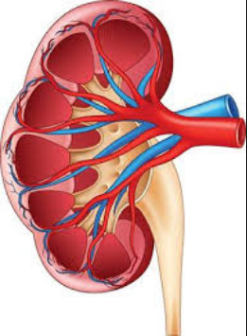
RENAL PHARMACOLOGY
AKINLUYI E.T. (Ph.D)
Department of Pharmacology and Therapeutics,
Afe Babalola University,
Ado-Ekiti, Ekiti state.

Slide 2
Overview of renal functions
Regulation of water and electrolyte balances
Ability to match the excretion to the intake
Enormous capacity (for sodium from 1/10 to 10 times normal)
Regulation of acid-base balance
Excreting acids and regulation of body fluid buffer stores
The only means for elimination of certain acids (sulfuric, phosphoric acid)
Excretion of metabolic waste products
Urea (metabolism of amino acids)
Creatinine (muscle creatine)
Uric acid (nucleic acids)
End products of hemoglobin breakdown (bilirubin)
Metabolites of hormones

Slide 3
Removal of foreign chemicals
Toxins
Pesticides
Drugs
Food additives
Regulation of arterial pressure
Excretion of variable amounts of water and electrolytes
Secretion of vasoactive factors (renin)
Secretion of hormones
Erythropoietin - production of red blood cells, hypoxia
Renin - regulation of arterial pressure
Gluconeogenesis
In prolonged fasting

Slide 4
Basic renal processes
There are three basic renal processes:
Glomerular Filtration: Filtering of blood into tubule forming the primitive urine
Tubular Reabsorption: Absorption of substances needed by body from tubule to blood
Tubular Secretion: Secretion of substances to be eliminated from the body into the tubule from the blood

Slide 5
Basic renal processes
Efferent Arteriole
Afferent
Arteriole
Glomerulus
GF
Kidney
Tubule
TR
Peritubular Capillary
TS
Urine Excreted

Slide 6
The nephron
Each kidney consists of approximately 1 million tiny structures called nephrons.
The nephron is the functional unit of the kidney and is divided structurally and functionally into several segments:
The glomerulus
The proximal tubule (convoluted and straight segments)
The loop of Henle (thin and thick limbs)
The distal convoluted tubule
The collecting tubule (and collecting duct)
Each segment of the nephron has a different mechanism for reabsorbing sodium and other ions.

Slide 7
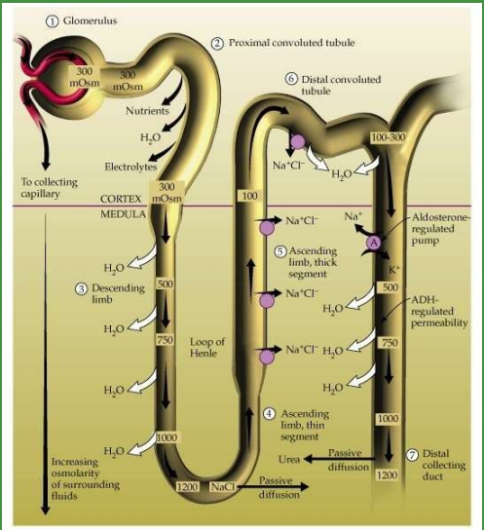
Anatomy of the nephron

Slide 8
Diuretics
Drugs that act on the kidney have important applications in renal, cardiovascular, and endocrine disorders.
These disorders mainly involve sodium and water homeostasis.
Diuretics are drugs which cause a net loss of Na⁺ and water in the urine
Each diuretic agent acts upon a single anatomic segment of the nephron, and these segments have distinctive transport functions.
The subgroups of the sodium-excreting diuretics are based on these sites and processes in the nephron. Several other drugs alter water excretion predominantly.
The effects of the diuretic agents are predictable from knowledge of the function of the segment of the nephron in which they act.

Slide 9
Classification of diuretics
High efficacy diuretics (Inhibitors of Na+/K+/2Cl¯ cotransport)
Sulphamoyl derivatives: Furosemide, Bumetanide, Torasemide
2. Medium efficacy diuretics (Inhibitors of Na+-Cl¯ symport)
(a) Benzothiadiazines (thiazides): Hydrochlorothiazide, Benzthiazide, Hydroflumethiazide, Bendroflumethiazide
(b) Thiazide like (related heterocyclics): Chlorthalidone, Metolazone, Xipamide, Indapamide, Clopamide
3. Weak or adjunctive diuretics
Carbonic anhydrase inhibitors: Acetazolamide
(b) Potassium sparing diuretics:
(i) Aldosterone antagonist: Spironolactone, Eplerenone
(ii) Inhibitors of renal epithelial Na+ channel: Triamterene, Amiloride.
(c) Osmotic diuretics: Mannitol, Isosorbide, Glycerol

Slide 10
Background to Mechanisms of Action of Diuretics
Channel
Na+/K+ pump
Co-transport
Counter-transport

Slide 11
Reabsorption and secretion occur along renal tubule
Movement of tubular fluid through renal epithelial cells into peritubular capillaries is accomplished by three transport mechanisms after cell interior is polarized by Na+/K+ pump:
Channels
Formed by membrane proteins
Allows only sodium to pass through
Co-transport (symporter)
Carrier mediated
Simultaneously transports both Na⁺ and other solute (Cl⁻, glucose, etc) from tubular lumen into renal epithelial cell
Counter-transport (antiporter/exchanger)
Carrier mediated
Transports Na⁺ in, another solute (H⁺) out of renal epithelial cell
Water moves transcellularly in permeable segments or via tight junctions between renal epithelial cells

Slide 12
Renal tubule transport mechanisms

Slide 13
The proximal tubule
Sodium bicarbonate (NaHCO₃), sodium chloride (NaCl), glucose, amino acids, and other organic solutes are reabsorbed via specific transport systems in the proximal convoluted tubule.
Of the various solutes reabsorbed, NaHCO₃ and NaCl are the most relevant to diuretic action.
Approximately 60-70% of Na⁺ reabsorption occurs in the proximal tubule, majority coming from NaHCO₃.
NaHCO₃ reabsorption by the Proximal tubule is initiated by the action of a Na⁺/H⁺ exchanger (NHE3) located in the luminal membrane of the proximal tubule epithelial cell.
Carbonic anhydrase (CAse) is an enzyme which catalyses the reversible reaction:
Carbonic acid spontaneously ionizes:
Intracellular carbonic anhydrase (CA) is essential for production of H⁺ for secretion into the lumen. Thus, Bicarbonate reabsorption by the proximal tubule is dependent on carbonic anhydrase

Slide 14
The proximal tubule

Slide 15
Loop of Henle
The proximal tubule empties into the thin descending limb of Henle's loop where water is extracted by osmotic forces found in the hypertonic medullary interstitium.
In the thick ascending limb of the loop, about 25% of the filtered Na⁺ is reabsorbed. But unlike the proximal tubule, it is nearly impermeable to water.
This segment is called a diluting segment because salt reabsorption which occurs dilutes the tubular fluid.
The Na⁺ and Cl⁻ transport system in the luminal membrane of the thick ascending limb is a Na⁺/K⁺/2Cl– co-transporter (NKCC2 or NK2CL)
Although the Na⁺/K⁺/2Cl– co-transporter is itself electrically neutral, its action contributes to excess K⁺ accumulation within the cell resulting in back diffusion of K⁺ into the tubular lumen.
This causes a lumen-positive electrical potential that drives divalent (and monovalent) cation reabsorption via the paracellular pathway

Slide 16
Loop of Henle

Slide 17
Distal convoluted tubule
Only about 10% of the filtered NaCl is reabsorbed in the distal convoluted tubule .
Like the Thick ascending limb of Henle's loop, this segment is relatively impermeable to water.
The sodium and chloride co-transporter (NCC) is the primary Na⁺ and Cl– transporter in the luminal membrane.
This co-transporter can be selectively blocked by thiazides.
NaCl reabsorption further dilutes the tubular fluid.
Ca²⁺ is actively reabsorbed by the epithelial cell of the distal convoluted tubule via an apical Ca²⁺ channel and basolateral Na⁺/Ca²⁺ exchanger. This process is regulated by parathyroid hormone

Slide 18
Distal convoluted tubule

Slide 19
Collecting tubule
The cortical collecting tubule is responsible for only 2–5% of NaCl reabsorption by the kidney and plays an important role in volume regulation.
As the final site of NaCl reabsorption, the collecting tubule is responsible for tight regulation of body fluid volume and for determining the final Na⁺ concentration of the urine.
It is the major site of K⁺ secretion by the kidney and thus the site at which all diuretic-induced changes in K⁺ metabolism occur.
The principal cells are the major sites of Na⁺, K⁺, and water transport , and the intercalated cells are the primary sites of H⁺ secretion.
The mechanism of NaCl reabsorption in the collecting tubule is distinct from that found in other tubule segments as the principal cells do not contain co-transport systems but separate ion channels for Na⁺ and other ions.
There is a net movement of charge across the membrane (3 Na⁺, 2K⁺), this makes the lumen “more negative” relative to the cell (i.e negative electrical potential develops).
The lumen negative potential drives the transport of Cl⁻ back to the blood via the paracellular pathway, and also drives K⁺ out of the cell through the apical membrane K⁺ channel.
Reabsorption of Na+ and its coupled secretion of K⁺ is regulated by aldosterone which increases the activity of both the channels and Na+/K+ ATPase, resulting in an increase in both Na⁺ reabsorption and K⁺ secretion.

Slide 20
Collecting tubule

Slide 21
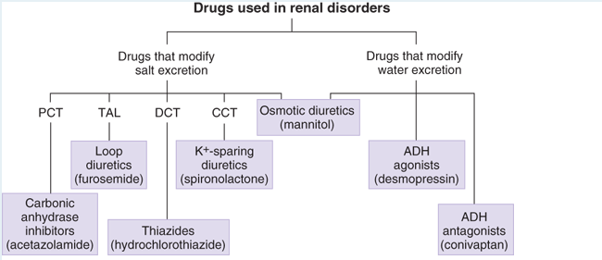
Proximal convoluted tubule (PCT), thick ascending limb of the loop of Henle (TAL), distal convoluted tubule (DCT), and cortical collecting tubule (CCT)

Slide 22
Basic pharmacology of diuretic agents

Slide 23
Carbonic anhydrase inhibitors
The prototype drug is Acetazolamide
It is a sulfonamide derivative which noncompetitively but reversibly inhibits Carbonic anhydrase (type II) in the proximal tubule cells resulting in slowing of hydration of CO2, resulting in decreased availability of H⁺ to exchange with luminal Na⁺ through the Na⁺/H⁺ antiporter.
They act by Inhibiting carbonic anhydrase which catalyzes formation of HCO₃⁻ and H⁺ from H₂O and CO₂ in renal proximal tubule cells.
They increase excretion of bicarbonate with accompanying Na⁺, K⁺ and H₂O, resulting in an increased flow of an alkaline urine and metabolic acidosis.
Inhibition of carbonic anhydrase blunts NaHCO₃ reabsorption and cause diuresis.

Slide 24
Pharmacokinetics
Carbonic anhydrase inhibitors are well absorbed after oral administration.
An increase in urine pH from the HCO₃⁻ diuresis is apparent within 30 minutes, maximal at 2 hours, and persists for 12 hours after a single dose.
Excretion of the drug is by secretion in the proximal tubule S2 segment.
Therapeutic uses
Treatment of glaucoma to reduce the formation of aqueous homor.
Treatment of acute mountain sickness.
Used in some unusual types of infantile epilepsy.
Used in the Prevention and treatment of metabolic alkalosis
Mostly used in combination with other diuretics in resistant patients
Notes:
Metabolic alkalosis is a primary increase in serum bicarbonate concentration. This occurs as a consequence of a loss of hydrogen ion from the body or a gain of bicarbonate. It is a metabolic condition in which the pH of tissue is elevated beyond normal range (7.35-7.45)

Slide 25
Adverse effects
Rapid tolerance
Increased HCO₃⁻ excretion causes metabolic acidosis
Drowsiness and fatigue.
CNS depression
Paresthesia (pins and needles under skin)
Nephrolithiasis (renal stones)
K⁺ wasting

Slide 26
High ceiling (loop) diuretics
The prototype drug is Furosemide.
Others are: Ethacrynic acid, Bumetanide and Torsemide
They are the most powerful diuretics, capable of causing excretion of 15-25 % of filtered Na⁺
They act on the thick ascending loop, inhibiting Na⁺/K⁺/2Cl⁻ co-transporter in the luminal membrane by combining with its Cl⁻ binding site.
By inhibiting this transporter, the loop diuretics reduce the reabsorption of NaCl and also diminish the lumen-positive potential that comes from K⁺ back-diffusion.
By reducing this potential which normally drives divalent cation reabsorption in the thick ascending loop, loop diuretics cause an increase in Mg²⁺ and Ca²⁺ excretion

Slide 27
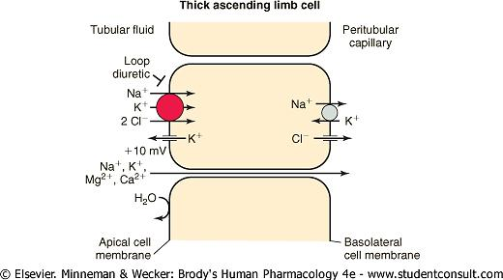
High ceiling (loop) diuretics

Slide 28
Pharmacokinetics
Orally administered, readily absorbed from the GI tract.
Have rapid onset of action.
Bound to plasma proteins: displaced by warfarin, and clofibrate.
Increase toxicity of cephalosporin antibiotics and lithium.
Additive toxicity with other ototoxic drugs.
Therapeutic uses
Edema: cardiac, pulmonary or renal.
Chronic renal failure or nephrosis
Cirrhosis of the liver complicated by ascites.
Hypertension
Hypercalcemia
Acute and chronic hyperkalemia.

Slide 29
Adverse effects
Hypokalemia
Hyperuricaemia which can precipitate acute gout
Metabolic alkalosis
Hyponatremia
Ototoxicity
Hypomagnesemia (Mg²⁺ depletion)
Osteoporosis in elderly patients

Slide 30
Thiazides
The prototype drug is Hydrochlorothiazide.
Thiazides inhibit NaCl reabsorption from the luminal side of epithelial cells in the distal convoluted tubule by blocking the Na⁺ /Cl⁻ co-transporter (NCC).
They cause increase excretion of Na⁺, K⁺, and Cl⁻ ions but increase reabsorption of Ca²⁺ in contrast to loop diuretics.
In the distal convoluted tubule, blockade of Na⁺ entry by thiazides causes a lowering in intracellular Na⁺ which enhances Na⁺ /Ca²⁺ exchange in the basolateral membrane and increases overall reabsorption of Ca²⁺ .
Increased activity of the Ca²⁺/Na+ antiporter leads to increased reabsorption of Ca²⁺ resulting in hypercalcemia which reduces osteoporosis. This could favour thiazides over loop diuretics in terms of bone metabolism during long-term use in older patients.
Magnitude of their effect is lower because they work on distal convoluted tubule which only receives 15% of filtrate.

Slide 31
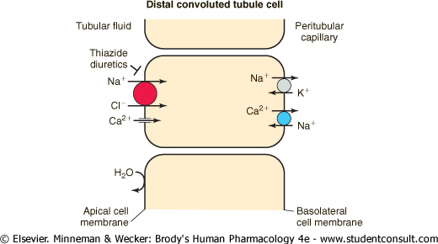
Thiazide

Slide 32
Pharmacokinetics
Given orally and well absorbed in the GIT.
All are excreted in the urine, mainly by tubular secretion for which they compete with uric acid.
Onset of action in ~ 1 hour
Therapeutic uses
Hypertension : When used in the treatment of hypertension, the initial fall in blood pressure results from the decreased blood volume caused by diuresis, but the later phase is also related to an action on vascular smooth muscle.
Congestive heart failure (mild).
Renal calculi
Nephrogenic diabetes insipidus: They reduce the volume of urine by interfering with the production of hypotonic fluid in the distal tubule, and hence reduce the ability of the kidney to secrete hypotonic urine.
Chronic renal failure (as an adjunct to loop diuretic).
Osteoporosis

Slide 33
Adverse effects
Allergies
Alkalosis
Hypokalemia
Hypercalcemia
Hypovolemia
Hyperglycemia
Hyperlipidemia
Erectile dysfunction

Slide 34
Potassium sparing diuretics
They act on the collecting tubules and collecting ducts, inhibiting Na⁺ reabsorption and decreasing K⁺ excretion.
Spironolactone and eplerenone act by antagonizing aldosterone receptors
Amiloride and triamterene act by inhibition of Na⁺ influx through ion channels in the luminal membrane.
They have very limited diuretic action when used singly, because distal Na⁺/K⁺ exchange (the site on which they act) accounts for reabsorption of only 2% of filtered Na⁺.
Often used in combination with thiazide diuretics to restrict K⁺ loss
Note: AIP = Aldosterone-induced proteins. Aldosterone stimulates the reabsorption of sodium across epithelial cells of target tissues.

Slide 35
Potassium sparing diuretics

Slide 36
Pharmacokinetics
Spironolactone: Onset and duration of action determined by the kinetics of the aldosterone response in the target tissue.
Substantial inactivation occurs in the liver.
Overall, has a rather slow onset of action, requiring several days before full therapeutic effect is achieved.
Eplerenone: A spironolactone analog with much greater selectivity for the mineralocorticoid receptor.
It is several hundredfold less active on androgen and progesterone receptors than spironolactone, and so has considerably fewer adverse effects.
Triamterene: Is metabolized in the liver, but renal excretion is a major route of elimination for the active form and the metabolites.
Because it is extensively metabolized, it has a shorter half-life and must be given more frequently than amiloride (which is not metabolized)

Slide 37
Therapeutic uses
Spironolactone is a weak diuretic in its own right and is used only in combination with other more efficacious diuretics
To counteract K⁺ loss due to thiazide and loop diuretics.
2. Edema: It is more useful in cirrhotic and nephrotic edema in which aldosterone levels are generally high. Spironolactone is frequently added to a thiazide/loop diuretic in the treatment of ascitis (abnormal buildup of fluid in the abdomen) due to cirrhosis of liver.
3. Hypertension: Used as adjuvant to thiazide to prevent hypokalaemia, it may slightly add to their antihypertensive action.
4. CHF: As additional drug to conventional therapy in moderate to severe CHF; spironolactone can retard disease progression and lower mortality

Slide 38
Adverse effects
Hyperkalemia: K⁺-sparing diuretics reduce urinary excretion of K⁺ and can cause mild, moderate, or even life-threatening hyperkalemia.
Hyperchloremic Metabolic Acidosis: By inhibiting H⁺ secretion in parallel with K⁺ secretion, the K⁺-sparing diuretics can cause acidosis similar to that seen with type IV renal tubular acidosis.
Gynecomastia (endocrine abnormalities)
Acute Renal Failure
Kidney Stones
Note: K⁺ sparing diuretics is contraindicated in patients with renal insufficiency and in those receiving angiotensin antagonists such as ACE inhibitors, because it causes life-threatening hyperkalemia.

Slide 39
Osmotic diuretics
The prototypic osmotic diuretic is mannitol.
Others are Urea, isosorbide, glycerol.
They do not interact with receptors or directly block renal transport. Their activity depends on development of osmotic pressure.
Their major effect is in the proximal tubule, descending limb of Henle’s loop where they increase osmotic pressure, and the collecting tubule where they oppose the action of antidiuretic hormone (ADH).
Osmotic diuretics are not reabsorbed and so prevents absorption of water, promoting water diuresis.
The increase in urine flow rate decreases the contact time between fluid and the tubular epithelium, thus reducing Na⁺ as well as water reabsorption.

Slide 40
Pharmacokinetics
Mannitol is poorly absorbed by the GI tract, and when administered orally, it causes osmotic diarrhea rather than diuresis.
For systemic effect, mannitol must be given intravenously.
Mannitol is not metabolized and is excreted by glomerular filtration within 30–60 minutes, without any important tubular reabsorption or secretion.
It must be used cautiously in patients with even mild renal insufficiency
Therapeutic uses
Drug of choice: non-toxic, freely filtered, non-reabsorbable and non-metabolized
Administered prophylatically for acute renal failure secondary to trauma, cardiovascular disease, surgery or nephrotoxic drugs
Short-term treatment of acute glaucoma
Infused to lower intracranial pressure
Urea, glycerol and isosorbide are less efficient
Can penetrate cell membranes

Slide 41
Adverse effects
Increased extracellular fluid volume
Cardiac failure
Pulmonary edema
Hypernatremia
Hyperkalemia secondary to diabetes or impaired renal function
Headache, nausea, vomiting

Slide 42
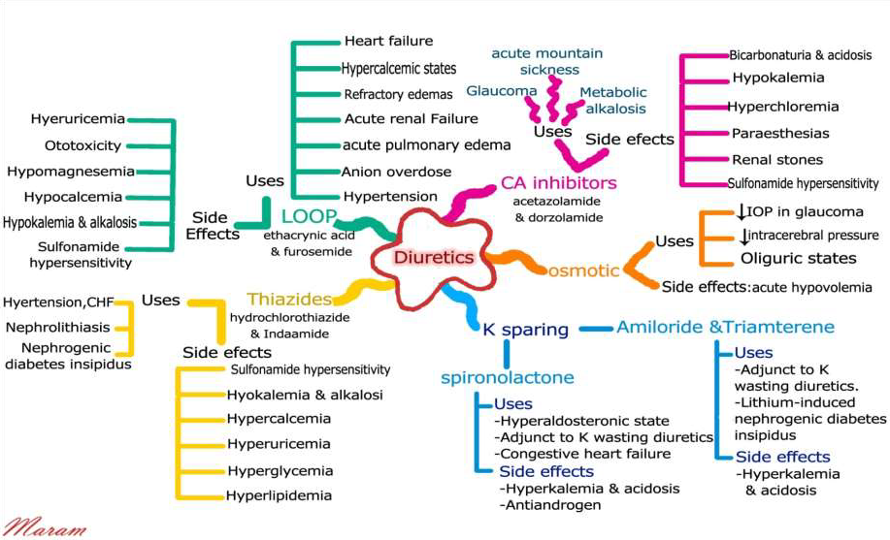
Uses and side effects of diuretics

Slide 43
Anti-diuretics
Antidiuretics essentially inhibits water excretion without affecting salt excretion.
They are more precisely called ‘anti-aquaretics’
They are drugs that reduce urine volume, particularly in diabetes insipidus (DI) which is their primary indication.
Antidiuretic drugs are:
Antidiuretic hormone (ADH; Vasopressin), Desmopressin, Lypressin, Terlipressin
Thiazide diuretics, Amiloride.
Miscellaneous: Indomethacin, Chlorpropamide, Carbamazepine.

Slide 44
Anti-diuretics

Slide 45
Anti-diuretic hormone
Also called arginine vasopressin (AVP), anti-diuretic hormone controls the permeability of the collecting tubule by regulating the insertion of preformed water channels (aquaporin-2, AQP2) into the apical membrane via a G protein-coupled, cAMP-mediated process.
In the absence of ADH, the collecting tubule (and duct) is impermeable to water, and dilute urine is produced.
ADH markedly increases water permeability, and this leads to the formation of a more concentrated final urine.
ADH also stimulates the insertion of urea transporter UT1 molecules into the apical membranes of medullary collecting tubule cells.
Urea concentration in the medulla plays an important role maintaining the high osmolarity of the medulla and in the concentration of urine.

Slide 46
Antidiuretic hormone antagonists
They inhibit the effects of ADH in the collecting tubule.
Of the three known vasopressin receptors (V_{1a} , V_{1b} , and V₂), only V₂ receptors are expressed specifically in the kidney while V₁ receptors are expressed in the vasculature and CNS,.
ADH antagonists include: lithium (seldom used because of side effects) and demeclocycline (an antimicrobial drug). Lithium and demeclocycline reduce ADH-induced cAMP by mechanisms that are not yet completely clarified.
Newer drugs are the Vaptans: Conivaptan (administered i.v, inhibits V_{1a} and V₂ receptors), tolvaptan, lixivaptan, and satavaptan (oral agents) are selectively active against the V₂ receptor.

Slide 47
Pharmacokinetics
The half-life of conivaptan and demeclocycline is 5–10 hours, while that of tolvaptan is 12–24 hours.
Therapeutic uses
Syndrome of inappropriate ADH secretion
Congestive heart failure
Side effects
Nephrogenic Diabetes Insipidus
Renal failure
Dry mouth and thirst
hypotension

