Slide 1
COURSE: GEY 202
Geological Map Interpretation and Field Mapping
Time: Wed. 1 – 3 pm 3 UNITS

Slide 2
COURSE OUTLINE
MODULE 1
Map reading and interpretation of structural features and geological history in simple geological maps.
MODULE 2
Practical recording of geological features on base maps.
MODULE 3
Drawing of geological cross sections.
MODULE 4
Introduction to field techniques and report writing.

Slide 3
INTRODUCTION:
A geological map shows the distribution of various types of bedrocks in an area.
It usually consists of a topographic map (map giving information about the form of the earth’s surface) which is shaded, or coloured to show where different rock units occur at or just below the ground surface.
Fig. 1.0 a typical geological map showing different rock units.
The lines on the map are drawn to show the boundaries between each of the rock units.

Slide 4
GEOLOGICAL MAPS
Geological maps represent the expression on the earth’s surface of the underlying geological structure.
The ability to correctly interpret the relationships displayed on a geological map relies heavily on knowledge of the basic principles of structural geology.
Geological map shows the disposition and the aerial distribution of the different rock types in a given area.
In other words, geological maps are topographical maps overprinted with different colours showing the various rock outcrops with appropriate signs and symbols indicating the dips, strikes, faults, mineral veins etc.

Slide 5
Fig. 1.1: Geological map showing different rock units.

Slide 6
USES OF GEOLOGICAL MAPS
Geological maps are used in many ways by geologists, engineers, mineral prospectors and naturalists.
1. The most obvious use of a geological map is to indicate the nature of the near-surface bedrock. This is of great importance to civil engineers who, for example, have to advise on the excavation of road cuttings or on the siting of bridges; to geographers studying the use of land and to companies exploiting minerals.
2. Geologist trains observer with the geological map which reveals vital clues about the geological history of an area.
3. Furthermore, the bands of colour on a geological map are the expression on the ground surface of layers or sheets of rock which extend and slant downwards into the crust of the earth. This provides tell-tale evidence of the structure of the layers beneath the surface.
4. Geological maps depict variation of rock units within an area. It can therefore be used to locate the occurrence of minerals to be exploited.
5. Geological maps help to estimate the position of water-bearing aquifer or oil bearing horizons and the depths of occurrence.
6. It enables geologist ascertain the geometry of a persistent horizon or bed such as a coal seam.
7. The scope of any geological investigation can be narrowed down considerably, if full use is made of the information presented on a geological map.

Slide 7
AERIAL PHOTOGRAPHS
The aerial photograph is a source of geological data. If compared, the features observed on the aerial photograph should conform to those on the field.
In metamorphic terrains where rocks are resistant and dip steeply, structures such as foliation, schistocity and fault even when covered by superficial deposits often show up on the photographs. Resistant rocks as a rule form high ground.
Aerial maps are often used to locate positions where identifiable map features are far apart.
Vegetation changes as observed on the aerial photographs can be related to the underlying rock types.
In carbonate area, shallow holes resulting from the dissolution of rocks show up clearly on aerial photographs.

Slide 8
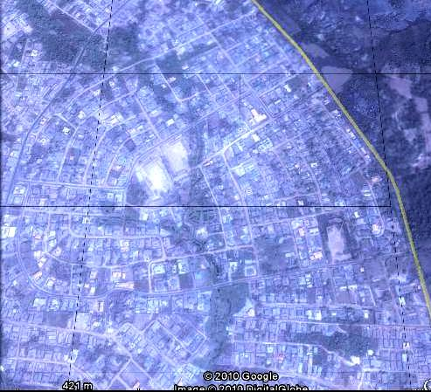
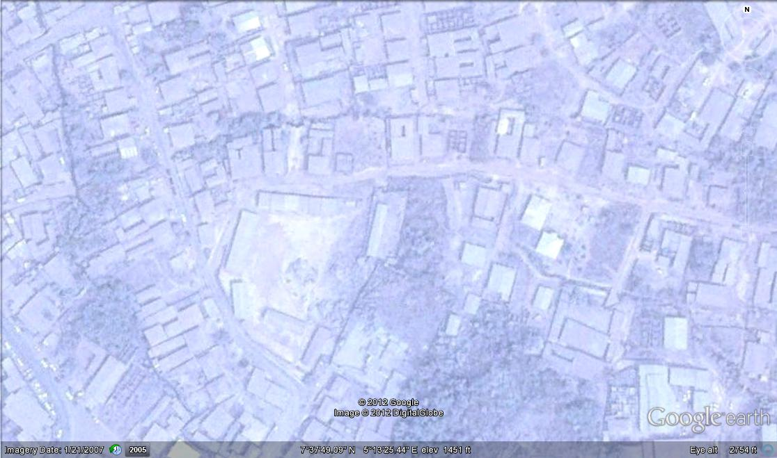
Aerial photograph of Ijapo Housing Estate, Akure, Ondo State, Nigeria. (www.googleearth.com)
Aerial photograph of parts of Ado Ekiti, Ekiti State, Nigeria. (www.googleearth.com)

Slide 9
TOPOGRAPHICAL MAPS
Topographical maps show a diversity of land forms by means of contours.
They also show different pattern of human settlement and vegetation.
Man-made features commonly depicted on topographical maps include, roads, tracks, footpaths, railways, building and field boundaries.
The commonly used scales on topographical maps are 1:50,000, 1:25,000 and 1:10,000 series.

Slide 10
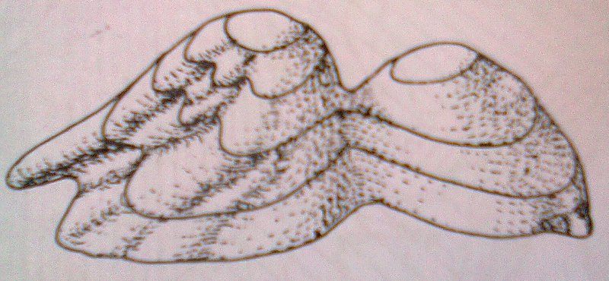
CONTOUR LINE
A contour line connects points of equal elevations above the sea level.
The reference contour line from which other lines are measured, is the datum line.
The datum line is adopted as the mean high water level by some surveyors and as the mean sea level by others.
Fig. 1.3 (a): An Island with two hills separated by a pass and with river valley.

Slide 11
Fig. 1.3(b): Contour map representing the plan view of the Island shown above.

Slide 12
DIRECTION AND SCALE
Direction: The north, or true north is the direction of the north pole. There is also the magnetic north which is the direction in which a compass needle points.
It varies from year to year. The difference betweeen the true north and the magnetic north is the magnetic variation which must be corrected for when working on the field.
The grid-north is the direction of the north-south grid lines on the map.
Direction can be shown by compass points or by angular bearings. The instrument used for measuring direction is the compass Fig.1.4(a).
There are four cardinal points on a compass namely North, South, East and West. These are used to describe direction.

Slide 13
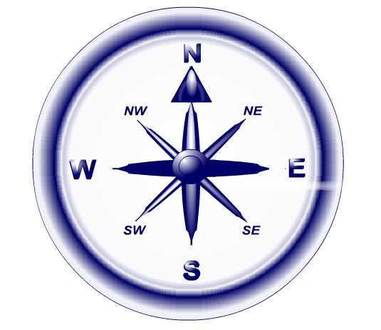
Another method of describing directions is by angular bearing which is measured in degrees on a map with a protractor.
In a map grid, the terms easting and northing are geographic Cartesian coordinates for a point. Easting refers to the eastward-measured distance (or the x-coordinate), while northing refers to the northward-measured distance (or the y-coordinate).
The pair is usually represented conventionally with easting first, northing second.

Slide 14
Field geologist should be able to make use of other means of reference such as the latitude and longitude.
All lines that run in a north-south direction and lie to the east and west of 0º longitude or Greenwich meridian are referred to as longitudes.
The 0º latitude or the Equator runs east-west.
Other lines that run east-west to the north and south of the equator and parallel to it are the parallels of latitude.
These lines are measured in degrees, minutes and seconds.
Every degree marked (º) is divided into 60 minutes. Every minute marked (‘) is divided into 60 seconds. A second is marked (‘’).

Slide 15
SCALE
Maps are usually drawn to represent portions of earth’s surface which are generally much bigger than the maps.
This is achieved by drawing the map to a scale which is used to convert distances on the map to actual distances on the earth’s surface.
Fig. 1.5 Maps showing comparison of scales.

Slide 16
There are three main ways of representing scale:
(a) Written scale: e.g 1 cm represents 25 km.
(b) Representative Fraction (R.F.) e.g. 1/25,000.00
(c) Linear scale: On all topographical maps, one scale line which may be open or divided is commonly shown. In Fig. 1.6, if distance AB is 2 cm, the scale is 2 cm equal 1 km.
Fig. 1.6: Linear Scales
Scales are also useful in calculating areas of regular or/and irregular shapes.

Slide 17
METRICATION OF MAPS
It is true that there has been conscious effort in cartography all over the world to adopt metric scales and units.
Some national surveys have long used metric scales and a metric grid while heights have been recorded in feet and areas in acres.
One way of changing from the imperial to the metric system of measurement is by photographic enlargement of the 1-inch maps with the contours re-labelled in metres.
Furthermore, the topographical maps of some countries still have their contours in feet and their scales in feet and miles.
For this reason some of the topographical maps in this course follow the imperial system, but all the geological map exercises are on metric scales.

Slide 18
CONVENTIONAL SIGNS AND SYMBOLS
It is important that all land marks and cultural features be accurately represented on a topographical map. Features may be divided broadly into:
(a) Natural and (b) Man-made types
Natural features include streams, lakes, ocean and vegetation while settlements, buildings, roads, railways, bridges and canals are some examples of man-made features.
All these features are normally included on topographical maps. The map maker has to device a suitable method of depicting all of these features adequately on a map.
Some of these signs and symbols are shown in Fig. 1.7 below. Signs and symbols which comprise pictures, letters, colours etc are some of the things used. These signs and symbols are normally printed on the margins of maps.

Slide 19
Pictures and colours are generally used to depict natural features such as vegetation and water.
The conventional signs included in this course are for Nigeria and Great Britain, scale 1:50,000.
Various types of linear structures are distinguished by different kind of signs. The dip or inclination of a stratum, for example, is shown by a little arrow pointing in the direction of inclination of the bed.
The tip of the arrow marks the exact spot where the measurement of the dip was taken.
The dip and strike are sometimes represented in other ways e.g.
In the above example, there is a line pointing in the direction of the dip of the bed with the value of the dip written in front of it, while the longer line indicates the direction of strike.

Slide 20
Fig. 1.7: Conventional signs and symbols used in geological map interpretation

Slide 21
PREPARATION OF A TOPOGRAPHICAL CROSS-SECTION
The following steps should be taken to prepare a topographic cross-section:
(a) Choose a section line, say AB (if one is not given).
(b) Choose a vertical scale and examine the contours along the section line noting the highest and the lowest values. Draw up a numbered scale of heights on a plain paper, or on a squared paper which is much easier to use for this purpose.
(c) Place a strip of paper along the section line and mark off all the points at which the section line cuts the contour line. Write down the height of each contour line. Move the stripe of paper to the base line of the scale of heights and project each point upwards to the corresponding height on the scale.
(d) Join all the points into a smooth curve. The curve produced is a topographical profile which shows the intersection of the land surface with a vertical plane.

Slide 22
INTERVISIBILITY
Two points on a map are mutually visible if no high ground, higher than either one of the two points, lies between them.
They are not mutually visible if higher ground or a convex slope exists between them.
In Fig. 1.8, point A and B are mutually visible since point C and other points between them are of lower altitude.

Slide 23
Fig. 1.8(a): A contour map

Slide 25
FAULTS

Slide 26
Introduction
When stresses in the earth crust act on soft plastic rocks, they bend or fold the rocks. But when stresses act on hard, brittle rocks, they fracture or break the rocks.
A fault is a type of fracture along which there has been relative movement displacing the wall rocks on either side of the fault.
The intersection of a fault with the earth’s surface is known as the fault line or fault trace or fault outcrop.
Movement of fracture can either be vertical or horizontal or a combination of these.
The surface on which movement has taken place is the fault plane. A fault is not always represented by a plane.
It may in fact be a zone of crushed or brecciated rock. While some faults are only a few centimeters long, others may be traceable for hundreds of kilometers.
Tensional, compressional and torsional forces operate within the earth’s crust to form faults.

Slide 27
The outcrop of a fault plane can be straight or sinuous depending on its dip and the relief of the area.
The dip of a fault is the angle between the Fault plane and the horizontal.
The rocks lying on either side of fault plane define the walls of the fault blocks.
The rock mass lying above the incline fault plane is the hanging wall while the mass lying below is the foot wall.
The side of the fault where movement has been apparently downward is the downthrow side while the other side where the apparent movement has been upward is the upthrow side.
The throw of a fault is the vertical displacement of the ends of a faulted bed.
The heave of a fault is the horizontal movement of the two ends of a faulted bed.
The throw is the vertical component of the dip separation in such a section while the heave is the horizontal component of the separation.

Slide 28
Fault Geometry

Slide 29
Movement along fault planes
The movement along fault planes can be translational or rotational.
(a) Rotational movements are those in which once parallel lines are no longer parallel faulting.
The center of rotation is a point in the fault plane and the axis of rotation is a line that is perpendicular to the fault plane at this point.
The center of rotation may shift with time. It must be stated that all faults have a certain amount of rotational movement.
(b) In translated movement, rotational movement is negligible.
All sides of the block which were parallel to one another before the faulting are still parallel after the dislocation.

Slide 30
CLASSIFICATION
Broadly, faults can be classified according to their geometry or genesis.
A. GENETIC CLASSIFICATION
(i) A normal Fault: is a fault along which the hanging wall has moved relatively downwards when referred to some datum. Movement along normal faults can take one of the following forms:
Footwall is stationary and the hanging wall moves down
Hanging wall remains stationary and the footwall moves up.
Both walls move up but the footwall more than the hanging wall.
Both walls move down, but the hanging wall moves farther than the footwall.

Slide 31
(ii) Reverse Fault: If the footwall has an apparent downward movement the fault is a reverse fault. Generally the dip angle is less than 45º. But this is not always true.
(iii) Strike-slip Fault: A strike-slip fault has its net slip along the fault strike. If the slip direction is parallel to the strike of the fault plane, the fault is known as a strike slip or tear or wrench or transform or transcurrent fault.
An observer standing on one side of the fault facing it, will discover that the block on the other side has moved. If it has moved to his right, the fault is referred to as right lateral (or dextral) strike slip fault.
If the block has moved to the left, the fault is a left lateral (or sinistral) strike slip fault.

Slide 32
Strike-slip Fault

Slide 33
(iv) Step fault: Normal faulting may be accompanied by the tilting of blocks resulting in tilted fault blocks. Several parallel faults may develop with their downthrow sides systematically on the sides of the faults. The beds affected are thrown down in a succession of steps
Step fault

Slide 34
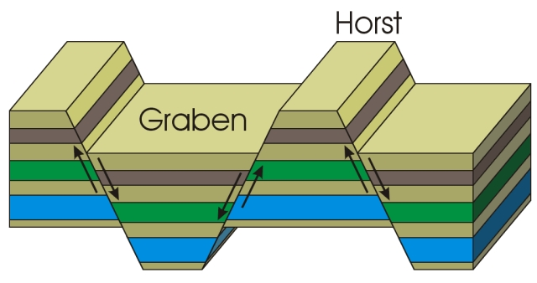
(v) Graben or Rift Valley: A fault block may be bounded on both sides by normal faults along which the net slip is more or less equal. There is therefore little or no tilting of the block.
A downthrow block which is long compared with its width and lowered between the faults is a rift valley or graben. When the block is raised, the structure is known as a Horst. The Black Hills in central Arizona constitute an example of the horst. The famous East African Rift valley and the Benue Valley in Nigeria are rift valleys.
Graben
Horst

Slide 35
(vi) Thrust fault: A thrust fault or thrust is a fault with a dip less than 45º and in which the hanging wall has moved up relative to the footwall.
An overthrust is a low angle fault plane (dip usually less than 10º) along which movement has taken place, the strata above the fault plane having been carried over great distances in a near horizontal direction.
High-angle thrust planes
Low-angle thrust plane

Slide 36
(B) GEOMETRICAL CLASSIFICATION
The geometrical classification of faults may be based on the following:
(a) Altitude of fault relative to the altitude of adjacent beds:
(i) A strike fault is one that strikes essentially parallel to the strike of the adjacent rocks.
(ii) A dip fault strike essentially parallel to the direction of the dip of adjacent beds. An oblique fault strike obliquely to the strike of the adjacent rocks.
(iii) A longitudinal fault strike parallel to the regional structure while a transverse fault strikes perpendicularly or diagonally to the strike of the regional structure.
(b) Direction of movement of the fault plane:
A dip-slip fault is one in which the net slip is up or down the dip of the fault. An oblique slip fault is one in which the net slip is diagonally up or down the fault plane.

Slide 37
EFFECT OF FAULTING ON OUTCROPS
When a normal fault affects horizontal strata, the fault brings rocks of different lithology or fossil content abruptly against each other.
When inclined strata are affected by reverse faults, the strata are concealed except when the dip of the fault planes is in the same direction as that of the beds and at a higher angle when repetition occurs. A rapid succession of steeply dipping reverse faults may lead to the development of imbricate structure.
In a faulted assymetrical fold, the outcrops of the two limbs will be displaced but the axial plane will not. If erosion follows the faulting of an anticline, the outcrops of the limbs tend to be more widely separated on the upthrow side.
If faulting follows erosion, there is a more pronounced shift of the beds of the less steeply dipping limb.

Slide 38
In an asymmetrical fold, the outcrops of the limb with the lower dip are shifted by greater amount and the outcrop of the axial plane will be moved laterally.
The wrench fault displaces the outcrops of both limbs of a symmetrical or asymmetrical fold by an equal amount and laterally.
If a fold is affected by a strike fault, the result will be either a repetition of the outcrops or a suppression of the outcrops as part of the succession.

Slide 39
Nappe:
When a fold is overturned beyond the vertical to the extent that the strata are nearly horizontal over wide area, it is known as a recumbent fold.
In one of the limbs, the beds are arranged in the correct order while the strata are inverted in the correct limb.
The axial plane is almost horizontal although it may curve. The intense lateral stresses responsible for the formation of recumbent folds may produce a low angle reverse fault or overthrust.
The thrust recumbent fold is a nappe and the thrust strata are usually carried over from their base.
Fault Rocks: Most faults are accompanied by the fracturing, crushing and granulation of the wall rocks on either side of the fault zone.
These rocks are referred to as cataclastic rocks which include fault breccia, fault gouges and mylonites. Mylonites are believed to form under conditions of high confining pressure.
Metamorphic processes often result in the formation of augen gneisses and phyllonites.

