Slide 1
ADMINISTRATION OF OXYGEN
Dr C. B. Bello

Slide 2
INTRODUCTION
Oxygen therapy is the medical administration of supplemental oxygen to client.
It is used to correct anoxia, a condition when the body is deficient of oxygen
.Oxygen is administered to treat acute & chronic respiratory problems
A supplemental supply of O2 can be done to increase the amount of oxygen the patient uses for inspiration.

Slide 3
INTRODUCTION CONTD
Oxygen therapy is usually initiated by the physician
Nurses should be able to make pertinent observations and carry out safety precautions.
Oxygen therapy involves inhalation of oxygen through various devices.
Oxygen therapy is intimidating and frightens both patient & family members
The nurse must provide adequate explanations to reduce or prevent anxiety.

Slide 4
INDICATIONS FOR OXYGEN THERAPY
Oxygen benefits clients with diminished respiratory capacity as in the following cases
Substantial loss of lung tissue due to tumors or surgery or fibrosis
Cardiac failure, Shock
Intraoperative care when client is on general anesthesia
Asphyxia, Delivery stress, Dying patient

Slide 5
INDICATIONS FOR OXYGEN THERAPY
High altitude where O2 content of air is low
Acute & chronic respiratory conditions (Chronic bronchitis, Pneumonia, Pulmonary edema, Asthma etc)
Severe hemorrhage
Carbon monoxide poisoning
Severe anemia
Terminally ill patients
atelectasis

Slide 6
SIGNS OF HYPOXIA
Cyanosis
Difficulty in breathing/labored respiration
Restlessness
Using other muscles (such as facial, neck and abdominal) in respiration.

Slide 7
OXYGEN SUPPLY
Oxygen is supplied in two ways in health care facility:
Portable system (cylinders and tanks with carriers)
Wall outlets
Oxygen delivered from a cylinder or wall-outlet system is dry
Dry gases dehydrate the respiratory mucous membranes
Humidifying devices that add water vapor to inspired air are thus essential adjunct of oxygen therapy particularly for liter flows over 4L per minute

Slide 8
OXYGEN SUPPLY (CONTD)
These devices provide 20% to 40% humidity.
Oxygen is not completely harmless to the client like any medication
Clients can receive an inadequate amount or an excessive amount of oxygen and both can lead to a decline in the clients’ condition
An inadequate amount of oxygen (hypoxia) will lead to cell death, and if left untreated can ultimately lead to death.

Slide 9
OXYGEN DELIVERY SYSTEM CONTD
Oxygen flow is regulated by a valve while oxygen flows in liters per minute
To release oxygen safely at the desired rate, a regulator is used
The main gauge shows the pressure of the amount of oxygen in the tank
The flowmeter shows the number of liters of oxygen flowing to the patient

Slide 10
OXYGEN DELIVERY SYSTEMS
The choice of system depends on the client’s oxygen needs, comfort, and developmental considerations.
Low-flow systems deliver oxygen via small-bore tubing.
Low flow administration devices include:
Nasal cannula
Face masks
Oxygen tents
Transtracheal catheters

Slide 11
OXYGEN DELIVERY SYSTEMS (CONTD)
High-flow systems supply all the oxygen required during ventilation in precise amounts regardless of the client’s respirations
The high-flow delivery system is the Venturi mask with large-bore tubing.

Slide 12
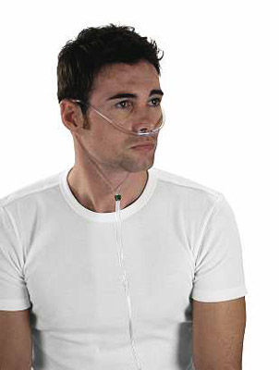
NASAL CANNULA
Most common and inexpensive device used to administer oxygen
Easy to apply and does not interfere with the client’s ability to eat or talk
Relatively comfortable , permits some freedom of movement
Well tolerated
Limitation include inability to deliver higher concentration of oxygen (24%- 45% at flow rate of 2-6L/min) and it can be drying and irritating to mucous membrane

Slide 13
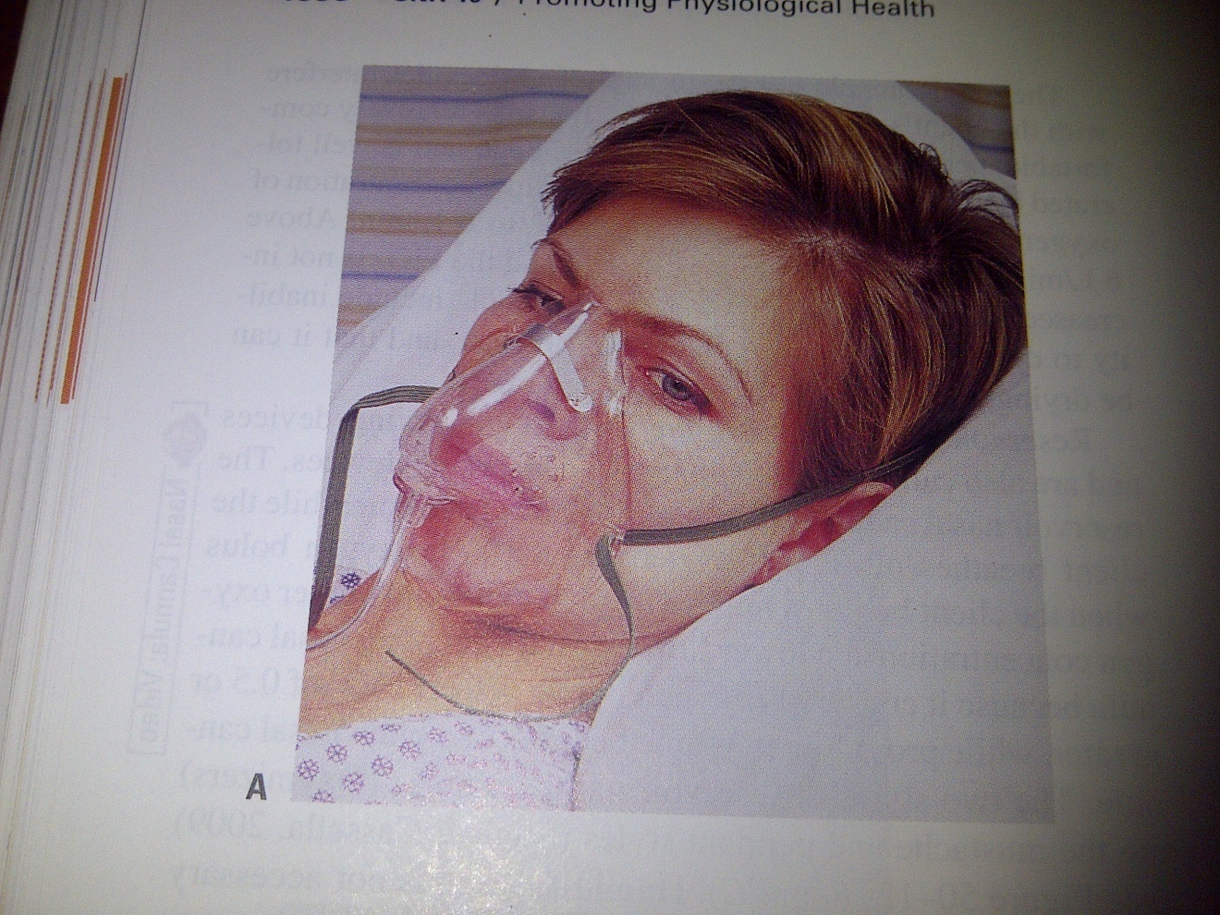
FACE MASK
Face masks that covers the client’s nose and mouth may be used for oxygen inhalation
Exhalation ports on the sides of the mask allow exhaled carbon dioxide to escape

Slide 14
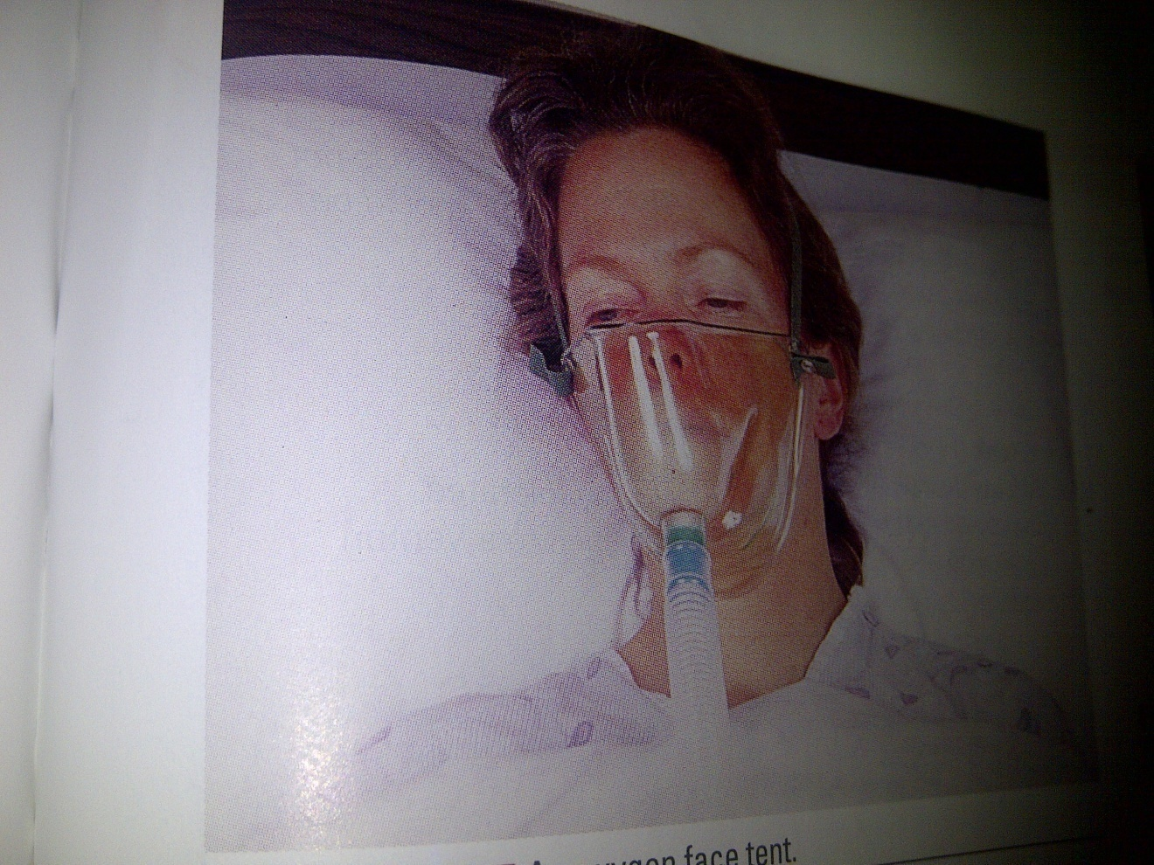
Oxygen Face Tent
Face tents can replace oxygen masks when masks are poorly tolerated by clients.
Face tents provide varying concentrations of oxygen, e.g. 30% to 50% concentration of oxygen at 4 to 8 L/min.
Frequently inspect the client’s facial skin for dampness or chafing, and dry and treat as needed because client’s facial skin must be kept dry

Slide 15
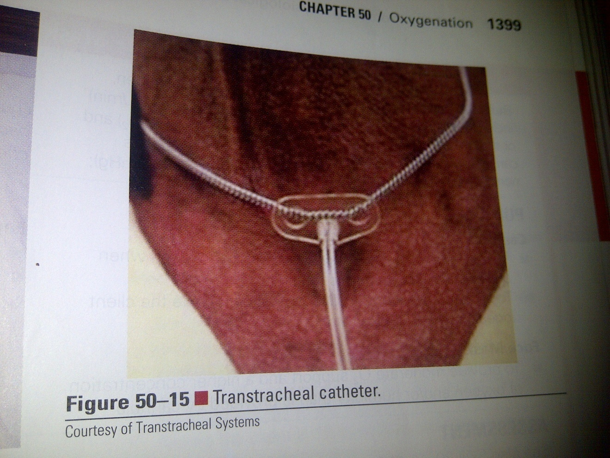
TRACHEOSTOMY MASK OR TRANSTRACHEAL CATHETER
Placed through a surgically created tract in the lower neck directly into the tracheal
Once the tract has healed, the client removes and cleans the catheter 2 or 4 times per day

Slide 16
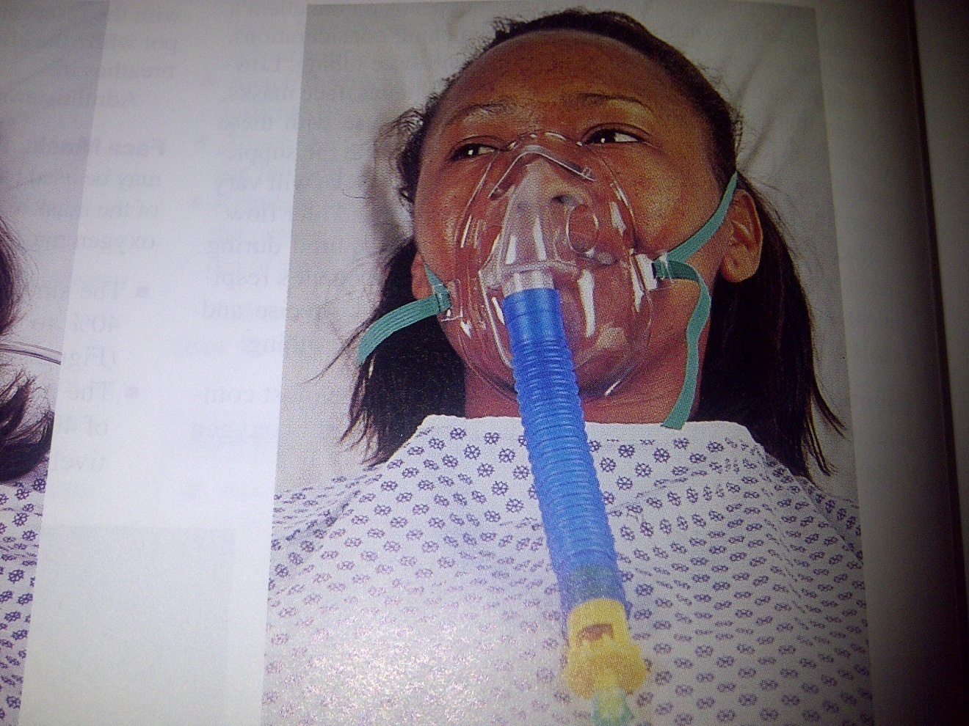
VENTURI MASK
Delivers oxygen concentrations varying from 24%-40% or 50% at liter flows of 4-10L/min

Slide 17
MEASURES FOR DETERMINING THE EFFECTIVENESS OF OXYGEN THERAPY
Determining the effectiveness of oxygen therapy involves several measures which include:
Checking vital signs and
Checking peripheral blood oxygen saturation (pulse oximetry)

Slide 18
COMPLICATIONS OF OXYGEN THERAPY
OXYGEN TOXICITY
May result from concentration of O2 (above 50%)
Or long hours of O2 therapy (above 24hrs-48hrs)
Especially in patients in poor lung condition.
Signs & symptoms are:
Non productive cough, substernal pain, nasal stuffiness,
Nausea, vomiting, fatigue, headache, sore throat, hypoventilation

Slide 19
SIGNS & SYMPTOMS OF OXYGEN TOXICITY
The skin becomes pinkish in colour
Drowsiness & difficulty in arousing
Shallow respiration
Deep and slow pulse
In severe cases- twitching & convulsion
Otitic barotrauma & aural atelectasis especially if there is blockage of the Eustachian tube

Slide 20
COMPLICATIONS CONTD
OXYGEN-INDUCED HYPOVENTILATION
May occur in pts with chronic pulmonary disease
Chronic hypoxemia
Chronic hypercarbia
Patients with COPD rely on low levels of arterial oxygen
High levels of O2 may decrease respiration
The nurse should always monitor client’s respiratory rate & pattern

Slide 21
COMPLICATIONS CONTD
FIRE OUTBREAK
Oxygen is highly inflammable and can cause a fire outbreak.
Nursing actions are as follows:
Post “NO SMOKING” or “OXYGEN IN USE” sign to alert others of fire hazard
Know where the closest fire extinguisher is located
Educate the client and family about the fire hazard of smoking or naked flame

Slide 22
NURSING ACTIONS CONTD
Have the client wear a cotton dress and use cotton linens
Avoid synthetic or wool fabrics which can generate static electricity
Ensure there are no open wires close by
Avoid friction with metals or steel equipment
Do not bring open fire around the patient
Avoid using volatile flammable materials (alcohol, acetone) near the patient.

Slide 23
NURSING ACTIONS
Check that electrical equipment (electric bell cords, radios, razors, suctioning machine) in the room are in good working condition & not able to emit sparks
Avoid the use of oil on patients skin or as lubricants

Slide 24
CONCLUSION
Most people in good health give little thought to their respiratory function.
Changing position frequently, ambulating and exercising usually maintain adequate ventilation and gas exchange.
Hence the need for clients’ teaching on promotion of healthy breathing.

Slide 25
Thanks for listening

