Slide 1
Textures and Structures of Sediment and Sedimentary Rocks

Slide 2
Sediment Texture
Sediment texture refers to the shape, size and three-dimensional arrangement of the particles that make up sediment or a sedimentary rock.
Textures can be clastic or crystalline, it is clastic when they are composed of grains from pre-existing rocks and crystalline, when the crystals grew from a fluid producing an interlocking mosaic of crystals.
Textures are primary or secondary, it is primary where the grains possess their arrangement that existed after they came to rest (or after precipitation in the case of crystals).
In sedimentary rocks, however, textures are commonly secondary, because they have been altered in some way from their original condition.
The most common effect is compaction, where the weight of overlying sediments causes the component grains to rearrange themselves or even become fractured.

Slide 3
Sedimentary rocks exhibit differences in texture:
Definition of texture:
“the size and shape of the particle that make up the rock.”
Grain angularity
Sphericity
Size
Sorting
Which reflect:
Derivation (original rocks)
Climate (during formation)
Post-depositional factors

Slide 4
Texture
T O S S S
Texture =
Orientation (random/lined up),
Size (measurements, all same?),
Shape (rounded/angular),
Sorting (well←→poor).
Sedimentary rocks show great differences in their texture
This relates back to their mode of formation

Slide 5
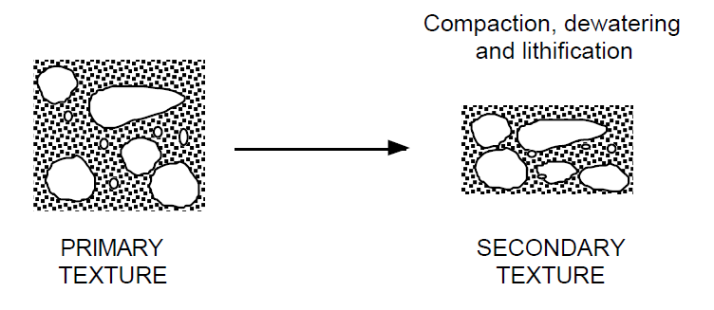

Slide 6
Grain Size
Particles are generally measured by their maximum grain diameter.
The most common classification is use is the Wentworth scale.
In this classification, terms such as pebble, sand and gravel have well-defined limits.
Many statistical methods can be applied to particle size distributions (e.g., median, mean, skewness, kurtosis, etc.) to try to characterize the depositional processes that produced them (e.g., wind, swash, etc.), and even to distinguish depositional environments.
The Wentworth scale is a geometric scale--adjacent orders differ be a factor of two (either doubling or halving).
A common practice in studying grain size distribution is to use the phi scale. As well as mm, the boundaries between each class can be expressed by the negative logarithm of this dimension to the base 2: (phi) Φ = -log2 d
where d is particle size in mm. Phi values are dimensionless, but because they are based on mm, the scale is metric.

Slide 7
Grain-Size Classification for Clastic Sediments
Name
Millimeters
Micrometers
4,096
Boulder
256
Cobble
64
Pebble
4
Granule
2
Very Coarse Sand
1
Coarse Sand
0.5
500
Medium Sand
0.25
250
Fine Sand
0.125
125
Very Fine Sand
62
0.062
Coarse Silt
0.031
31
Medium Silt
0.016
16
Fine Silt
0.008
8
Very Fine Silt
0.004
4
Clay
(modified from Blatt, 1982)

Slide 9
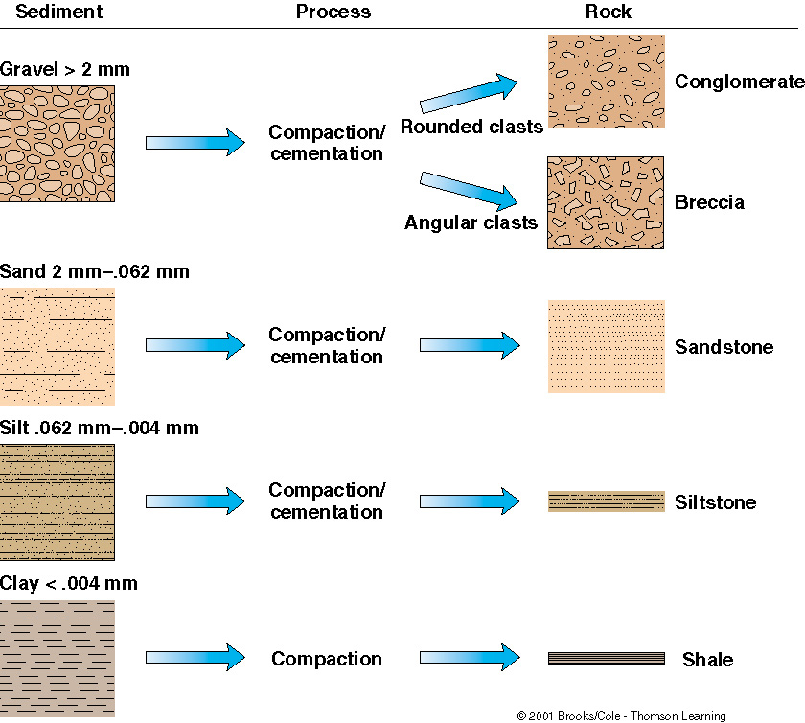
This figure shows how clastic sediment of various sizes will, after compaction and cementation, form different types of detrital sedimentary rocks.
The process of sediment turning into rock is called lithification.

Slide 10
Shape
Particle shape is difficult to quantify or describe.
Shape is commonly described with reference to three axes at 90° to each other that can theoretically be placed inside any particle.
The longest axis is a, shortest c and the intermediate is b.
In a sphere or cube, those axes intersect at the centre and have equal length.
By comparing the ratios of the axes, it is possible to describe four basic "shapes" of particles: oblate, equant, bladed and prolate.
Shape is some cases reflects erosional processes (how the rock broke up with weathering and transportation), but may also reflect structures and fabrics present in the parent rock.
Shale, for example, will commonly produce flat particles, whereas quartzite (metamorphosed sandstone) may be more equant.

Slide 11
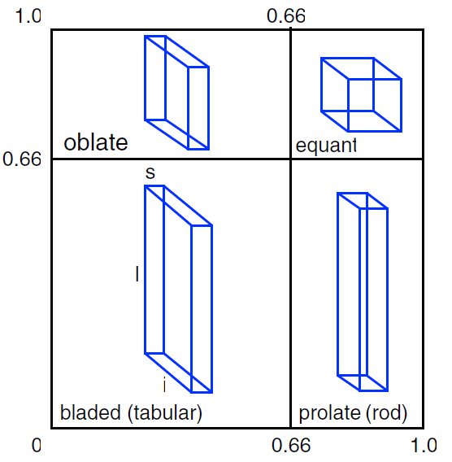
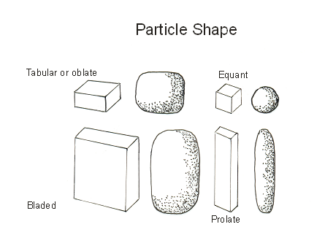
The four main classes of grain shape, which are based upon the ratios of the long, intermediate and short diameters of any particle (after Zingg 1935).
Angular – little evidence of wear, sharp corners, little transport
Increased sphericity - more spherical, rounded, corners smoothed off to broad curves, great amount of transport

Slide 12
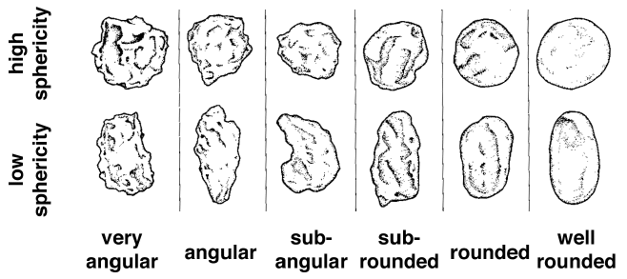
Roundness
Roundness (or angularity) refers to how smooth or sharp are the edges of particles.
It is usually measured with reference to a comparative chart (The commonest is: Powers, M.C., 1953, A new roundness scale for sedimentary particles. Journal of Sedimentary Petrology, 23: 117-119)
Roundness and sphericity are not the same thing.
A grain with highly irregular shape can be well rounded; a cube has high sphericity but very low roundness..

Slide 13
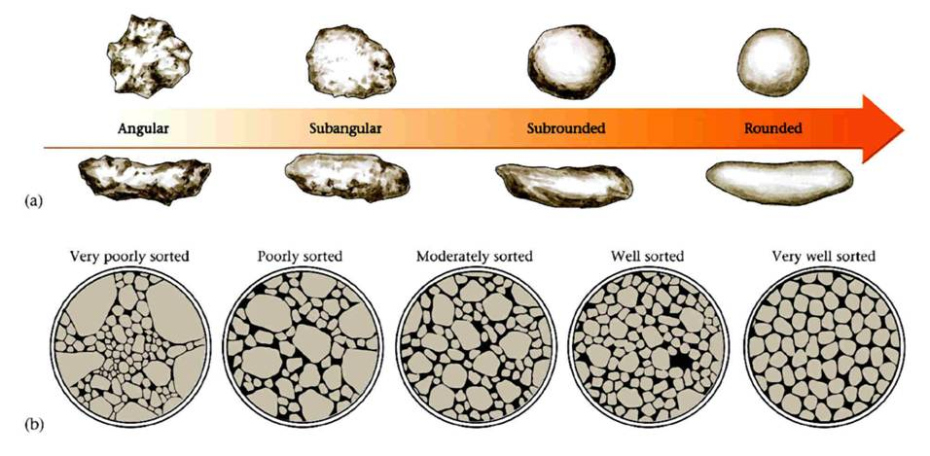
Roundness and Sphericity

Slide 14
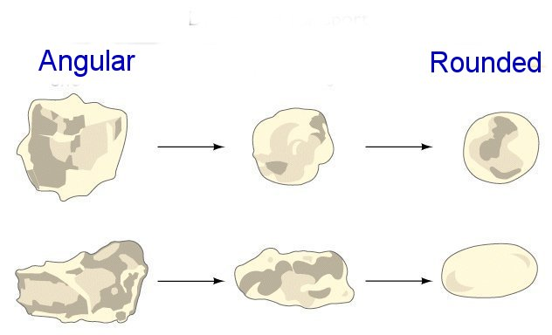
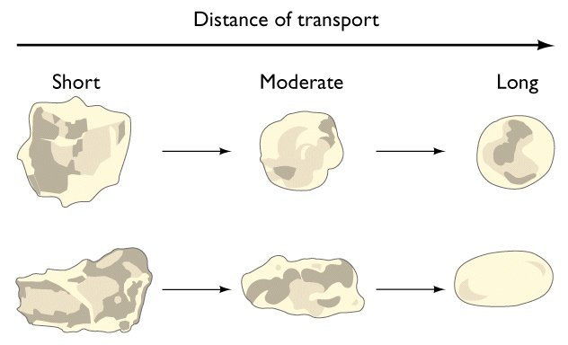
Increasing Roundness=increasing maturity

Slide 15
Maturity
Maturity is a function of sediment transport
Textural maturity refers to:
The degree of roundness of the grains
The amount of sorting of the grain sizes
Texturally mature sandstones have well-rounded and well-sorted grains, immature if not
Mineralogical maturity refers to the percentage of quartz grains
Feldspars break down with transport
Quartz grains more resistant
Mineralogically mature sandstones have mostly quartz grains
Arkose is mineralogically immature

Slide 16
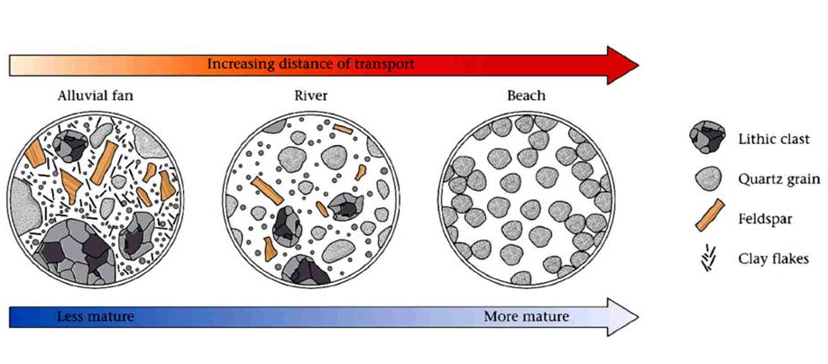
Maturity of Sediments

Slide 17
Sorting
Sorting: increases with length of transportation history (weaker minerals broken down).
Well sorted = particles nearly all the same size
Current strength constant and for long periods of time
Poorly sorted = particles of a great mix of sizes
Current strength suddenly drops and material is dumped
Sorting of the sediments also suggest the mode of deposition and transportation.
Long distance transport= well-rounded and well-sorted sediments,
Short distance transport = poorly sorted angular grains.
Also helps in knowing the energy conditions of the river.

Slide 18
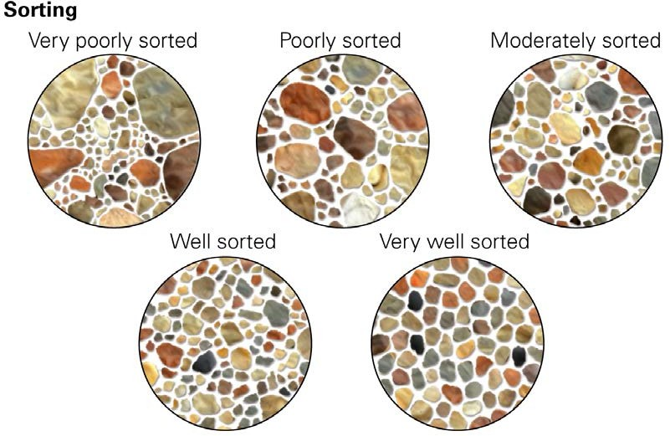
Sorting

Slide 19
Grain shape
Defined by ratio of dimensions of the fragment
Length, breadth, thickness (a, b, c axes)
Zingg classified shape into tabular, equant, blade and rod
Some unusual: DREIKANTER/VENTIFACT – wedge shaped (wind transport, desert)

Slide 20
Porosity/Permeability
Obviously sorting links well to poroperm
Well sorted, rounded, medium grain size has good pore spaces and will allow water to fall through quickly
Poorly sorted, angular sediments have small pore spaces and trap water reducing permeability

