Slide 1
GEY 314
SEDIMENTOLOGY
Tuesday 7 – 9 pm

Slide 2
COURSE OUTLINE:
Origin of Sediments
Sedimentary Rocks
  Sedimentary Processes:
    Physical
    Chemical
    Biological
Depositional Environments
Statistical study of Texture
Structure and Composition of Sedimentary rocks
Description of Sedimentary rocks
Sedimentary Structures
Analysis of Paleo-current data.

Slide 3
SEDIMENTOLOGY
Sedimentology encompasses the study of modern sediments such as sand, mud (silt), and clay, and the processes that result in their deposition.
Sedimentologists apply the understanding of modern processes to interpret geologic history through observations of sedimentary rocks and sedimentary structures.
Sedimentary rocks cover most of the Earth’s surface, keep record of the Earth's history, and harbour fossil record.
Sedimentology is closely linked to stratigraphy, the study of the physical and temporal relationships between rock layers or strata.
The premise that the processes affecting the earth today are the same as in the past is the basis for determining how sedimentary features in the rock record were formed.
By comparing similar features today to features in the rock record—for example, by comparing modern sand dunes to dunes preserved in ancient aeolian sandstones—geologists reconstruct past environments.

Slide 4
What is Sediment?
Sediment is a solid material that is moved and deposited in a new location. Sediment can consist of rocks and minerals, as well as the remains of plants and animals.
It can be as small as a grain of sand or as large as a boulder. Sediment moves from one place to another through the process of erosion.
Erosion is the removal and transportation of rock or soil. Erosion can move sediment through water, ice, or wind.
Water can wash sediment, such as gravel or pebbles, down from a creek, into a river, and eventually to that river's delta.
Deltas, river banks, and the bottom of waterfalls are common areas where sediment accumulates.
Ice can freeze sediment and then deposit it elsewhere as the ice carves its way through the landscape or melts. Sediment created and deposited by glaciers is called moraine.

Slide 5
What is Sediment? (Cont’)
Wind can move dirt across a plain in dust storms or sandstorms. Sand dunes are made of rocky sediment worn down by wind and collision with other sand particles.
Sediment is important because it often enriches the soil with nutrients. Areas rich in sediments are often also rich in biodiversity.
Sedimentary soil is usually better for farming. Deltas and river banks, where much sediment is deposited, are often the most fertile agricultural areas in a region.
For thousands of years, the Nile River flooded yearly and brought with it 4 million metric tons (4.4 million short tons) of nutrient-rich sediment. The banks of the Nile are still Egypt's richest agricultural land.

Slide 6
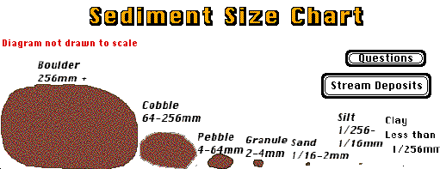
Sediment is defined by the size of the particles that make up the sediment.
Sedimentary rocks are formed in three ways from these different sized sediments.

Slide 7
Sedimentary rocks
Sedimentary rocks are types of rock that are formed by the accumulation or deposition of small particles and subsequent cementation of mineral or organic particles on the floor of oceans or other bodies of water at the Earth's surface.
Sedimentation is the collective name for processes that cause these particles to settle in place.
Before being deposited, the geological detritus was formed by weathering and erosion from the source area, and then transported to the place of deposition by water, wind, ice, mass movement or glaciers, which are called agents of denudation.
Biological detritus was formed by bodies and parts (mainly shells) of dead aquatic organisms, as well as their fecal mass, suspended in water and slowly piling up on the floor of water bodies (marine snow).
Sedimentation may also occur as dissolved minerals precipitate from water solution.
The sedimentary rock cover of the continents of the Earth's crust is extensive (73% of the Earth's current land surface), but the total contribution of sedimentary rocks is estimated to be only 8% of the total volume of the crust.

Slide 8
Sedimentary rocks (Cont’)
Sedimentary rocks are only a thin veneer over a crust consisting mainly of igneous and metamorphic rocks.
Sedimentary rocks are deposited in layers as strata, forming a structure called bedding.
The study of sedimentary rocks and rock strata provides information about the subsurface that is useful for civil engineering, for example in the construction of roads, houses, tunnels, canals or other structures.
Sedimentary rocks are also important sources of natural resources like coal, fossil fuels, drinking water or ores.
The study of the sequence of sedimentary rock strata is the main source for an understanding of the Earth's history, including, palaeogeography, paleoclimatology and the history of life.
The scientific discipline that studies the properties and origin of sedimentary rocks is called sedimentology.
Sedimentology is part of both geology and physical geography and overlaps partly with other disciplines in the Earth sciences, such as pedology (soil science), geomorphology, geochemistry and structural geology.
Sedimentary rocks have also been found on Mars.

Slide 9
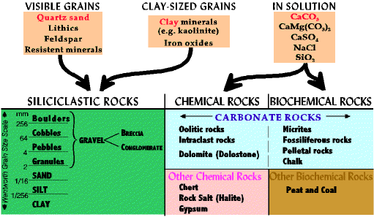
Sedimentary Rocks
Sedimentary rocks are those rocks which form at or near the earth's surface primarily through:
  Deposition of weathered silicate material by water, wind, or ice (detrital, clastic, terrigenous)
  Direct inorganic chemical precipitation from water
  Precipitation by organic processes

Slide 10
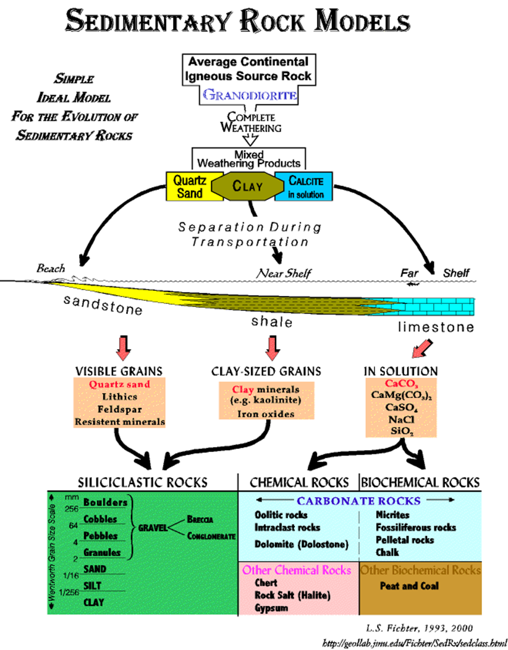
Evolution of Sedimentary Rocks

Slide 11
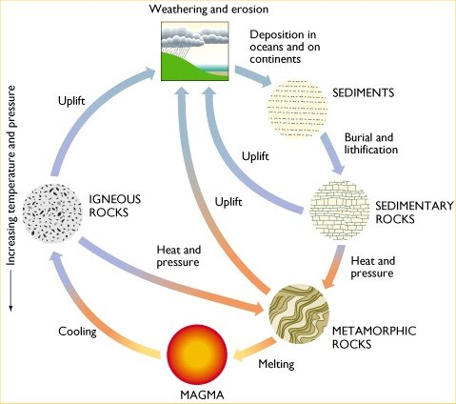
THE ROCK CYCLE

Slide 12
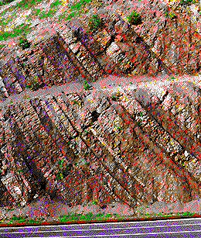
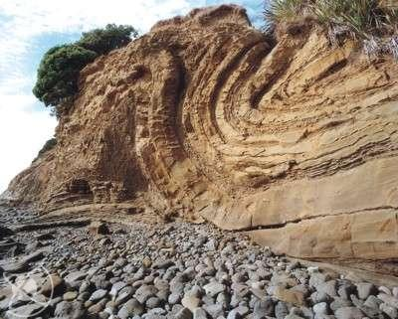
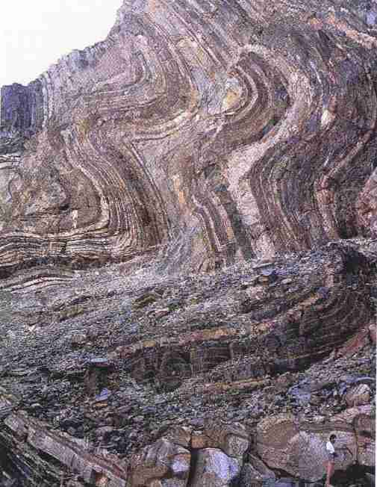
  A sedimentary rock is a layered rock that is formed from the COMPACTION, CEMENTATION, and the RE-CRYSTALLISATION of sediments.
  The photos above show layers of sedimentary rocks that were deposited in flat horizontal layers. These layers were then uplifted and bent by mountain building.
Notes:
Middle photo: mudstone sandstone, East Coast, Whangaparoa

Slide 13
COMPACTION is the squeezing together of layers of sediment due to the great weight of overlying layers of rock.
This squeezing of the layer results in reduction in thickness of the original layer. When the layers are reduced in thickness, the pore spaces around the sediments are also reduced, which leads to a tighter packing of the layers.
CEMENTATION is the changing of sediment into rock by filling spaces around the sediments with chemical precipitates of minerals. Binding the sediments, and forming solid rock.
Calcite and silica are common minerals that cement the sediments together.
RE-CRYSTALLISATION is the formation of new mineral grains that are larger than the original grains.
As the sediments re-crystallise they arrange themselves in a series of interlocking crystals that connect the other grains together into a solid rock.

Slide 14
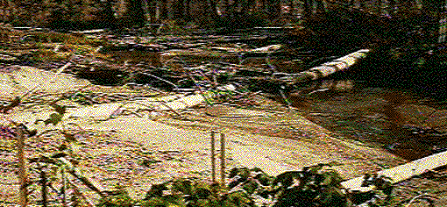
Sedimentary rocks form a thin layer of rock over 75 per cent of the Earth's surface.
They are the site of very important resources such as ground water, coal, oil, and soil.
Shale, sandstone, and limestone are the most common types of sedimentary rocks.
They are formed by the most common mineral that is found on or near the surface of the Earth.
The mineral that forms these sedimentary rocks is feldspar.
Running water, such as the mountain stream above, sorts and transports more sediment than any other agent of deposition.

Slide 15
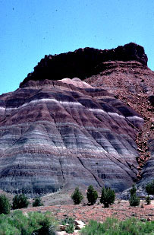
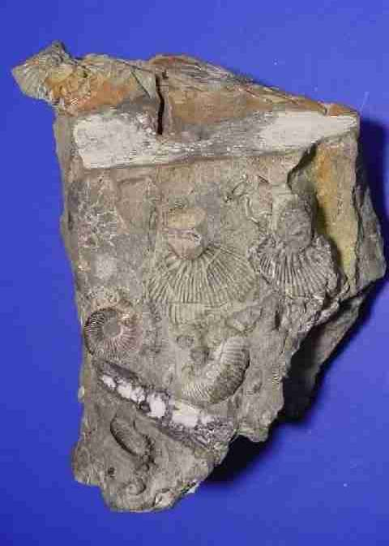
STRATA & FOSSILS
The rock layers are called STRATA or BEDS and can be seen on eroded cliff faces, river valleys, and canyons, where earthquakes have uplifted the land.
These strata often contain FOSSILS formed from the hard skeletons or shells of creatures that lived during that time.
If the sediments are mainly plant material, the result is PEAT or COAL.
Notes:
Photo bottom: fossiliferous sandstone

Slide 16
SEDIMENTARY ROCKS
There are two major groupings of sedimentary rocks:
Clastic sedimentary rocks
e.g. conglomerate, shale, sandstone, siltstone, mudstone, and greywacke.
Non-clastic sedimentary rocks e.g. limestone, chert, shale.

Slide 17
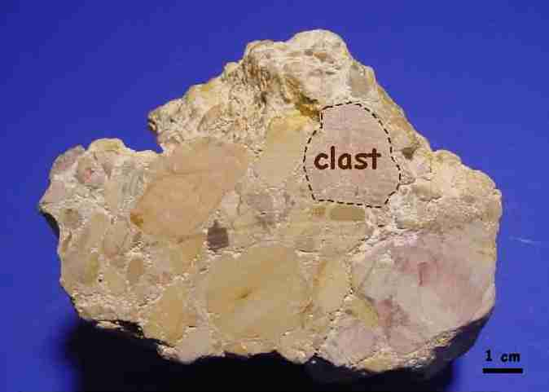
CLASTIC SEDIMENTARY ROCK
The fragments of pre-existing rocks or minerals that make up a sedimentary rock are called CLASTS.
Sedimentary rocks made up of clasts are called CLASTIC (clastic indicates that particles have been broken and transported).
These particles and grains become solid rock by the processes of compaction or cementation of sediments.
Clastic sedimentary rocks are primarily classified on the basis of sizes of their clasts.
Notes:
Photo: conglomerate rock showing rounded pebble (clast) cemented together with others

Slide 18
NON-CLASTIC SEDIMENTARY ROCK
NON-CLASTIC sedimentary rocks form from the precipitation of minerals from ocean water or from the breakdown of the shells and bones of sea creatures.
Precipitation is the separation of a solid from a solution.
Sea animals such as coral produce calcium carbonate solutions that harden to form rock.
As the chemicals, that comes from the mineral or biological precipitation, mix with sediments on the floor of the ocean or lake they crystallize and grow in the spaces around the sediment.
When these crystals grow large enough to fill the spaces they harden and form a solid rock.

Slide 19
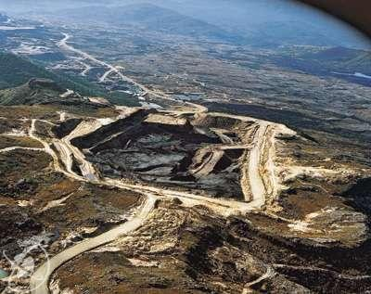
ORGANIC SEDIMENTARY ROCK
Organic sedimentary rocks form from the build up and decay of plant and animal material.
This usually forms in swamp regions in which there is an abundant supply of growing vegetation and low amounts of oxygen.
The vegetation builds so quickly that new layers of vegetation bury the dead and decaying material very quickly.
The bacteria that decay the vegetation need oxygen to survive. Because these decaying layers are buried so fast the bacteria use up the oxygen that
is available and can not finish the
decomposition of the vegetation.
The overlying layers become so heavy
that they squeeze out the water and
other compounds that aid in decay.
Notes:
Photo: Coalfield, Buller, West Coast NZ

Slide 20
COMMON EXAMPLES OF SEDIMENTARY ROCKS
Common examples of sedimentary rocks include:
  Coal
  Shale
  Sandstone
  Mudstone
  Limestone
  Conglomerate
  Etc.

Slide 21
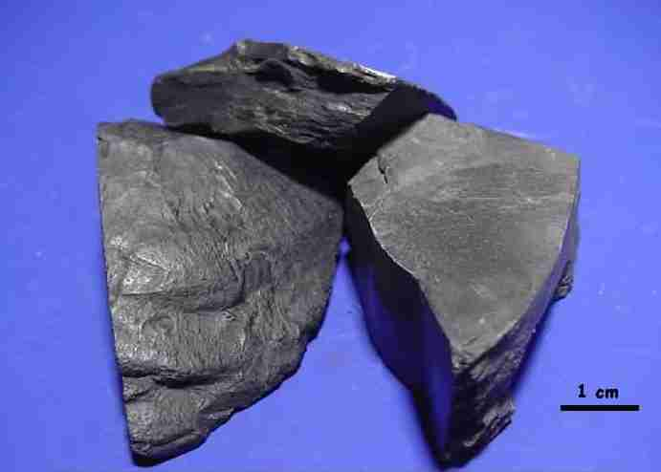
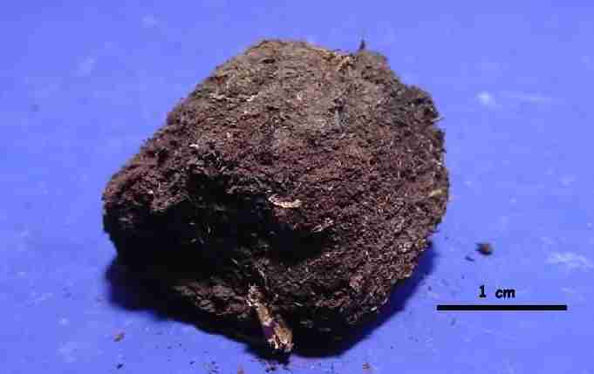
COAL
Compressed vegetation forms COAL.
The longer and deeper that coal is buried makes it of higher quality.
Peat is the first stage of coal formation.
Lignite is the next grade of coal followed by bituminous and the highest grade, anthracite.
Anthracite is actually a metamorphic rock. It forms during mountain building when compaction and friction are extremely high.
This form of coal burns very hot and almost smokeless. It is used in the production of high grade steel.
Notes:
Photo left: bituminous coal
Photo right: peat

Slide 22
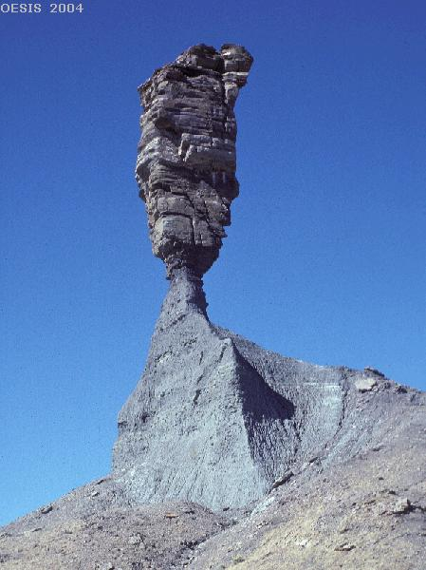
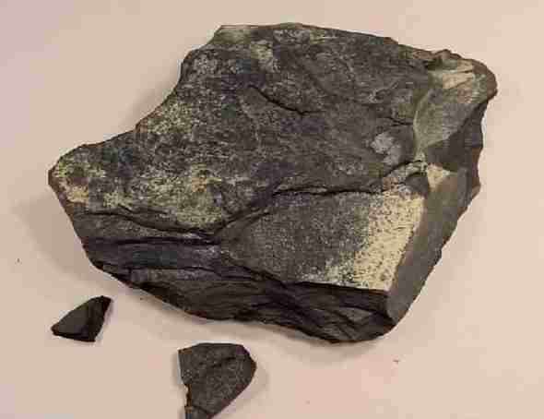
SHALE
Shale is one of the most common sedimentary rocks.
It is composed of silt or clay that has been compacted or squeezed together to form a solid rock.
Shale is usually found in thin layers.
The silt or clay that form shale is made of very small pieces of weathered rock. The pieces are 1/16 to 1/256 of a millimetre in diameter.
The colour of a sample of shale is that of the clay or silt that it was formed from.

Slide 23
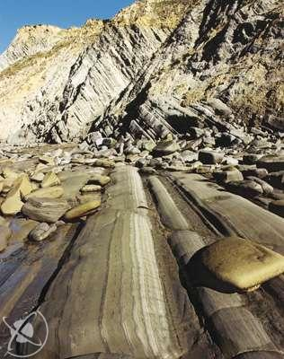
SANDSTONE & MUDSTONE
Sandstone & mudstone are clastic sedimentary rocks that form from the cementing together of sand sized grains & silt sized grains respectively forming a solid rock.
Quartz is the most abundant mineral that forms sandstone. Calcium carbonate, silica, or iron has been added to the water that is in contact with the sand grains.
These minerals grow crystals in the spaces around the sand grains. As the crystals fill the gaps the individual sand grains are now transformed into a solid rock.
Sandstone-mudstone on the Wairarapa coastline

Slide 24
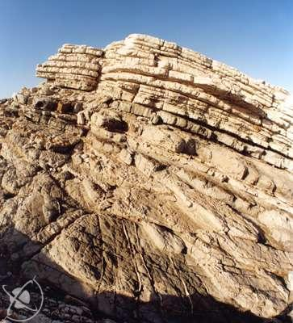
LIMESTONE
Limestone is the most abundant of the non-clastic sedimentary rocks.
Limestone is produced from the mineral calcite (calcium carbonate) and sediment. The main source of limestone is the limy ooze formed in the ocean.
The calcium carbonate can be precipitated from ocean water or it can be formed from sea creatures that secrete lime such as algae and coral.
Chalk is another type of limestone that is made up of very small single-celled organisms. Chalk is usually white or grey in colour.
Limestone at Te KauKau Point, Wairarapa

Slide 25
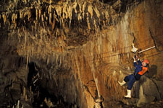
LIMESTONE CAVES
Limestone caves are an interesting geological feature. They form because the limestone deposits located under the ground are chemically dissolved by moving ground water.
The ground water contains minerals that make the water slightly acidic. When an acid comes into contact with a rock that is composed of calcium carbonate a chemical reaction takes place. The acid dissolves the limestone.
The calcium carbonate then goes into the ground water which moves down farther into the cave. The water will find its way into small crack and crevasses.
The dripping water will create formations called stalactites and stalagmites. The photo shows these in Waitomo Caves.

Slide 26
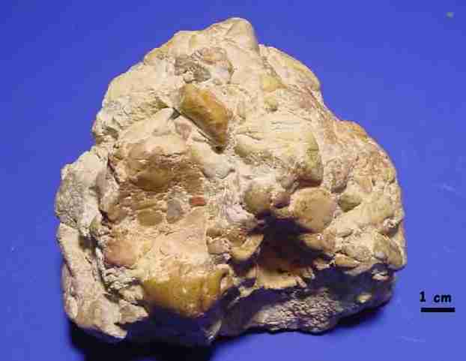
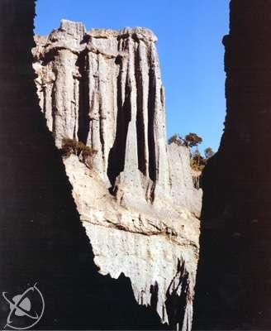
CONGLOMERATE
  Conglomerate is a clastic sedimentary rock that forms from the cementing of rounded cobble and pebble sized rock fragments.
  Conglomerate is formed by river movement or ocean wave action which rounds the rock edges.
  The cementing agents that fill the spaces to form the solid rock conglomerate are silica, calcite, or iron oxides.
Conglomerate, South Wairarapa

Slide 27
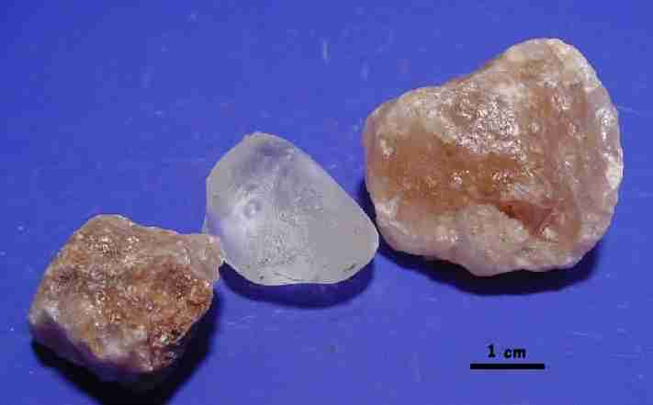
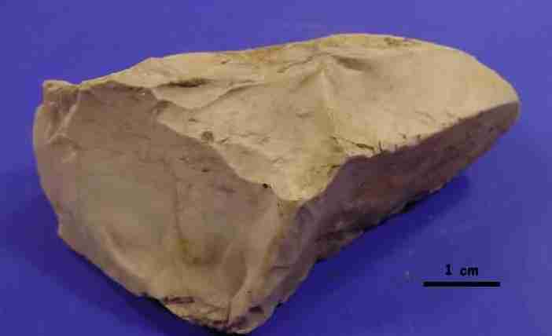
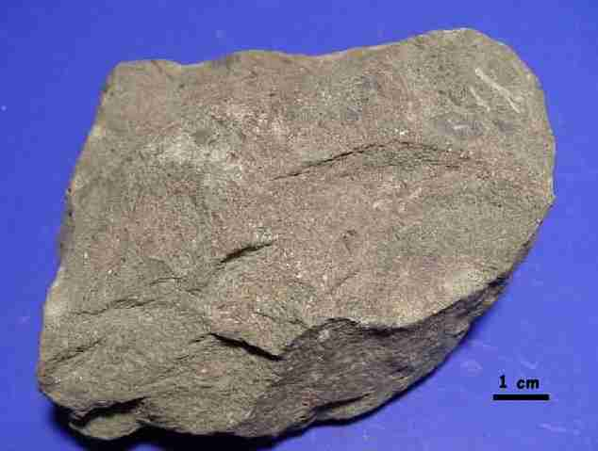
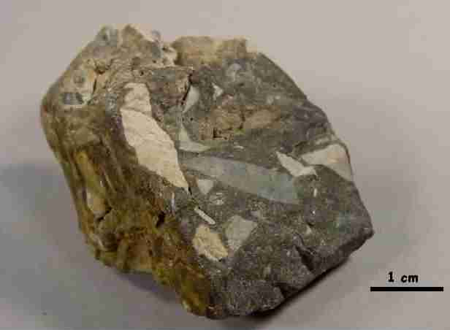
OTHER SEDIMENTARY ROCKS
Halite – rock salt
Chert
Greywacke
Breccia

