Slide 1
Atomic Absorption Spectrophotometer
By Obagaye O. V.

Slide 2
Atomic absorption spectroscopy (AAS) is a spectro-analytical procedure for the quantitative determination of chemical elements using the absorption of optical radiation (light) by free atoms in the gaseous state. Atomic absorption spectroscopy is based on absorption of light by free metallic ions.

Slide 3
In analytical chemistry the technique is used for determining the concentration of a particular element (the analyte) in a sample to be analyzed. AAS can be used to determine over 70 different elements in solution, or directly in solid samples via electrothermal vaporization.
It is commonly used in biophysics, toxicology, pharmacology and archaeology research.

Slide 4
Atomic absorption spectrometry has many uses in different areas of chemistry such as clinical analysis of metals in biological fluids and tissues such as whole blood, plasma, urine, saliva, brain tissue, liver, hair, muscle tissue e.t.c.

Slide 5
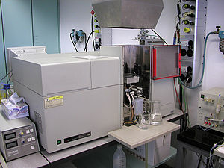
Flame atomic absorption spectrophotometer.

Slide 6
Principle of operation
The technique makes use of the atomic absorption spectrum of a sample in order to assess the concentration of specific analytes within it. It requires standards with known analyte content to establish the relation between the measured absorbance and the analyte concentration and relies therefore on the Beer-Lambert Law.

Slide 7
In order to analyse a sample for its atomic constituents, it has to be atomized. The atomizers most commonly used nowadays are flames and electrothermal (graphite tube) atomizers. The atoms should then be irradiated by optical radiation, and the radiation source could be an element-specific line radiation source or a continuum radiation source. The radiation then passes through a monochromator in order to separate the element-specific radiation from any other radiation emitted by the radiation source, which is finally measured by a detector.

Slide 8
Beer-Lambert Law
The Beer–Lambert law, relates the absorption of light to the properties of the material through which the light is travelling.
A common and practical expression of the Beer-Lambert law relates the optical absorption of a physical material containing a single attenuating species of uniform concentration to the optical path length through the sample and absorptivity of the species. This expression is:
A = εɭc

Slide 9
Where;
ε is the molar attenuation coefficient or absorptivity of the attenuating species.
ɭ is the optical path length.
c is the concentration of the attenuating species.

