Slide 1
CAESAREAN SECTION
                ADVANCED
                MATERNAL AND CHILD HEALTH NURSING
                NSC504

Slide 2
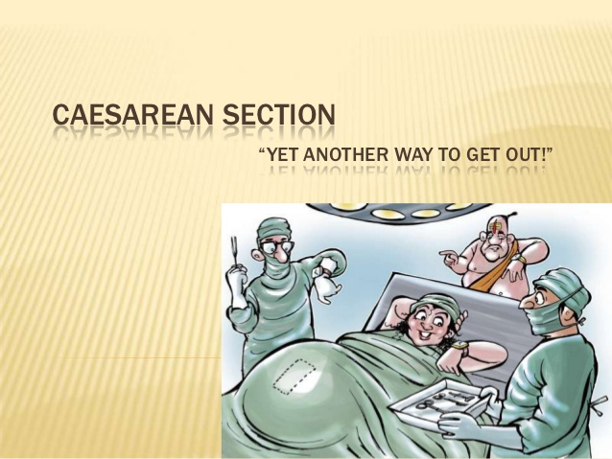

Slide 3
DEFINITION OF CAESARIAN SECTION
Caesarian section (C/S) is an operative procedure which is carried out under anesthesia (regional or general) whereby the fetus, placenta and membranes are delivered through an incision made in the abdominal wall and uterus.
Caesar is derived from the latin word meaning to cut. It was suggested that Julius caesar was named after an ancestor who was born by C/S. The operation was always fatal in those days, and more over as the uterine wall was not sutured after the baby was extracted; a woman was not likely to have other children afterward.

Slide 4
HISTORY ABOUT CAESARIAN SECTION
Caesarian section cannot be talked of without mentioning people that started the practice. Hendrick Van Roomhuyse was credited with helping peformed severraal caesarian sections with success as early as 1663. the mordern era for performing caesarian section is said to have started about 1882,when Max sanger refined the method of suturing the uterine wall. In America, John Lambet Rutmond performed the first caesarian section at Newton, ohion, on April 22, 1827.
The Low cervical caesarian section, originated by H. Sekhein in 1908, was perfected and popularised by Joseph De Lee in 1916

Slide 5
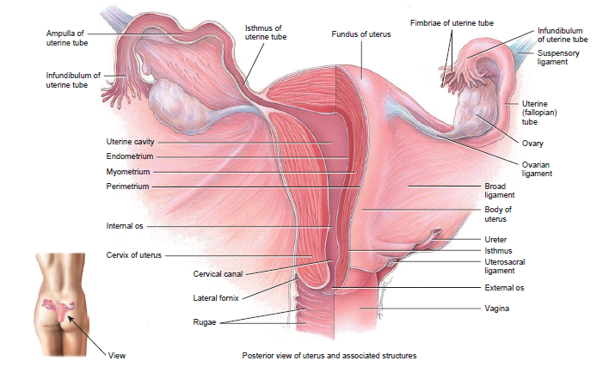
ANATOMY AND PHYSIOLOGY OF THE UTERUS

Slide 6
ANATOMY AND PHYSIOLOGY CONTINUED
Introduction:
The uterus is one of the major organs of reproduction in females. It performs several functions in the females. It is also referred to as the ‘womb’, in lay mans terms.
Description:
It is a thick walled, pear shaped organ located in the true pelvis of a female
Position:
The uterus is situated in the cavity of the pelvis, behind the bladder and in front of the rectum. It is in the anti-version and anti-flexed position. When the woman is standing, it lies in the almost horizontal position with the fundus resting on the bladder.
Size:
It is 7.5cm long, 5cm wide and 2.5cm thick

Slide 7
CONTINUATION
Embryological development of the uterus
The female genital tract is formed in early embryonic life when pair of ducts develop. These Mullerian ducts come together in the midline and fuse into a Y-shaped canal. The open upper end of this structure opens into the peritoneal cavity and the unfused portion becomes the uterine tubes. The fused lower portion forms the utero-viginal area which further develops into the uterus and vagina

Slide 8
CONTINUATION
Parts of the Uterus
Fundus is the dome-shaped upper part of the body that is between the insertions of the Fallopian tubes. It is 2.5cm in length
Cornua are the area of the insertion of the Fallopian tubes
The body or Corpus is the upper two third of the uterus and it measures 5cm from the fundus to the isthmus
The cavity is the space between the anterior and posterior walls. It is triangular in shape with the base above and the apex below. The cavity of the uterus communicates with the vigina through the cervical canal below and with the Fallopian tubes at the cornua
Isthmus is the narrow portion between the body and the cervix. It is 7cm long and enlarges during pregnancy and labour to become the lower uterine segment
The cervix is the lower third of the uterus. It measures about 2.5cm in length, width and thickness. It consists of muscle fibers which is circularly arranged and lined with columnar epithelium.. It has two orifice;

Slide 9
PART OF THE UTERUS CONTINUED
Internal OS: this communicates with the uterine cavity above. It is the constricted end of the cervical canal
External OS: it is a round opening at the lower end of the cervix which opens into the Vagina below. After child birth, it becomes a transverse slit with an anterior and posterior lip
The cervix protrudes into the vagina and the upper half above the vagina is known as the supra vagina portion while the lower portion is known as the infra-vagina portion.
The cervix also consist of the cervical canal which lies between the inter and external OS. It is a continuation of the uterine cavity. It is wider in the middle and narrow at each end

Slide 10
ANATOMY AND PHYSIOLOGY CONTINUED
Layers or covering of the uterus
The uterus consists of three layers namely; the perimetrium, myometrium and endometrium.
Perimetrium: is the outermost covering of the uterus. It consist of peritoneum which drapes over the uterus, covering all except narrow strip on both side and the anterior wall of the upper part of the cervix. It covers the bladder at the bladder to form the uteri-vessical pouch in front and the recto-vessical pouch (pouch of douglas) behind. The peritoneum extends beyond to form the broad ligament
Myometrium: is the middle layer coat and it’s about 1.5cm thick. It consists of interlacing bundles of smooth muscles running in a criss-cross fashion which facilitates the arrest of bleeding after delivery of a baby
Endometrium: is the innermost lining of the uterus. It is thick and consist of mucous membrane. It is lined with columnar epithelial cells, many of which are ciliated. It also contains numerous glands which nourishes the fertilized ovum at conception

Slide 11
ANATOMY AND PHYSIOLOGY CONTINUED
Organs in relation
Anteriorly: the utero-vessical pouch and bladder
Posteriorly: pouch of Douglas and rectum
Laterally: broad ligaments, uterine tubes and the ovaries
Superiorly: intestines
Inferiorly: vagina

Slide 12
ANATOMY AND PHYSIOLOGY CONTINUED
Supports of the uterus
The Transverse cervical ligaments fan out from the sides of the cervix to the side walls of the pelvis. They are sometimes known as the cardinal ligaments or Mackenroid’s ligaments
The Utero-sacral ligaments pass backwards from the cervix to the sacrum
The pubo-cervical ligaments pass forwards from the cervix, under the bladder, to the pubic bones
The broad ligaments are formed from the folds of peritoneum which are draped over the uterine tubes. They hang down like a curtain and spread from sides of the uterus to the side walls of the pelvis
The round ligaments have little value as a support but tend to maintain the anteverted position of the uterus. They arise from the cornua of the uterus and below the insertion of each uterine tube and pass between the folds of the broad ligament, through the inguinal canal, to be inserted into each labium majus
The Ovarian ligaments also begin at the cornua of the uterus but behind the uterine tubes and pass down between the folds of the broad ligament to the ovaries

Slide 13
ANATOMY AND PHYSIOLOGY CONTINUED
Blood supply: the uterine artery emerges at the level of the cervix and is a branch of the internal iliac arteries. It sends a small branch to the upper vagina, and then runs upwards in a twisted fashion to meet the ovarian artery and also from an anastomosis with it near the cornua. The ovarian artery is a branch of the abdominal aorta, leaving near the renal artery. It supplies the ovary and uterine tube before joining the uterine artery. Blood drains through the corresponding veins
Lymphatic drainage: lymph is drained from the uterine body to the internal iliac glands and also from the cervical area to many other pelvic lymph glands. This provides an effective defense against uterine infections
Nerve supply: this is mainly from the autonomic (sympathetic and parasympathetic) nervous system, via Lee Frankenhauser’s plexus or pelvic plexus

Slide 14
ANATOMY AND PHYSIOLOGY CONTINUED
Functions of the Uterus
i) It houses the fertilized ovum, the embryo and the fetus during pregnancy
ii) It contracts to expel the baby during labour and control bleeding in third stage of labour.
iii) It shreds off its endometrium every month in the menstrual cycle
iv) It serves as a medium for the passage of sperm cells to the oviduct
v) It serves as a medium for the insertion of intrauterine contraceptive device (IUCD)

Slide 15
CLINICAL INDICATION FOR CAESAREAN SECTION
This can be discussed under maternal and fetal conditions
Maternal Indications
Previous classical caesarean section
Feto-pelvic disproportion
Pregnancy-induced hypertension (pre-eclampsia, eclampsia, chronic nephritis)
Antepartum haemorrhage (placenta praevia or placenta abruption)
Fracture of the pelvis
Maternal death
Obstructing pelvic mass

Slide 16
CLINICAL INDICATION CONTINUED
Fetal Indications
Fetal distress
Diabetes mellitus
Prolapse of the cord in labour
Hydrocephalus
Compound presentation
Malpresentations and malpositions
Monoamniotic twins or higher-order multiple pregnancy

Slide 17
TYPES OF CAESAREAN SECTION
There are two types of caesarean section;
Classical caesarean section
This is rarely performed. It involves a vertical incision made through the visceral peritoneum and the contractile part of the uterus above the bladder
Indications
Gestational age less than 32 weeks before the lower segement are formed
Placental praevia
Fetus in a transverse lie
Shoulder presentation

Slide 18
TYPES OF CAESAREAN SECTION CONTINUED
Advantages of Classical caesarean section
It doesn’t take much time to perform
It can be employed when general anaesthesia is not available
Disadvantages of Classical caesarean section
Rupture of a uterine scar in subsequent pregnancies
Haemorrhage is greater
Small bowel adhesion to the anterior suture line
Delayed wound healing

Slide 19
TYPES OF CAESAREAN SECTION CONTINUED
2) Lower segment caesarean section
This is possible by means of transverse incision through the lower uterine segment.
Advantages
Less danger of infection or haemorrhage
Less incidence of uterine rupture in subsequent pregnancies
It is the caesarean section mostly employed by obstetricians

Slide 20
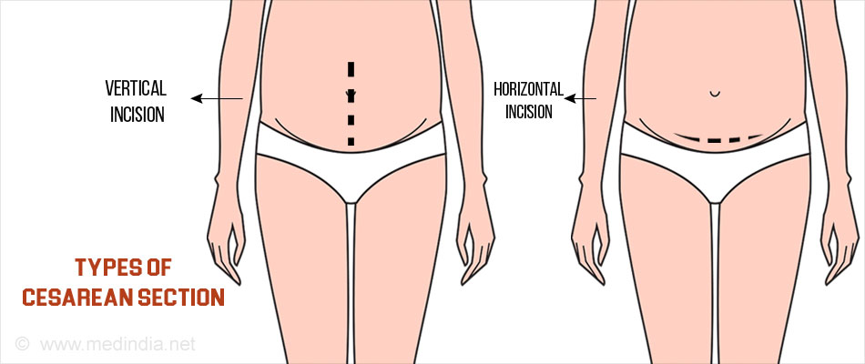

Slide 21
METHODS OF CAESAREAN SECTION
Elective caesarean section
This type is used when the caesarean section is performed at a scheduled time, such with a known fetus pelvic disproportion. The patient is usually admitted to the hospital the day prior to surgery. This allows for laboratory investigations and provides an opportunity to rule out presence of infection
Emergency caesarean section
Here, there is no indication of caesarean section prior to the surgery. It is usually done when a woman must have laboured with failure and there is an urgent need to save the life of both the mother and the child or either

Slide 22
TREATMENT OF PATIENT FOR CAESAREAN SECTION
PRE OPERATIVE NURSING CARE.
Admission
In case of elective caesarean section, parent will be admitted into the ward at least a day prior to the scheduled surgery depending on the policy of the hospital. In case of emergency, she is taken to the labour ward.

Slide 23
INVESTIGATION
The following laboratory investigations are carried out to ensure patient’s health state is stable and suitable for the surgery. Haemoglobin, full blood count, blood grouping and cross matching is done to prepare suitable blood for the surgery, blood clotting time, ultrasound is done to note fatal well-being. In case of pre- eclampsia, urea and electrolyte levels will be examined and clotting factors acquired.
OBSERVATION AND MONITORING
A pre-operative observation chart is opened. The weight is checked and observed of blood pressure, pulse, respiration and temperature which serve as a baseline data is taken and charted. Results of investigation requested are obtained and ready for review for approval.

Slide 24
PHYSICAL CARE
An assisted bathroom bath, oral toileting may be done depending on client’s condition. Jewelries, dentures, make ups should be removed and a hospital or theatre gown is given. Shaving should be done and an indwelling catheter is passed to monitor urinary outputs during and after surgery.
PSYCHOLOGICAL CARE
Reassure patient and her relative to relieve any form of anxiety and uncertainty. Explain the procedure and what she should expect in the theatre, show her others that have had caesarean section and are now recuperating. Answer all her questions in a respective manner. Provide privacy and a calm atmosphere.
ANESTHETIST VISIT
This is carried out in the night or morning prior to surgery to determine the woman’s suitability to the surgery, her present health status and he determine the type of anesthesia that will be used for her.

Slide 25
DIET
Light and easily digestible diet is given the night prior to surgery but nothing is taken on the morning of the surgery day to prevent aspiration or in eadelson’s syndrome.
DRUG
Prescribe pre-operation drug are served such as antacids because of the fasting atropine is given to reduce gastro intestinal motility and mucus secretions.
PROCEDURE
The abdomen is opened and the loose fold of the peritoneum over the anterior aspect of the lower & uterine segment and above the bladder is incised. The operator continues to incise this further to visualize the fundus of the bladder which is then pushed down and away from the surgeon.

Slide 26
Procedure Continue
The uterus is incised transversely. The surgeon directs the fetal head out while the assistant applies fundal pressure to help the delivery of the baby. Oxytocics may be given by the anesthetist after the delivery of the baby and clamping of the cord. When the baby and placenta are delivered, the uterus is sutured. This is usually done in 2 layers. The peritoneum may then be closed over the uterine wound to exclude hit from the peritoneal cavity. The rectus sheath is closed, then the layer of fat and finally the skin is sutured with the surgeon’s choice of materials; commonly chromic catgut is used.

Slide 27
POST OPERATION NURSING CARE
Immediate Care
(1) Observation
The vital signs (temperature, pulse, respiration and blood pressure) should be observed 1/4 hourly for the 1st One hour and 30 minutes in the 2nd hour, hourly until she is transferred to the post partum unit.
Assess the abdominal dressing (wound) to note any blood loss.
Assess the fundus for firmness, height and location.
Also if poorly contracted, inform the physician.
Assess urinary catheter for patency.
Lochia should also be inspected and drainage should be small
Document and report any abnormality to the Doctor.

Slide 28
DRUGS
Analgesia:- This is prescribed and given as required e.g. fortwin zongs for 2 days
Anti emetics e.g. cyclizine, prochlorperazine are usually prescribed by the anesthetist following general anesthesia.
Nurse the patient in left lateral or recovery position until she is fully conscious. Since the risk of airway obstruction or regurgitation and silent aspiration of the stomach content are still present.
Position should be changed 4 hourly to prevent bed sore development.

Slide 29
POST OPERATIVE CARE CONTINUED.
Following regional block, damage to the legs should be avoided when patient is still unconscious which will gradually regain sensation and movement:
Respiration should be monitored and recorded.
Patient may sit up as soon as she wishes provided her blood pressure is not low.
Monitor intravenous fluid and replaced when necessary to ensure patency of intravenous life
Breastfeeding can be initiated.
Mother is transferred to the post-natal ward 1-2 hours when condition is stable.
Care in the Post-natal ward:

Slide 30
1. Reception
Receive a line patient and promote comfort by placing her in lateral position or supine due to the site of the incision.
2. Observation
Observe and record the vital signs 4 hourly
Monitor and replace intravenous fluid promptly, monitor its paternity as use, it may still continue until bowel sounds resumes and patient can tolerate sips of water.
Monitor and maintain indwelling catheter urinary output and fluid intake even after catheter removal, report any form of haematuria, polyuria, or oliguria to the Doctor.
Assess involution and observe abdominal dressing and lochia flow. The lochia flow may be reduced due to removal of some of the uterine decidua during the procedure.

Slide 31
Psycholothraphy
Provide emotional support as some women may have a lingering feelings of failure or disappointment at having had a caesarean section and may value the opportunity to talk this over with the midwife. Reassure her and allay her anxiety.
Comfort measures
Provide comfort measures by positioning her changing her position 4hourly to prevent bed sores, administration of prescribed appropriate analgesia to relief pain: pentazocine 30-60mg 4-6 hourly for the 1st 24-48 hours post operatively then PRN. Help maintain her personal hygiene to boost her morale.

Slide 32
Diet
Once bowel sound is re-established, sips of warm plain water are first introduced then graded oral diet (pap) until well tolerated then patient can eat adequate diet, high protein diet is advocated. High fluid intake should be stressed to avoid constipation.
Dressing
Wound dressing is done under aseptic techniques with spirit until stitches are removed 7-8 days post- operation. However this is done after the wound has been inspected by the surgeon 12-24 hours following surgery.

Slide 33
DRUGS
Prescribed post-operative antibiotics such as Augumentin are given to prevent onset of infection and promote wound healing.
EXERCISED AND REST
Encourage mother to move her legs and perform breathing exercise . Early ambulation decreases respiratory and circulatory complications, so the woman should be assisted out of bed as much as possible. The mother should be encouraged to as much as possible and tactful advice may be given to her concerning her visitors. Visitors are restricted to minimal to promote her resting.

Slide 34
DISCHARGE
On discharge, the following are stressed:
__ Breast care feeding
__ Infant care ( exclusive breast, immunization and cord care etc.)
__ Personal hygiene as well as perinea hygiene
__ Nutrition
__ Sexual activity and contraception
__ Compliance with prescribed take-home medications
__ Follow up at the post-natal clinic at 6 weeks post
__ Delivery or she may report to the clinic anytime she notices any sign or symptoms of complications.

Slide 35
Roles of midwives in Caesarean section
__ Midwives gives relevant information in a comprehensive manner to women going for caesarean section, this will help the women to decide what is best for them, in relation to their own specific circumstances.
__ One _ to _ one care from a midwife during labour can influence the rate by birth by caesarean section.
__ Supportive presence given by midwife in labour is undoubtedly of considerable benefit, both to the woman and to her family.
__ Prepare patient for operation i.e. pre, intra and post operatively
To give health education to the woman concerning her care and that of her baby e.g. Immunization and family advice.

Slide 36
S/N | NURSING DIAGNOSIS | NURSING OBJECTIVE | NURSING INTERVENTION | SCIENTIFIC RATIONALE/ PRINCPLE | EVALUATION | SIGNATURE
1 | Deficient Knowledge Related as surgical procedure As evidence by asking Questions. | Patient will Demonstrate Improved Knowledge of surgical procedure within 3hours of nursing actions. | 1. Encourage to verbalize known information 2. Explain surgical procedure building on patients information 3. Show her the instruments and environment where the procedure will be done. | 1. Assess chants level of information 2. Provide adequate information and correct misconceptions 3. Improves knowledge of surgery procedure and expectations . | Patient demonstrated improved knowledge of surgical procedure within 3hours of Nursing action | BCA

Slide 37
2 | Acute pain related to surgical incisions evidenced by restlessness and verbalization . | Patient will verbalize reduced pain Within 1hours of nursing actions . | 1. Position patient on left lateral or supine 2. Provide diversional therapy 3. Reassure patient 4. Administer prescribe analgesic (1.m pentazozine (30-60mg 6hourly). | 1. Relieves pain 2. Distracts patients attentions from pain 3. Promotes pain relief 4. Blocks the pain pathway thereby relieves pain. | Patient verbalized reduced pain within 1hour of nursing action | BCA
3 | Impaired tissue integrity related to surgical procedure as evidenced by incision site | Incision site will heal by first intension within 2 weeks of nursing management | 1. monitor incision site foe cleanliness 2. Dress incision site with spirit as prescribed 3. Ensure aseptic measures during dressing 4. Administer prescribed haematics | 1. Assess would healing 2. Promote healing and prevent infection 3. Prevents Infection 4. Aids healing process | Patients incision site healed with first intention within 2 weeks of nursing management | BCA

Slide 38
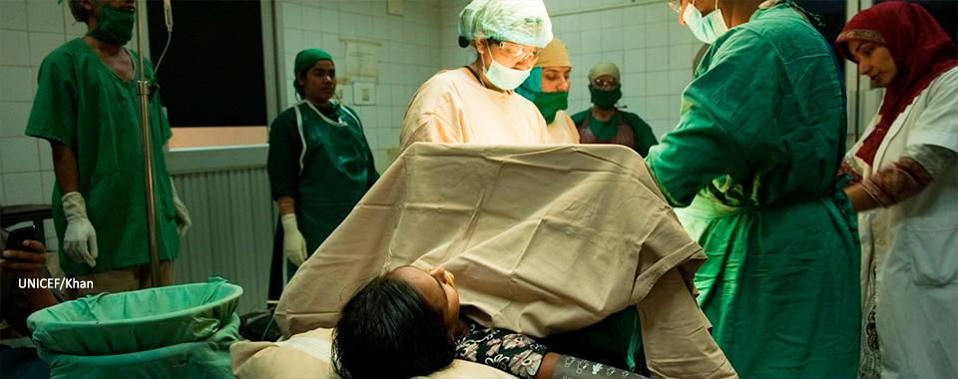

Slide 39
GEOGRAPHICAL DIFFERENCES IN PREVALENCE OF CAESAREAN SECTION
The geographical differences in prevalence of caesarean section rates observed may be explained by differences in the demographic and clinical characteristics of the population, such as age, ethnicity, previous caesarean section, breech presentation, prematurity and induction of labour

Slide 40
CONTINUATION ON PREVALENCE
Caesarean deliveries account for a large percentage of all births worldwide. For example, the USA caesarean delivery account for 30% of all birth and the operation represents the most common major surgical procedure for women. In Egypt, the caesarean delivery rate is 22% with higher rates seen in private hospitals.

Slide 41
CONTINUATION ON PREVALENCE
Women aged 35 to 49 year old were more likely to have had caesarean section to those aged 15 to 24years old
Women from the richest household were almost as twice as likely to have had caesarean section than there from poorest

Slide 42
CONTINUATION ON PREVALENCE
Drawing on world health organisation and UNICEF data from 169 countries, the research uncovered large discrepancies between geographical region with 60% of countries over using caesarean section and 25%under using caesarean section
In at least 15 countries, more than 40% of births were delivered using a caesarean section; with Dommican republic topping the list with 58.1% of all babies delivered using the caesarean section procedure more than half of all births are carried out with caesarean section in Brazil, Egypt and turkey while in parts of west and central Africa region, the caesarean procedure were used in only 4.1% of births.

Slide 43
INTERVENTION TO REDUCE MATERNAL NATIONAL MORTALITY AND MORBIDITY
Interventions to reduce maternal neonatal mortality and morbidity during caesarean section;
Preventing postpartum haemorrhage.
The most effective intervention for preventing PPH is the use of uterotonics- An injectable uterotonic is the drug of choice, oral or sublingual misoprostol may be used when injectables are not available.
Uterine massage
Uterine tamponade- involving mechanical device to exert pressure from within the uterus
Artery embolization: used to treat PPH with appropriate equipment and expertise
Surgical intervention e.g ligation of the total or subtotal hysterectomy
Non-pneumatic antishock garment

Slide 44
CONTINUATION ON INTERVENTION TO REDUCE MATERNAL NATIONAL MORTALITY AND MORBIDITY
2. Preventing pre-eclampsia
This can be achieved with low dose aspirin and dietary supplementation with calcium supplementation. The WHO strongly recommend the use of calcium in areas with low dietary ccalcium intake. Calcium supplementation commence in early pregnancy, particularly for women at high risk of pre-eclampsia, inncluding those with multiple pregnancy, previous pre-eclampsia, preexisting existing hypertension, diabetes, renal or auto immune diseases or obesity
Treating pre-eclampsia and Eclampsia: the only definite cure for pre-eclampsia is timely delivery of the baby, by induction of labour or by pre-labour caesarean section to prevent progression of disease and related morbidity and mortality. The main stays of treatment are anti-hypertenive drugs for blood pressure control and magnesium sulphate for eclampsia

Slide 45
CONTINUATION ON INTERVENTION TO REDUCE MATERNAL NATIONAL MORTALITY AND MORBIDITY
3. Preventing Obstructed Labour
The first priority for preventing poor outcomes related to obstructed labour is to create the demand for skilled birth assistance and to ensure that this demand can be met,
Provide maternity waiting Homes: a maternity waiting home is a facility that is within easy reach of a hospital or health center that provides antenatal care and emergency obstetric care. Women with high risk pregnancies or those who live remotely are encouraged to stay at these facilities, if they exist, towards the end of their pregnancies

Slide 46
TO PREVALENCE
In Nigeria, at the regions level, the south west had the highest prevalence of 4.7%, 9.4% reported at Eboyin, State, 9.9% in sokoto and 10.3% at Enugu, 27.6% at Sagamu, Southern Nigeria.
In Ekiti state the prevalence rate of caesarean section were performed because of severe preeclampsia 35 ( 83.3%) of women in Ekiti State University Teaching Hospital, Ado- Ekiti: Nigeria.
3 NURSING DIAGNOSIS FOR PATIENT THAT HAD CAESAREAN OPERATION
1. Deficient knowledge related to surgical procedures as evidence by asking of questions.
2. Ante pain related to surgery as evidenced by restlessness
3. Impaired tissue integrity related to surgical procedure evidence by incision site

Slide 47
Continuation on Obstructed labour
Treating obstructed labour
Caesarean section forms the backbone of the management of obstructed labour and saves many lives because of the availability of operative delivery. In high income countries, maternal deaths there due to obstructed labour are rare
Vacuum and forceps delivery: this operative vaginal delivery may be used to assist women with obstructed labour at the pelvic outlet or low or mid-cavity. Operator training is vital in all facility setting to maximise benefits and reduce morbidity with vacuum and forceps deliveries
Symphysiotomy: is an operation in which the firbes of the pubic symphysis are partially divided to allow separation of the joint and thus enlargement of the pelvic dimensions during childbirth.

Slide 48
CONTINUATION ON INTERVENTION
4. Maternal sepsis
Sepsis associated with pregnancy and child birth is among the leading direct cause of maternal mortality worldwide, accounting for approximately 10% of the global burden of maternal death. Maternal infections occurring before or during the birth of the baby have considerable impact on new born mortality and an estimated one million new born deaths associated with maternal infection are recorded each year

Slide 49
Continuation on maternal sepsis
Preventing maternal sepsis includes the following;
The use of stringent infection control measure to limit the spread of microorganism
General measures, such as hand washing with soap or other cleansing agents
Antibiotics prophylaxis at caesarean sections
Vaginal application of chlorohexidine, an antiseptics for vaginal delivery and for caesarean section. Its beneficial effects might be greater for women with ruptured membranes
Treating maternal Sepsis
The mainstay of treating maternal sepsis is antibiotics. Intra-partum treatment with potent antibiotics is clinically reasonable

Slide 50
INTERVENTION TO REDUCE NEONATAL MORBIDITY AND MORTALITY
Addressing neonatal mortality requires interventions across the continuum of care (preconception, antenatal, intrapartum, immediate postnatal period and after) and interventions across the health system (family and community level, outreach and clinical care or facility level)

Slide 51
CONTINUATION ON INTERVENTION TO REDUCE NEONATAL MORBIDITY AND MORTALITY
Antenatal intervention
Routine Antenatal care visit: this is important. As revealed by WHO, antenatal care trial, which showed that Neonatal morbidity and mortality was reduced in participants who received more frequent antenatal visits
Nutritional Interventions: which are
Folic acid: nutritional interventions may be implemented before and during pregnancy supplementation of diets with folic acid and fortification of staple commodities peri-conceptually reduces the risk of neural tube defects that accounts for a small proportion of neonatal deaths
Dietary advice and balanced energy supplementation (BES) is an important intervention for the prevention of adverse perinatal outcomes in populations with high rates of food insecurity and maternal under nutrition
Maternal calcium supplementation: the WHO recommends maternal calcium supplementation from 2 weeks gestation in population in which calcium intake is low to reduce the risk of hypertensive disorders in pregnancy

Slide 52
CONTINUATION ON INTERVENTION TO REDUCE NEONATAL MORBIDITY AND MORTALITY
Intrapartum Interventions
Labour surveillance is needed for early detection, clinical management and referral of women for complications. Basic emergency obstetric care should be available at first level facilities providing childbirth care

Slide 53
CONTINUATION ON INTERVENTION TO REDUCE NEONATAL MORBIDITY AND MORTALITY
Postpartum Intervention
Newborn resuscitation: training of birth attendants improves initial resuscitation practices and reduces inappropriate and harmful practices
Essential newborn care includes; cleaning, drying and warming the infant, initiating exclusive breast feeding and cord care

Slide 54


Slide 55
General intervention
Hygiene: poor hygienic condition and poor delivery practices contribute to the burden of neonatal morbidity, but the use of a plastic sheet during delivery, a boiled blade to cut the cord, a boiled thread to tie the cord and individual use of kit associates with reductions in mortality
Fetal monitoring in labour is important
Antenatal corticosteroids: the administration of antenatal corticosteroids to women in preterm labour or in whom preterm delivery is anticipated (for example, in severe preeclampsia) for the prevention of neonatal respiratory distress syndrome (RDS) has been shown to be very effective in preventing poor neonatal outcomes in well resourced setting

Slide 56
CONSEQUENCIES ASSOCIATED WITH OVERUSE OF CAESAREAN SECTIONS
Women and children can be harmed or die from the procedure especially when there are not sufficient facilities, skills and health care available
Maternal death and disability is higher after caesarean section than vaginal birth
Babies born via caesarean section have different hormonal, physical, bacterial and physical exposures during birth which can subtly alter their health
Changes in baby immune development which can increase the risk of allergies and asthma and alter the bacteria in the gut.
Caesarean section is a type of major surgery which carries risk that require careful consideration
The growing use of caesarean section for non medicinal purpose could be introducing avoidable complications

Slide 57
Conclusion
Caesarean section _ is the surgical delivery of a baby or babies, some women welcome caesarean section as a means of escaping the rigours of labours, others feels disappointed that they have not had the experience of a normal delivery and have not enjoyed the accompanying sense of achievement.
If the possibility of caesarean sections arises during labour, the midwife should begin to prepare for the woman for this eventuality. The couple should be kept fully informed of events and progress during labour and should be given every opportunity to ask questions, but the important part of it is to have life mothers and babies.

Slide 58
QUESTIONS
Define caesarean section
Mention five (5) indications for caesarean section
Briefly describe anatomy and physiology of the uterus
Write three (3) Nursing care plan for patient that had caesarean section

Slide 59
REFRENCES
Annamma Jacob (2012) A comprehensive textbook foe midwifery, 3rd Edition. Jaypee Brothers Medical publisher (p) Ltd., India
Anne Waugh, Allison Grant, (2014). Ross and Wilson, ANATOMY and PHYSIOLOGY in Health and illness, 12th Edition. Churchill Livingstone, Elseveir Limited Edinburgh, UK
Diane M. Frasier, Margaret A. Cooper (2016). Myles Textbook for Midwives, 16th Edition. Churchill Livinstone, Elseveir Limited Edinburgh, UK
Hamza A, Herr D, Solomayer EF, et al; Polyhydramnios: Cause, diagnosis, and Therapy. Gilbertshilfe Frauenhekd. 2012 Dec 73 (12) 1241-1246
Mattew M, Saquib S, Ruzvi SG: polyhydraminos. Risk factors and outcome. Saudi Med J 2008 Feb 29 (2): 256-260
Pri-Paz S, Khalek N, Fuchskm, et al; Maximal Amniotic Fluid Index as a Prognostic factor in Pregnancies complicated by polyhydramnios. Ultrasound Obstet Gynecol. 2012 Jun39 (6);648-53. doi:10.1002/uog.10093.

Slide 60

THANKS FOR LISTENING

