Slide 1
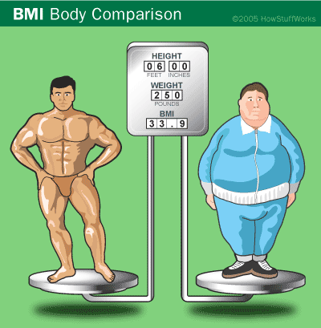
Body Mass Index

Slide 2
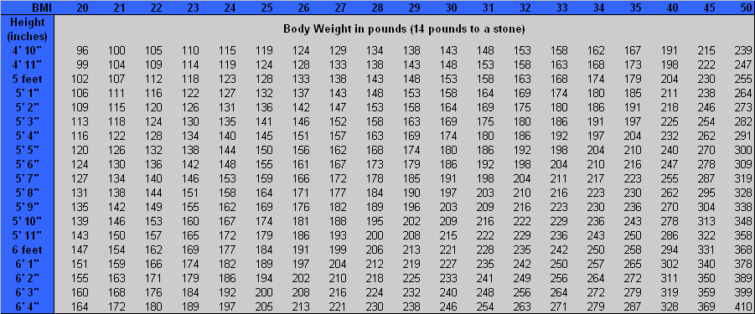
Introduction
The body mass index (BMI) is a statistical measurement using a person’s height and weight to determine their “healthy” body weight.

Slide 3
Introduction
BMI is controversial, because it does not actually measure a person’s percentage body fat.
It just displays what a healthy weight range would be for a person’s height.

Slide 4
Introduction
It is so easy to determine, which makes it so widespread in use.
Mathematically it is figured out by the equation on the right.
Most people, however, just use a BMI chart which are widely published.

Slide 5
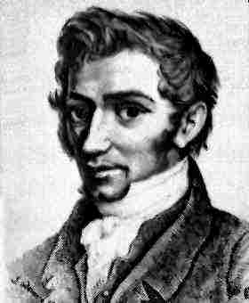
The History Behind It
BMI was formulated around 1840 by Adolphe Quetelet.
He was a Belgian “Renaissance Man”.
He took a person’s mass in kilograms and divided it by their height in meters, squared. This gave BMI, which was originally called the Quatelet Index.

Slide 6
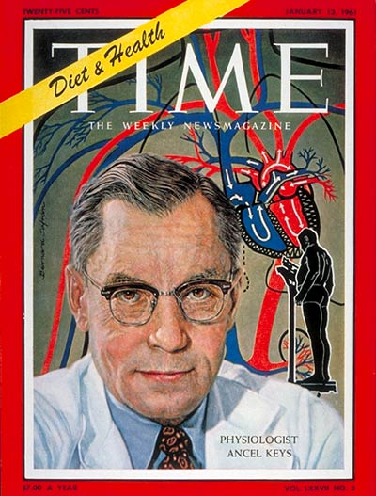
The History Behind It
The term BMI came about in the 1970s in a paper by Ancel Keys.
He was a scientist who looked at the influence of diet on health.
He coined the categories for BMI: underweight, healthy, overweight and obese.

Slide 7
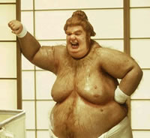
The History Behind It
Keys said BMI could only be used when dealing with population studies and not individual studies, as he felt this was inappropriate.
Unfortunately no one heeded his advice and BMI started to become a widespread measurement used to determine a person’s “fatness” or “thinness”.

Slide 8
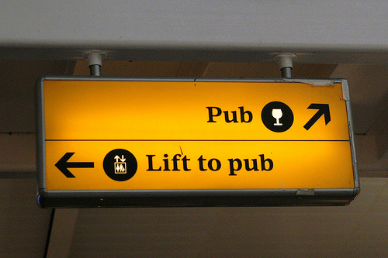
The History Behind It
BMI’s original purpose was to determine if inactive people were at a healthy weight since their diet would be the only thing to regulate their size.
Knowledgeable doctors and scientists use it for population trends only.

Slide 9
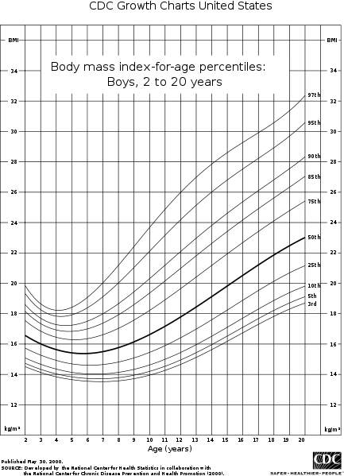
Improving BMI
There are lots of things BMI does not account for, however, recently there have been variations implemented for children and for non-North Americans.
This last variation was adopted by the World Health Organization (WHO) and consequently moved 30 million previously “healthy” Americans into the “overweight” category.

Slide 10
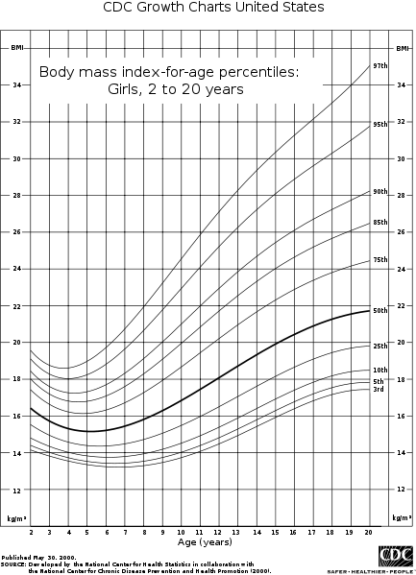
BMI for The Under 20s
This compares the BMI total with the general averages for children and not adults.
Calculate your BMI on the BMI Index and then plot it and your age on the chart.
Anywhere between the 5th and 85th percentile is considered “healthy”.

Slide 11
International BMI Categories
Unfortunately our world is one of have and have not and consequently the WHO has added the categories of “Starvation” to anyone who has a BMI under 15 and “morbidly obese” to anyone who has a BMI over 40.
Category | BMI range – kg/m²
Starvation | less than 14.9
Underweight | from 15 to 18.4
Normal | from 18.5 to 22.9
Overweight | from 23 to 27.5
Obese | from 27.6 to 40
Morbidly Obese | greater than 40

Slide 12
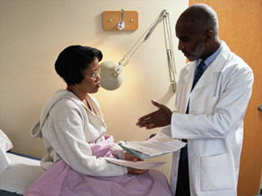
Conclusion
While BMI is fast and easy to calculate, it should not be the be all end all of determining whether or not someone is at a healthy weight.
However, if someone has a low BMI or a really high BMI, that should signal the potential for health problems and that person should see their doctor to discuss this.

Slide 13
Homework
What does BMI stand for? What does it calculate?
What does BMI take into consideration in its calculation?
What are three limitations of the BMI calculation? Another way of saying this is what are three things BMI does not take into consideration.
Calculate your BMI using the BMI index and compare the category you are in with the percentile you are in on the BMI for the U20s. Are you in the same category on both charts?
What country/countries do you believe would have the most people who fall into the “morbidly obese” category? Why?
What country/countries do you believe would have the most people who fall into the “starvation” category? Why?

Slide 14
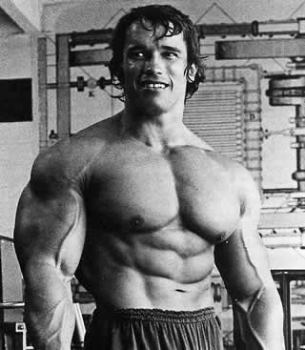
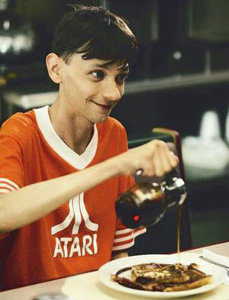
Healthy or not?
Arnold
DJ Qualls

Slide 15
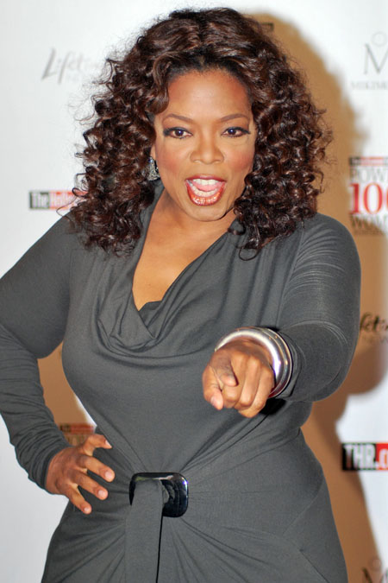
Healthy or not?
Keira Knightley
Oprah Winfrey

