Slide 1
GENTICALLY MODIFIED FOODS

Slide 2
What is a Genetically Modified (GM) Food?
Foods that contain an added gene sequence
Foods that have a deleted gene sequence
Animal products from animals fed GM feed
Products produced by GM organisms
Notes:
A GM food is one that has sequences of DNA from another organism inserted into its genome in order to get a desired phenotype. The definition of GM foods may also include foods that have an a deleted gene, foods such as cheese that are made from enzymes that are from a genetically modified organism, and foods such as beef that have been fed genetically modified feed.

Slide 3
Why are foods genetically modified?
Genetic engineering offers a rapid and precise method of altering organisms as compared to traditional methods that are slow and inaccurate.
Notes:
Traditionally, plants and animals were selectively mated in order to get desired phenotypes. This took many generations to improve organisms.

Slide 4
Common GM Foods
Vegetables
Tomatoes
Potatoes
Rice
Cheese
Meat

Slide 5
How is genetic modification possible?
The components of DNA are the same in all organisms.
Sequences that code for proteins can be moved from one organism to another.
Notes:
The components that make up DNA are the same in all organisms. The sequence of these components is the “ recipe” for the proteins synthesized by different organisms. Proteins are responsible for the characteristics exhibited by life forms. By taking the DNA sequence that codes for a protein responsible for a desirable characteristic and putting it into the DNA (Genome) of another organism; the desired characteristic will be expressed. The new sequence will begin to make the intended protein.

Slide 6
How can DNA be moved from one organism to another?
Find an organism with the desired trait
Isolate the gene sequence that codes for the desired trait
Insert the gene sequence into the genome of the plant cell
Notes:
A good example is insect resistant corn. The bacteria Bacillus turingiensis has a gene that directs the synthesis of a protein that is toxic to some insects and benign to others.

Slide 7
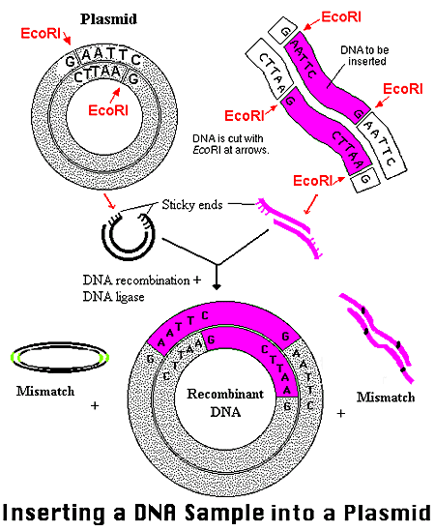
How can DNA be moved from one organism to another?
A vector can carry DNA. The vector can be a pellet from a gene gun. Viruses and bacteria also can be utilized to transfer genes.

Slide 8
Possible Benefits of GM Foods
Easing of world hunger
Development of crops that can be grown in marginal soil
Reduced strain on nonrenewable resources
Development of drought resistant crops
Development of salt-tolerant crops
Development of crops that make more efficient use of nitrogen and other nutrients

Slide 9
Possible Benefits of GM Foods
Reduced use of pesticides and herbicides
Development of pest resistant crops
Reduced herbicide use is better for the environment and reduces costs for farmers

Slide 10
Possible Benefits of GM Foods
Improved crop quality
Development of frost resistant crops
Development of disease resistant crops
Development of flood resistant crops
Improved nutritional quality
Development of foods designed to meet specific nutritional goals

Slide 11
Who makes sure GM foods are safe?
Government agencies regulate GM foods
GM foods in the United States are required to be labeled only if the nutritional value is changed or a new allergen is introduced.

Slide 12
Possible Risks of GM Foods
Insects might develop resistance to pesticide-producing GM crops
Herbicide-tolerant crops may cross-pollinate weeds, resulting in "superweeds"

Slide 13
Possible Risks for GM Foods
Certain gene products may be allergens, thus causing harm to human health
There may be unintended harm to wildlife and beneficial insects
Photo courtesy of T. W. Davies, Cal. Acad. of Sciences.

Slide 14
Assignment
Write a short report on your views about GM foods.

