Slide 1
HEALTH law ii
Ifeoluwayimika Bamidele, PhD

Slide 2
TWO MAJOR TOPICS
DOCTOR PATIENT RELATIONSHIP
MENTAL HEALTH LAW
Types
Paternalism
Mutuality
Consumerist approach
Patient centred
Importance to Law
Professional ethics and discipline
Personal conduct and professional discipline
Mental Health Law in Nigeria
The mental health bill in Nigeria
The Lunacy Act
Comparative analysis with other jurisdictions

Slide 3
DOCTOR PATEINT RELATIONSHIP
The doctor patient relationship is an important element of care.
It is one of the core elements in the ethical principles of medicine and health care.
It promotes the outcome that is desired by the patient and prevents outcomes that are not desired like medical malpractice litigation.

Slide 4
DOCTOR PATIENT RELATIONSHIP
The doctor-patient relationship is "the legal predicate to the recognition of a professional duty of care owed to a patient“.
This forms the basis of a legal duty and relationship between the doctor and the patient.

Slide 5
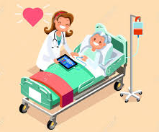
DOCTOR –PATIENT RELATIONSHIP
CODE OF MEDICAL ETHICS.
MEDICAL AND DENTAL PRACTITIONERS ACT.
ETHICAL GUIDELINES OF PROFESSIONAL ETHICAL BODIES
DECISIONS OF PROFESSIONAL REGULATORY BODIES
CASE LAW

Slide 6
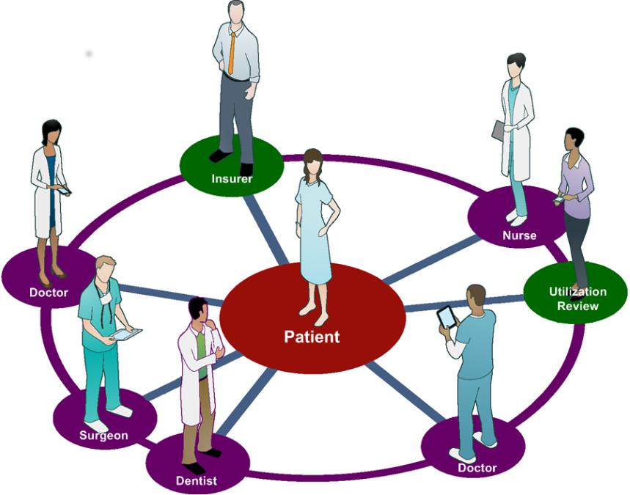
TYPES OF DOCTOR PATIENT RELATIONSHIP
DOCTOR CENTRED
PATIENT CENTRED
"an asymmetrical relationship in which the doctor occupies the dominant position by virtue of his or her specialist knowledge and the patient merely cooperates“- Pearsons

Slide 7
ASSESSING THE TYPES OF DOCTOR PATIENT RELATIONSHIP
Paternalism
Mutuality
Consumerist approach

Slide 8
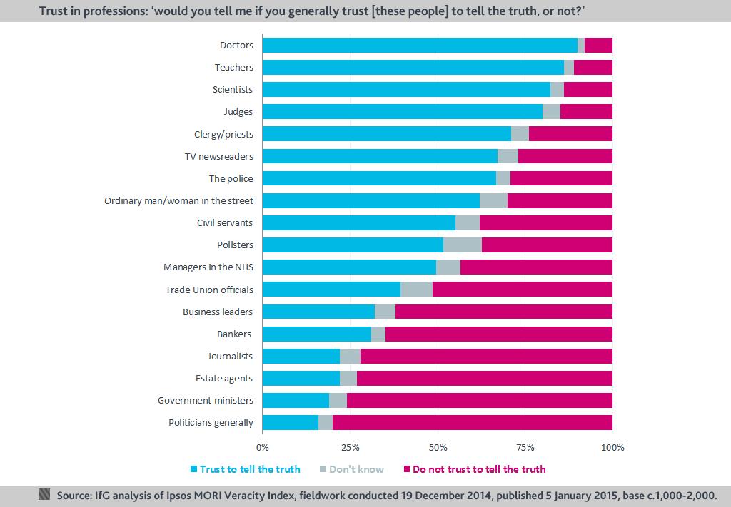
PATERNALISM

Slide 9
DOCTOR PATIENT RELATIONSHIP
The doctor-patient relationship means many things or all, to both the patients and their doctors from the waiting room to: Consultation, diagnosis, treatments and compliance/adherence, improved patient and physician satisfaction, better patient compliance, improved health outcomes, better-informed medical decisions, reduced costs of care and reduced malpractice suits/litigations when it go sour.

Slide 10
Doctor patient relationship
Moral Dilemmas
Ethical issues
Interface between Moral, Ethical and Legal Problems in Modern Medicine

Slide 11
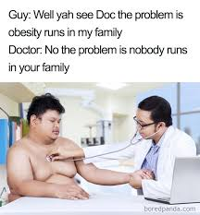
FOCUS ON PERSONAL CONDUCT V PROFESSIONAL DISCLIPINE

Slide 12
DOCTOR-PATIENT RELATIONSHIP
Driving offences
Dishonesty outside clinical practice
Relationship/affairs with patients
Pre-qualification misconduct
Other Character related misconduct

Slide 13
DRIVING OFFENCES: DR CRABBIE
. The case of Crabbie v General Medical Council is one of the leading cases in driving offences and professional discipline by the GMC. Dr Crabbie was convicted of causing death by dangerous driving and excess alcohol. She however requested that her case be referred to the GMC’s health committee, the Privy Council held that it was a right decision to hear her case before the Professional Conduct Committee since that was the only body that could order an erasure and it was convinced that an erasure from the medical register was the only right decision to make.

Slide 14
DRIVING OFFENCES: DR CRABBIE
The defence of the Professional Conduct Committee was that she was already showing features of alcohol dependency and had already brought the profession into disrepute by her actions; it claimed that its decision was justified and proportionate to the offence.

Slide 15
SEXUAL RELATIONSHIPS: NWABUEZE V GMC
In Nwabueze v GMC, the doctor had sexual intercourse at his surgery with an ex-patient and other allegations of sexual misconduct with staff which and formed about six of the grounds of the allegation that led to his erasure. In addition to these allegations, he also faced other allegations of dishonesty, on his allegations, the court held per Lord Hope of Craighead, that the professional relationship that existed between the patient and the doctor had elapsed and allowed the appeal in part.

Slide 16
NWABUEZE V GMC
At the panel, the doctor’s action was said to be a flagrant abuse of trust considering one of the persons involved was a vulnerable patient and another was a member of staff, the Chairman of the Panel therefore considering this abuse of trust as well as dishonesty and announced an erasure which was quashed and returned to the panel based on circumstances surrounding the legal assessor’s advice.

Slide 17
NWABUEZE V GMC
The focal point of this case was the multiple allegations of sexual impropriety brought against this doctor and the discipline meted out to him. It is considerable that if the allegations brought against him were founded justly, his argument that his sexual activity did not have an impact on his clinical competence can be queried. A patient might indeed be unwilling to continue treatment if they have been harassed by their doctor, however it is difficult to draw the dividing line between mutual and consensual sexual activity between mature adults and coercion based on the use of professional position Nwabueze v GMC [2002] 1 W.L.R 1760

Slide 18
Dr Oluwaseyi Farombi
Dr Oluwaseyi, who appeared before the Fitness to Practise Panel in 2011, shows how difficult it is to overlook pre-qualification misconduct, the doctor had been convicted for fraud, had forged a Nigerian passport, forged references and included places and positions he had not worked at on his CV. He also submitted a fake National Insurance Number and also claimed while filling his employment forms that he had never been convicted.
Dr Oluwaseyi Olorundamola Farombi, Sept-Dec 2011, FTPP http://www.gmc-uk.org/static/documents/content/Farombi.pdf

Slide 19
Akpata v GMC [2007] EWHC 2713
In Akpata the doctor claimed in his application that he was a member of the Royal College of Obstetrics and Gynaecology and had also been convicted of ten offences of false accounting and dishonesty.

Slide 20
Rumbold v GMC
Dr Rumbold was involved in child pornography as he had seventy-seven (77) indecent images of children at his home and confessed to having viewed between up to 200 images. The GMC suspended him and further extended his suspension after its initial expiration on the basis of lack of sufficient understanding of the seriousness of the offence Rumbold v GMC [2007] EWHC 2569 (Admin)

