Slide 1
BCH 201: Medical Biochemistry I
Module II
Acids, Bases and Buffers

Slide 2
Many biologically important molecules are acids or bases.
Hydrochloric, sulfuric, and nitric acids, commonly called strong
acids, are completely ionized in dilute aqueous solutions;
the strong bases NaOH and KOH are also completely ionized.
Of more interest to biochemists is the behaviour of weak acids and bases - those not completely ionized when dissolved in water.
These are common in biological systems and play important roles
in metabolism and its regulation.

Slide 3
Bronsted Lowry defined an acid as a proton donor and a base as a
proton acceptor.
Hydrochloric acid (HCl) and sulfuric acid (H₂SO₄) are strong
acids because they dissociate totally:
HCl H⁺ + Cl⁻
H₂SO₄ 2H⁺ + SO₄²⁻
OH⁻ ion is a base because it accepts a proton, shifting the
equilibrium:
OH⁻ + H⁺ H₂O
Lactic acid is a weak acid
A proton donor and its corresponding proton acceptor make up a
conjugate acid-base pair

Slide 4
Acetic acid (CH₃COOH), a proton donor, and the acetate anion
(CH₃COO⁻), the corresponding proton acceptor, constitute a
conjugate acid-base pair, related by the reversible reaction:
CH₃COOH H⁺ + CH₃COO⁻
Each acid has a characteristic tendency to lose its proton in an aqueous solution.
The stronger the acid is, the greater its tendency to lose its proton.
The tendency of any acid (HA) to lose a proton and form its conjugate base (A⁻) is defined by the equilibrium constant (K_{eq}) for the reversible reaction.
Equilibrium constants for ionization reactions are usually called ionization or dissociation constants, often designated Ka

Slide 5
HA A⁻ + H⁺
K_{a} = K_{eq} = [H⁺][A⁻]
[HA]
Ionization of water, weak acids and bases
Pure water ionizes slightly, forming equal numbers of hydrogen ions (hydrozonium ions, H₃O⁺) and hydroxide ions (OH⁻).
H₂O OH⁻ + H⁺
K_{eq} = [H ⁺][OH⁻]
[H₂O]
K_{eq} = 1.8 × 10⁻¹⁶ M
The value for K_{eq}, determined by electrical-conductivity measurements of pure water, is 1.8 × 10⁻¹⁶ M at 25 ⁰C. Substituting this value for Keq gives the value of the ion product of water (Kw):

Slide 6
K_{w} = [H⁺][OH⁻] = (55.5 M)(1.8 × 10 ⁻¹⁶ M) = 1.0 × 10⁻¹⁴ M²
Thus the product [H⁺][OH⁻] in aqueous solutions at 25 ⁰C always equals 1.0 ×10⁻¹⁴ M². When there are exactly equal concentrations of H⁺ and OH⁻, as in pure water, the solution is said to be at neutral pH. From which the ion product of water, Kw, is derived. At 25⁰C,
Kw = [H⁺][OH⁻] = (55.5 M)(K_{eq}) = 10⁻¹⁴ M²
The pH
The pH of an aqueous solution reflects, on a logarithmic scale, the concentration of hydrogen ions:
pH = - log [H⁺] = 1
log [H⁺]

Slide 7
For hydrogen ion concentration of 1.0 ×10⁻⁷ M, the pH can be calculated as follows:
pH = - log [H⁺] = 1 = 1 = log1 + log 10⁻⁷
log [H⁺] 1.0 ×10⁻⁷ M
= 0 + 7 = 7
The expression pOH is sometimes used to describe the basicity, or OH⁻concentration, of a solution;
pOH = -log [OH⁻], which is analogous to the expression for pH
Note that in all cases, pH + pOH = 14.

Slide 8
Table 1. pH of Some Biological Fluids
Fluid pH
Blood plasma 7.4
Interstitial fluid 7.4
Cytosol (liver) 6.9
Lysosomal matrix < 5.0
Gastric juice 1.5–3.0
Pancreatic juice 7.8-8.0
Human milk 7.4
Saliva 6.4-7.0
Urine 5.0-8.0

Slide 9
The greater the acidity of a solution the lower its pH.
Weak acids partially ionize to release a hydrogen ion, thus lowering the pH of the aqueous solution.
Weak bases accept a hydrogen ion, increasing the pH.
The extent of these processes is characteristic of each particular weak acid or base and is expressed as a dissociation constant, Ka:
Keq = [H⁺] [A⁻] = Ka
[HA]

Slide 10
The pKa
The pKa expresses, on a logarithmic scale, the relative strength of a weak acid or base:
pKa = - log [Ka] = 1
log [Ka]
The stronger the acid the lower its pKa;
the stronger the base, the higher its pKa.
The pKa can be determined experimentally; it is the pH at the midpoint of the titration curve for the acid or base

Slide 11
Henderson-Hasselbalch (HH) Equation Defines the Relationship Between pH and Concentrations of Conjugate Acid and Base
Conjugate acid conjugate base + H⁺
K′_{eq} = [H⁺][conjugate base] (1)
[conjugate acid]
Rearranging eqn. 1 by dividing through by both [H⁺] and K′_{eq} leads to:
1 = 1 [conjugate base]
[H⁺] K′_{eq} [conjugate acid]
Taking the logarithm of both sides gives:
Log 1 = log 1 + log [conjugate base] (2)
[H⁺] K′_{eq} [conjugate acid]

Slide 12
Since pH = log 1/[H⁺] and pK’ = log 1/K’eq, eqn 2 becomes:
pH = pK′ + log [conjugate base] (3)
[conjugate acid]
Equation 3, developed by Henderson and Hasselbalch, is a convenient way of viewing the relationship between pH of a solution and relative amounts of conjugate base and acid present.
Analysis of Eq. 3 demonstrates that when the ratio of (base)/(acid) is 1: 1, pH equals the pK’ of the acid because
log 1 = 0

Slide 13
Worked Examples
Calculate the ratio of HPO₄²⁻/H₂PO₄⁻ (pK = 6.7) at pH 5.7, 6.7, and 8.7.
Solution: pH = pK + log [HPO₄²⁻]
[H₂PO₄⁻]
5.7 = 6.7 + log of ratio; rearranging
5.7 – 6.7 = -1 = log of ratio
The antilog of -1 = 0.1 or 1/10.
Thus HPO₄²⁻/H₂PO₄⁻ = 1/10 at pH 5.7.
Using the same procedure,
the ratio at pH 6.7 = 1/1 and at pH 8.7 = 100/1.

Slide 14
If the pH of blood is 7.1 and the HCO₃⁻ concentration is 8 mM, what is
the concentration of CO₂ in blood (pK’ for HCO₃⁻/CO₂ = 6.1)?
Solution: pH = pK + log HCO₃⁻
CO₂
7.1 = 6.1 + log 8mM/(CO₂); rearranging
7.1 – 6.1 = 1 = log 8 mM/ (CO₂).
The antilog of 1 = 10.
Thus, 10 = 8mM/(CO₂), or (CO₂) = 8 mM/10 = 0.8 mM.

Slide 15
3. At a normal blood pH of 7.4, the sum of [HCO₃⁻] + (CO₂) = 25.2 mM. What is the concentration of HCO₃⁻ and CO₂ (pK’ for HCO₃⁻/CO₂ = 6.1)?
Solution: pH = pK + log HCO₃⁻
CO₂
7.4 = 6.1 + log (HCO₃⁻)/(CO₂); rearranging
7.4 – 6.1 = 1.3 = log (HCO₃⁻)/(CO₂).
The antilog of 1.3 is 20.
Thus (HCO₃⁻)/(CO₂) = 20. Given (HCO₃⁻) + (CO₂) = 25.2,
solve these two equations for (CO2) by rearranging the first equation;
(HCO₃⁻) = 20 (CO₂):
Substituting in the second equation,
20 (CO₂) + (CO₂) = 25.2
or CO₂ = 1.2 mM
Then substituting for CO₂,
1.2 + (HCO₃⁻) = 25.2, and solving,
(HCO₃⁻) = 24 mM.

Slide 16
Buffering is Important to Control pH
Buffering capacity is defined as the ability of a solution to resist a change in pH when an acid or base is added.
If weak acid were not present, the pH would be very high with only a small amount of OH⁻ because there would be no source of H⁺ to neutralize the OH⁻.
The best buffering range for a conjugate pair is in the pH range near the pK’ of the weak acid.
Starting from a pH one unit below to a pH one unit above pK′.
The maximum buffering range for a conjugate pair is considered to be between 1 pH unit above and below the pK′.

Slide 17
Lactic acid with pK′ = 3.86 is an effective buffer in the range of pH 3 to 5 but has no buffering capacity at pH = 7.0.
The HPO₄²⁻/H₂PO₄⁻ pair with pK′ = 6.7, however, is an effective buffer at pH = 7.0. Thus at the pH of the cell’s cytosol (7.0), the lactate-lactic acid pair is not an effective buffer but the phosphate system is.
Buffering capacity also depends on the concentrations of conjugate acid and base.
The higher the concentration of conjugate base, the more added H⁺ with which it can react.
The more conjugate acid the more added OH⁻ can be neutralized by the dissociation of the acid.

Slide 18
A case in point is blood plasma at pH 7.4 for HPO₄²⁻/H₂PO₄⁻ , the pK′ of 6.7 would suggest that this conjugate pair would be an effective buffer; the concentration of the phosphate pair, however, is low compared to that of the HCO₃⁻/CO₂ system with a pK’ of 6.1, which is present at a 20-fold higher concentration and accounts for most of the buffering capacity.
In considering the buffering capacity, both the pK′ and the concentrations of the conjugate pair must be taken into account.
Most organic acids are relatively unimportant as buffers in cellular fluids because their pK′ values are more than several pH units lower than the pH of the cell, and their concentrations are too low in comparison to such buffers as HPO₄²⁻/H₂PO₄⁻ and the HCO₃⁻/CO₂ system

Slide 19
Blood, Lungs, and Buffer: The Bicarbonate Buffer System
In animals with lungs, the bicarbonate buffer system is an effective physiological buffer near pH 7.4, because the H₂CO₃ of blood plasma is in equilibrium with a large reserve capacity of CO₂ (g) in the air space of the lungs.
This buffer system involves three reversible equilibria between gaseous CO₂ in the lungs and bicarbonate (HCO₃⁻) in the blood plasma.
When H⁺ (from lactic acid produced in muscle tissue during vigorous exercise, for example) is added to blood as it passes through the tissues, reaction 1 proceeds toward a new equilibrium, in which the concentration of H₂CO₃ is increased.

Slide 20
This increases the concentration of CO₂ (d) in the blood plasma (reaction 2) and thus increases the pressure of CO₂ (g) exhaled.
Conversely, when the pH of blood plasma is raised (by NH₃ production during protein catabolism, for example), the opposite events occur: H⁺ concentration of blood plasma is lowered, causing more H₂CO₃ to dissociate into H⁺ and HCO₃⁻.
This in turn causes more CO₂ (g) from the lungs to dissolve in the blood plasma.
The rate of breathing – that is, the rate of inhaling and exhaling CO₂ – can quickly adjust this equilibrium to keep the blood pH nearly constant.

Slide 21
H⁺ + HCO₃⁻
Reaction 1
Aqueous phase
(blood in capillaries)
H₂CO₃
H₂O
Reaction 2
H₂O
CO₂ (d)
Reaction 3
Gas phase
(lung air space)
CO₂ (g)
Fig. 2. The bicarbonate buffer system

Slide 22
The CO₂ in the air space of the lung is in equilibrium with the biocarbonate buffer in the blood plasma passing through the lung capillaries.
Because the concentration of dissolved CO₂ can be adjusted rapidly through changes in the rate of breathing, the biocarbonate buffer system of the blood is in near-equilibrium with a large potential reservoir of CO₂

Slide 23
Titration
Titration is an analytical method to determine the amount of acid in solution by adding bases;
There are two equilibria occurring in solution when an acid is added to water:
(1)
fast dissociation (large Ka)
(2)
fast association (small Ka)
When a base, typically NaOH, is slowly added to the solution, the hydroxyl ion will neutralize any hydronium ion present by equilibrium (2). More acid will be dissociated and the acid will eventually dissociate completely to A⁻ .
The solution pH is related to the amount of hydroxyl ion according to the HH equation (note that when [A⁻] = [HA],
pH = pKa):

Slide 24
This refers to amount remaining after titration.

Slide 25
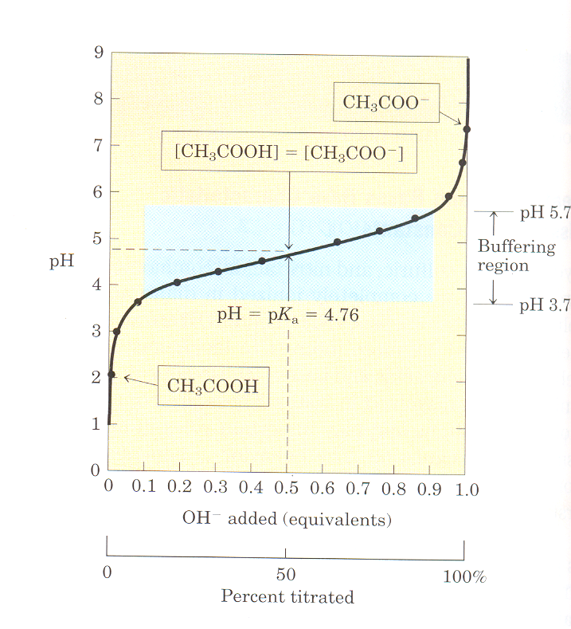
Figure 3.
The titration curve of
acetic acid

Slide 26
Figure 3. The titration curve of acetic acid.
After addition of each increment of NaOH to the acetic acid solution, the pH of the mixture is measured.
This value is plotted against the amount of NaOH required to convert all the acetic acid to its deprotonated form, acetate.
The points so obtained yield the titration curve.
Shown in the boxes are the predominant ionic forms at the points designated. At the mid-point of the titration, the concentrations of the proton donor and proton acceptor are equal, and the pH is numerically equal to the pK_{a}.
The shaded zone is the useful region of buffering power, generally between 10% and 90% titration of the weak acid

Slide 27
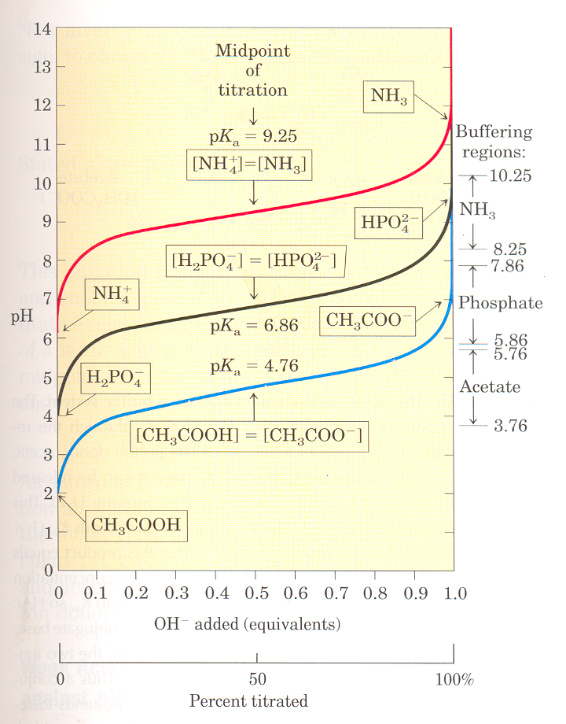
Figure 4.
Comparison of the titration
curves of three weak acids

Slide 28
Figure 4. Comparison of the titration curves of three weak acids
Shown in Figure 4 are the titration curves for CH₃COOH, H₂PO₄⁻, and NH₄^{+.}
The predominant ionic forms at designated points in the titration are given in boxes.
The regions of buffering capacity are indicated at the right.
Conjugate acid-base pairs are effective buffers between approximately 10% and 90% neutralization of the proton-donor species

Slide 29
Steps for Drawing a Titration Curve
Examine the molecule first. Find out the number of dissociable protons;
Obtain the pKa value(s) for all dissociable group(s);
Start the graph by labelling the vertical axis “pH” and the horizontal axis “equivalent OH”;
Find the values of pKa on the vertical axis and mark them;
Find the value of 0, 0.5, and 1 on the horizontal axis and mark them; (You may need to mark 1.5, 2.0 etc. as well, depending on the number of dissociable groups)
Draw two intercepting lines, one through the first pKa value, the other through the 1.5 equivalent OH⁻ position (repeat for all pKas)

