Slide 1
OBISESAN A.O. PHARMACOLOGY AND THERAPEUTICS DEPARTMENT
Introduction To Molecular Biology
PHA 208

Slide 2
Contents
The Genome
The Cell
Eukaryotic Cell
Prokaryotic Cell
Three Domain of Life
The General Structure of Nucleic Acid
DNA
RNA
The Central Dogma of Molecular Biology
DNA Replication
From DNA to Protein
Genetic Mutation
Human genome project
Functional Genomics/Transcriptomics /Proteomics

Slide 3
Target Audience
Physician assistant;
Postgraduate in clinical specialties;
Medical students;
Medical technologist;
Beginners and
For every laboratory worker and everyone passion for learning.

Slide 4
Molecular Biology
Molecular biology; the branch of biology that study gene structure and function at the molecular level.
The Molecular biology field overlaps with other areas, particularly genetics and biochemistry.
The Molecular biology allows the laboratory to be predictive in nature; events that occur in the future.

Slide 5
The Genome Database
The genome database is organized in six major organism groups:
Eukaryotes,
Bacteria,
Archaea,
Viruses,
Viroids and
Plasmids.

Slide 6
Three Domain of Life
Eukaryotic
Prokaryotic
Archaea

Slide 7
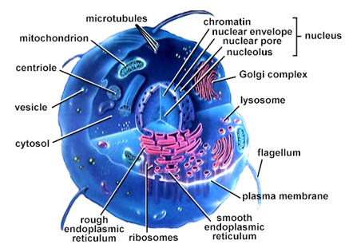
Eukaryotic Cell
Eukaryotes are generally more advanced than prokaryotes

Slide 8
Eukaryotic Cell
Eukaryotic cells are found in animals, plants, fungi and protists cell;
Cell with a true nucleus, where the genetic material is surrounded by a membrane;
Eukaryotic genome is more complex than that of prokaryotes and distributed among multiple chromosomes;
Eukaryotic DNA is linear;
Eukaryotic DNA is complexed with proteins called histones;
Numerous membrane-bound organelles;
Complex internal structure;
Cell division by mitosis.

Slide 9
Prokaryotic Cell
Mariana Ruiz Villarreal, LadyofHats. Source: Wikipedia

Slide 10
Prokaryotic Cell
Unicellular organisms, found in all environments. These include bacteria and archaea;
Without a nucleus; no nuclear membrane (genetic material dispersed throughout cytoplasm;
No membrane-bound organelles;
Cell contains only one circular DNA molecule contained in the cytoplasm;
DNA is naked (no histone);
Simple internal structure; and
Cell division by simple binary fission.
Dr./Salwa Hassan Teama 2012

Slide 11
Archaea
Archaea is prokaryotes; organisms without nucleus but some aspects of their molecular biology are more similar to those of eukaryotes.
Saperaud. Source: Wikipedia

Slide 12
The Genome
Totality of genetic information of an organism.
Encoded in the DNA (for some viruses, RNA).

Slide 13
The Genome Size

Slide 14
Species/ Number of Chromosomes
Species | Number of chromosomes
Human | 46
Mouse | 40
Rat | 42
Fruit flies | 8
Bacteria | 1

Slide 15
Human Genome
Human Genome; Arranged on multiple chromosomes; twenty three pairs of chromosomes;
Twenty two pairs (autosomes).
One pair (sex chromosome) (xx) (female) or (xy) (male).
Humans have 23 pairs of chromosome in every cell (except mature red blood cells..); Gametes or sex cells (sperm and eggs) have half the normal complement of chromosomes.

Slide 16
Human Genome
Jane Ades. Source: National Human Genome Research Institute

Slide 17
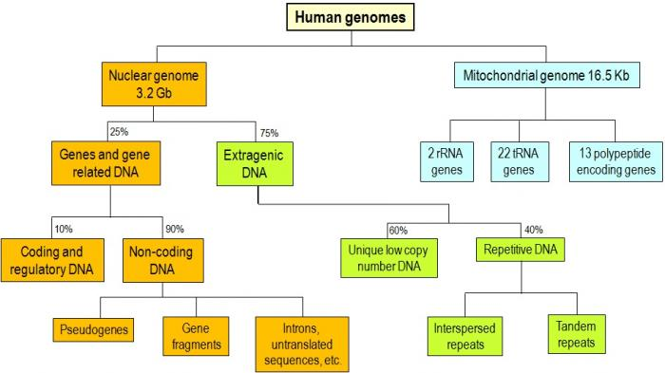
Modified from Strachan and Read . Source: http://geneticssuite.net/node/33

Slide 18
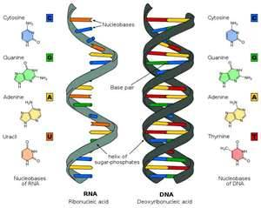
General Structure of Nucleic Acid
DNA and RNA are long chain polymers of small chemical compound called nucleotides.

Slide 19
Nucleotides
Nucleotides; ring shaped structures composed of:
Nitrogenous base; these bases are classified based on their chemical structures into two groups:
Purine; double ringed structure (Adenine and Guanine).
Pyrimidine; single ring structures (cytosine and thymine).
Sugar
Phosphate group

Slide 20
Nucleotides
DNA: Four different types of nucleotides differ in nitrogenous base:
A is for adenine;
G is for guanine;
C is for cytosine and
T is for thymine.
RNA: thymine base replaced by uracil base.

Slide 21
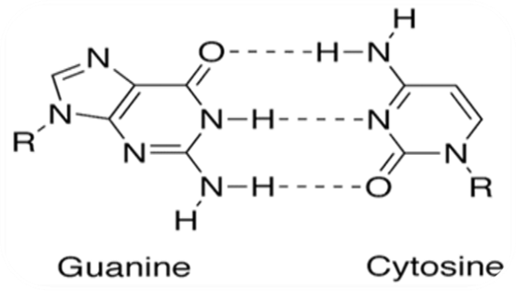
Nucleotides
Jypx35. Source: Wikipedia

Slide 22
The DNA
Deoxyribonucleic Acid (DNA); the genetic material of all cellular organisms and most viruses.
DNA; the gigantic molecule which is used to encode genetic information for all life on Earth.
A human cell contains about 2 meters of DNA. DNA in the body could stretch to the sun and back almost 100 times. So it is tightly packed.
DNA responsible for preserving, copying and transmitting information within cells and from generation to generation.

Slide 23
DNA Double Helix
Linked as a twisted ladder.
The curving sides of the ladder represent the sugar-phosphate backbone of the two DNA strands; the rungs are the base pairs.
Possess antiparallel polarity.
Stabilized by hydrogen bonds between the bases.

Slide 24
DNA Double Helix
Madprime. Source: Wikipedia

Slide 25
The Gene
The gene; it is a segment within a very long strand of DNA.
Genes are the basic units of hereditary.
Genes located on chromosome on its place or locus.
Allele; a variant of the DNA sequence at a given locus. Each allele inherited from a different parent.

Slide 26
The Gene
Source: National Human Genome Research Institute.

Slide 27
Dominant and Recessive
Dominant
The one pair of allele that masks the effect of the other when present in the same cell.
Recessive
The one pair of allele that is masked by the other when present in the same cell and capable of producing its characteristics phenotype in the organism only when two alleles is present and identical.

Slide 28
Dominant and Recessive

Slide 29
Gene Structure
Most of the genes consist of; short coding sequences or exons are interrupted by a longer intervening noncoding sequence or introns; although a few genes in the human genome have no introns.

Slide 30
DNA Organization
DNA molecules complexed with other proteins, especially basic proteins called histones to form a substance known as chromatin.

Slide 31
DNA Organization

Slide 32
The RNA
Three major classes of RNA: messenger (mRNA), transfer (tRNA) and ribosomal (rRNA). Minor classes of RNA include small nuclear RNA; small nucleolar RNA;……….
RNA is a single stranded; the pyrimidine base uracil (U) replaces thymine and ribose sugar replaces deoxyribose.

Slide 33
Messenger RNA/ mRNA
Transcripts of structural genes.
Encode all the information necessary for the synthesis of a polypeptide of protein.
The 5' terminus is capped by 7 methyguanosine triphosphate.
Synthesis of the poly (A) tail involves cleavage of its 3' end and then the addition of about 200 adenine residues.
Intermediate carrier of genetic information; deliver genetic information to the cytoplasm.

Slide 34
mRNA

Slide 35
Transfer RNA/ tRNA
All the tRNAs share a common secondary structure resembles a cloverleaf: They have four base- paired stems defining three stem-loops (the D loop, anticodon loop, and T loop) and the acceptor stem.
tRNA carry correct amino acids to their position along the mRNA template to be added to the growing polypeptide chain.

Slide 36
tRNA

Slide 37
Ribosomal RNA/ rRNA
The central component of the ribosome.
Ribosome; factory for protein synthesis; composed of ribosomal RNA and ribosomal proteins (known as a Ribonucleoproteinor RNP).
rRNA provides a mechanism for decoding mRNA into amino acids.

Slide 38
The Central Dogma of Molecular Biology
DNA molecules serve as templates for either complementary DNA strands during the process of replication or complementary RNA during the process of transcription.
RNA molecules serve as a template for ordering amino acids by ribosomes during protein synthesis.

Slide 39
The Central Dogma of Molecular Biology

Slide 40
DNA Replication
The DNA duplication.
The transfer the genetic information from a parent to a daughter cell.
The DNA base sequences are precisely copied.

Slide 41
Source: National Institute of General Medical Sciences.
DNA Replication

Slide 42
George Rice. Montana State University.
Source: http://serc.carleton.edu/microbelife/research_methods/genomics/replication.html

Slide 43
Post-Replicative Modification of DNA
Methylation; one of the major post- replicative reactions.
Site of methylation of eukaryotic DNA is always on cytosine residues in CG dinucleotide.
DNA methylation plays an important role for epigenetic gene regulation in development and disease.

Slide 44
Gene Expression
Transcription
RNA polymerase makes a copy of information in the gene (complementary RNA) complementary
to one strands of DNA.
Translation
Occurs on ribosomes, messenger RNA decoded or translated to determine the sequence of amino acid in the protein being synthesized.

Slide 45
From DNA to Protein
Ashcraft. Source: http://creationwiki.org/File:Gene_expression.PNG

Slide 46
Ribosomes
Factory for protein synthesis.
Composed of ribosomal RNA and ribosomal proteins (known as a Ribonucleoprotein or RNP).
Translate (mRNA) to build polypeptide chains using amino acids delivered by (tRNA).

Slide 47
The Protein
Proteins are chain like polymers of a few or many thousands of amino acids.
Amino acids: (3-nucleotide RNA sequences) (codon).

Slide 48
Four levels of Protein Structure
Primary protein structure: Sequence of a chain of amino acid.
Secondary protein structure: A chain of amino acids linked by hydrogen bonds.
Tertiary protein structure: It occurs when certain attraction occurs between alpha helices and pleated sheets.
Quaternary protein structure: Protein containing more than one amino acid chains.

Slide 49
Four levels of Protein Structure
LadyofHats. Source:Wikipedia

Slide 50
Genetic Mutation
A mutation is a change in the DNA sequence or arrangement of DNA.
Yassine Mrabet . Source:Wikipedia

Slide 51
Common Tools of Molecular Biology
Nucleic acid fractionation
Polymerase chain reaction
Probes, Hybridization
Vector, Molecular cloning
Nucleic acid enzymes
Microarray
DNA sequencing
Electrophoretic separation of nucleic acid
Detection of genes:
*DNA: Southern blotting
*RNA: Northern blotting
*Protein: Western blotting

Slide 52
Human Genome Project
HGP is an international project aiming for:
Sequencing and localization of the base sequence that makes up human DNA.
Store this information in databases.
Mapping of human genome requires a set of landmarks; some of this landmarkers are genes but many more are nameless stretches of DNA such as RFLPs, VNTRs, STSs.

Slide 53
Human Genome Project
1990, American geneticists started an ambitious quest to map and sequence the entire human genome.
1999, the final draft of human chromosome 22.
2000, the final draft of human chromosome 21.
2001, working draft of the whole human genome.
2004, the finished sequence of the euchromatic part of human genome.

Slide 55
Functional Genomics / Transcriptomics/ Proteomics
Functional Genomics
The study of expression of large number of genes.
Transcriptomics
The study of transcriptomes (all the transcripts an organism makes at any given time).
Proteomics
The study of proteomes (the set of expressed proteins in a given type of cells or an organism at a given time under defined conditions).

Slide 56
Source: European Bioinformatics Institute. http://www.ebi.ac.uk/microarray/biology_intro.html

Slide 57
Application of Molecular Biology
Research
Diagnosis
Transplantation
Paternity
Forensic analysis
Gene therapy
Drug Design
……

Slide 58
References and Further Reading
Ali Khalifa. Applied molecular biology; eds: ( Fathi Tash and Sanna Eissa). 109 pages. Egypt. University Book Center. 2002. Available in paper copy from the publisher.
Bruce Alberts, Alexander Johnson, Julian Lewis, Martin Raff, Keith Roberts, and Peter Walter. Molecular Biology of the cell. 1392 pages. Garland Science; 5 edition (November 16, 2007).ISBN. 9780815341055. Available in paper copy from the publisher.
Daniel H. Farkas. DNA Simplified: The Hitchhiker's Guide to DNA. 110 pages. Washington, DC: AACC Press, 1996, ISBN 0-915274-84-1. Available in paper copy from the publisher.
Daniel P. Stites, Abba T. Terr. Basic Human Immunology: 336 Pages. Appleton & Lange (November 1990). ISBN. 0838505430. Available in paper copy from the publisher.
Innis, David H. Gelfand, John J. Sninsky. PCR Applications: Protocols for Functional Genomics: 566 pages. Academic Press; 1 edition (May 17, 1999). ISBN:0123721865. Available in paper copy from the publisher.
Robert F. Mueller, Ian D. Young. Emery's Elements of Medical Genetics: Publisher: Churchill Livingstone. 1995. ISBN. 044307125X. Available in paper copy from the publisher.
Robert F. Weaver. Molecular Biology. 600 Pages. Fourth Edition. McGraw-Hill International Edition. ISBN 978-0-07-110216-2. Available in paper copy from the publisher.
William B. Coleman, Gregory J. Tsongalis. Molecular Diagnostics. For the Clinical Laboratorian: 592 pages. Humana Press; 4th Printing. edition (August 15, 2005). ISBN 1588293564. Available in paper copy from the publisher.

Slide 59
Thank you

