Slide 1







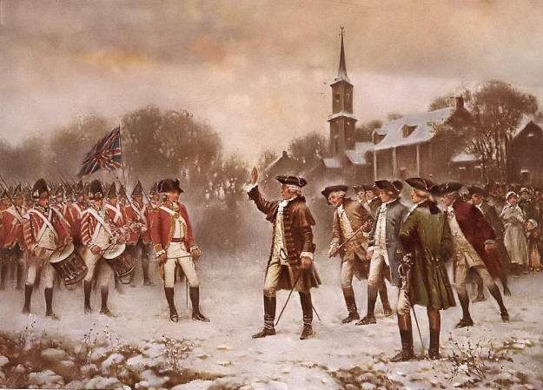




Slide 2


What is a Revolution?

A revolution is the violent removal of the leadership or government of a country.
The last quarter of the eighteenth century is called the Age of Revolutions.
Why do you think it was called this?

Slide 3

Background:

 There were thirteen states on the East Coast of America in the second half of the eighteenth century.
 These states were known in Britain as The Colonies.
Ancestors of people who had emigrated from Britain.
 They were part of the British Empire and were ruled by King George III.

Slide 4

Causes of the American Revolution:

1. The Enlightenment:
During the mid-eighteenth century educated people in Europe came up with new ideas.
Ideas such as the idea that people should rule their own country.

Slide 5


2. The Question of Taxes:
The British sent armies to America to defend the colonists from the attacks of American Indians and French forces in Canada.
The forces helped to defeat the American Indians and drove the
French out of Canada.
Britain believed that the colonists should help to pay for this military support.
The British Parliament passed laws such as the Stamp Act.
Taxes were placed upon American documents such as newspapers and wills.

Slide 6


3. The Boston Massacre 1770:
A group of local people were protesting against taxes in Boston.
They jeered and threw stones at British soldiers.
The soldiers opened fire and killed five people.
Anger spread through the Colonies which forced the British to cancel some of the taxes they had put in place.
What tax remained in place?

Slide 7


4. The Boston Tea Party:
The American colonists wanted to avoid paying tax on tea.
They often smuggled tea into America.
Many colonists made a lot of money through smuggling tea.
In November 1773, English ships arrived at Boston port.
They carried tea that was taxed but it was still cheap
enough to make smuggling unprofitable.
On December 16th a group of colonists arrived at the port
disguised as Indians.
They dumped the tea into the harbour.

Slide 8

What action did the British government take?

 The British closed the port and city of Boston.
 They replaced locally-elected councils with officials in London.

Slide 9


5. The First Continental Congress:
In 1774, delegates from the thirteen Colonies met in Philadelphia for this important meeting.
The Congress called for an end to British taxation and for the return of elected councils.
It asked each Colony to raise an army to fight against the British.

Slide 10

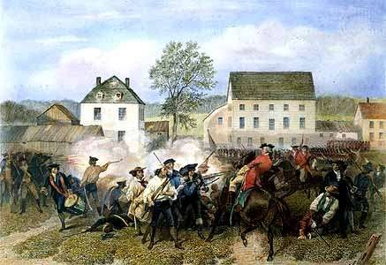
The Battles of Lexington and Concord 1775:


Slide 11


 The British Parliament and Crown could see that the Americans colonists were moving into a state of rebellion.
 King George III believed that the colonists were hiding a large amount of weapons in the town of Concord near Boston.
 He sent his British troops to the town in April 1775 to
destroy the ammunition.

Slide 12


 The colonists were told of the British troops arrival by a number of spies such as Paul Revere.
 A large group of colonists gathered in the town of Lexington as the British soldiers approached.
 A violent battle emerged between the two sides leaving many casualties for both sides in the town of Lexington.

Slide 13


 The British troops reached Concord and destroyed what weapons and ammunition they could find.
 The fighting continued upon the North Bridge which forced the British troops to retreat back to Boston.
 By this time, almost thousands of American colonists had emerged to engage in the conflict.
 This marked the beginning to the War of
Independence!

Slide 14

Questions to consider:

Who started the American War of Independence in April 1775?
Was it the American colonists or the British troops sent by King George III?

Slide 15


http://www.mrnussbaum.com/history/battles%20_of_lexington_and_concord.htm

Slide 16



Slide 17

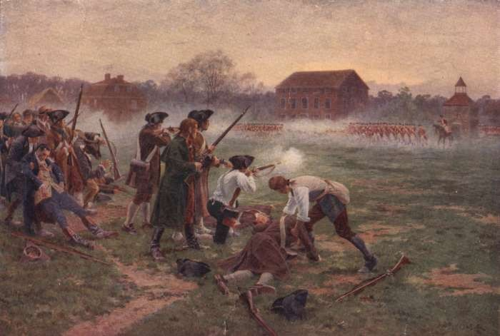


Slide 18

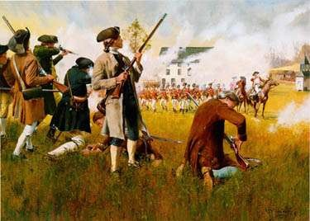


Slide 19

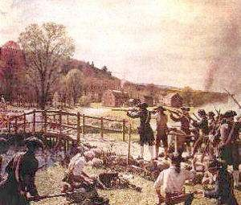


Slide 20

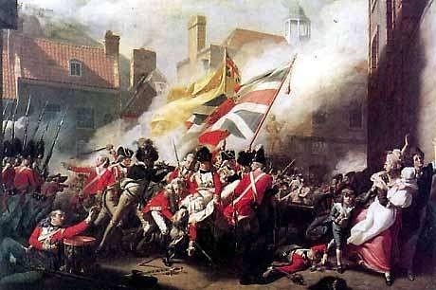
The American War of Independence: 1775-81


Slide 21

Timeline:

The war began in April 1775 when the Americans colonists clashed with British troops at Lexington and Concord near Boston.
At Bunker Hill near Boston the British defeated the Americans but suffered heavy casualties.
The Second Continental Congress meets in May 1775 and appoints George Washington as Commander in Chief of the American army.

Slide 22


The Continental Congress meet for the third time on the 4th July 1776 to create the American Declaration of Independence.
The British claim victories in New York and Philadelphia but the Americans defeat them at the battle of Saratoga in 1777.
The American army spent the winter of 1777-78 in training at Valley Forge. They lived in terrible conditions which meant many died or ran away.

Slide 23


After the American victory at Saratoga, France
decides to enter the war and join the colonists‟ side. French intervention was a major reason for an American victory.
With the help of the French troops the Americans surrounded the British army at Yorktown in October 1781.
The British army were forced to surrender.

Slide 24

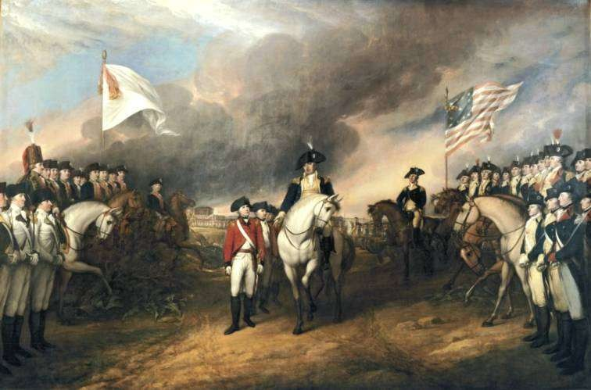
The Americans had won their
War of Independence!


Slide 25

The American Declaration of Independence – 4th July 1776:

It declared that the “United States of
America” was “free and independent” of Britain.
It declared equality for all the men of America.
It declared that an elected president would rule a free United States of America.

Slide 26

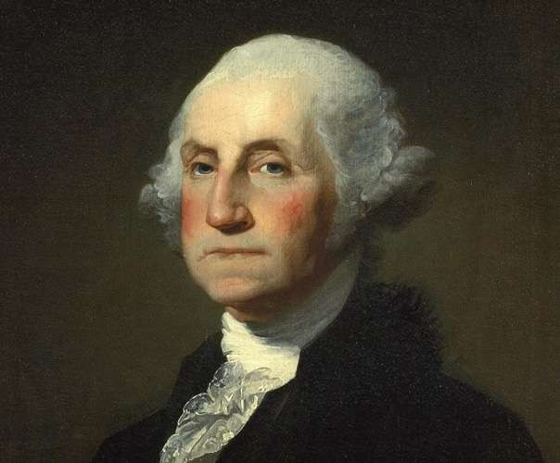
George Washington 1732-1799

Slide 27

 At the age of twenty he inherited his father‟s large estate.
 George Washington was born in Virginia in 1732.
 He joined the British Army in Virginia.
 He served as an officer in wars against the American Indians and the French.
 After leaving the army in his mid-twenties he married a
rich widow named Martha Dandridge.

Slide 28


 He became a Virginian Deputy to the First Continental Congress in 1774.
 He was appointed Commander-in-chief of the American army by the Second Continental Congress in 1776.
 America won the War of Independence in October 1781.

Slide 29


 Washington was appointed the first president of the newly independent United States of America.
 He served as president for eight years.
 He retired to Mount Vernon, Washington D.C.
 He died in 1799.

Slide 30


http://www.mrnussbaum.com/presidents/georgewas hington.htm

Slide 31


The United States of America


Slide 32


 The American colonists decided they should form a single state, the United States of America.
 The individual states wanted independence too.
 The Constitution of the United States of America was drawn up in a Congress meeting in Philadelphia.

Slide 33

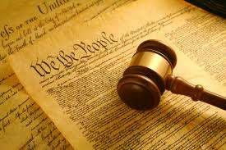
The Constitution of the United
States of America


Slide 34


 The central (Federal) government = defence, foreign affairs, international treaties and the economy.
 Each state could regulate its own local affairs such as public health, education, welfare and law and order.
 The USA became one of the most democratic countries in the world.

Slide 35

The Bill of Rights

 The Constitution also contains a Bill of Rights and Amendments that lay down basic rights that cannot be taken away from a citizen.
 Examples: The right to free speech, to practise religion, to a fair trial and not to suffer „cruel and unusual punishments‟.
 However, this did not apply originally apply to slaves or women.

Slide 36


The Importance of the AmericanRevolution

Slide 37


 The American Revolution created the most powerful country in the world.
 The success of the Revolution showed that ordinary people could take control of their own country.
 The American Revolution influenced other countries:
 The French Revolution 1789
 Revolution in Ireland 1798
 South America during the 1800s

Slide 38


 In America, the power belonged to the people:
 NO ROYAL FAMILY!
 NO ARISTOCRATS!
 During the 19th Century, the USA expanded towards the Pacific Ocean.
 It bought territory from French, Spanish, Mexicans, British and Russians.
 It conquered territory from the Mexicans and the Native Americans.

Slide 39

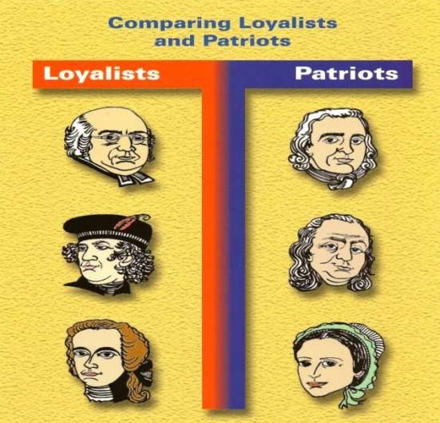
Loyalists VS Patriots


Slide 40

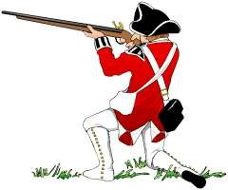
Loyalists


Slide 41

 During the time of the American Revolution, many residents of the colonies were unsure whether the idea of separating from England was a wise one.

 The loyalists were strictly opposed to a separation from Britain
.
 They had a strong belief in their shared cultural heritage with the British.
 They also felt a strong sense of duty and loyalty toward the British crown.
 Loyalists benefitted from the Trans-Atlantic trade with England, and were worried that an independent nation would be reduced to anarchy.

Slide 42

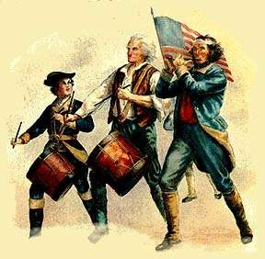
Patriots


Slide 43

 The Patriots had valid reasons for wanting to part with England.
 They believed their individual liberties had been violated by the
British Crown.

 They felt their rights were being taken away because of various taxes and acts.
 Examples of these acts include the Quartering Act and the Boston
Harbour Bill.
 The colonists lacked representation in Parliament.
 Patriots believed the English Crown was attempting to gain more and more control over their lives and businesses.

